Slide 1
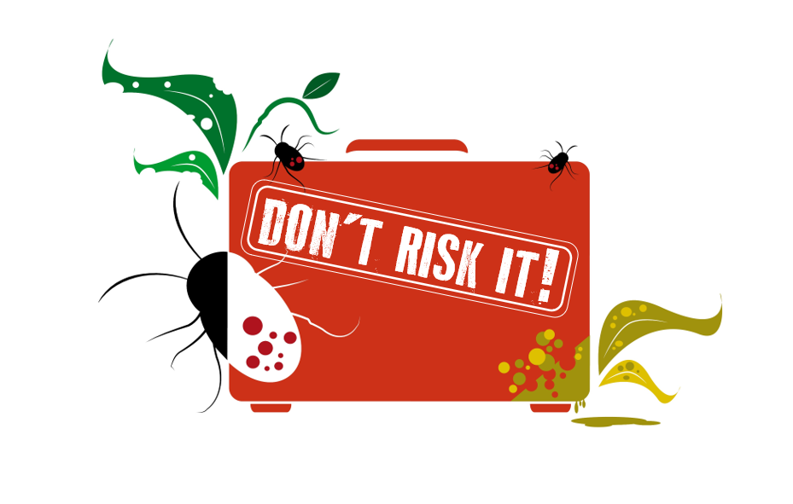
Pests and diseases can hide on plants.
Please do not bring home plants, seeds, fruits, vegetables, or flowers.

Slide 2
Pests and diseases can hide on plants.
Please do not bring home plants, seeds, fruits, vegetables, or flowers.

Slide 3
Pests and diseases can hide on plants.
Please do not bring home plants, seeds, fruits, vegetables, or flowers.

