Slide 1

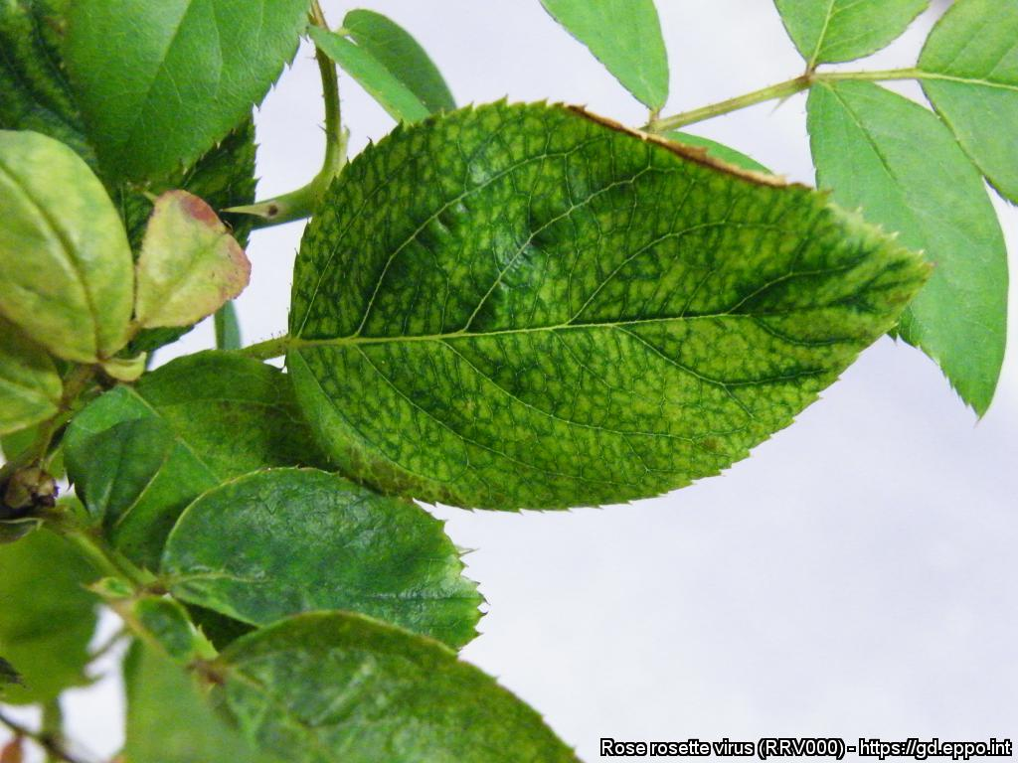
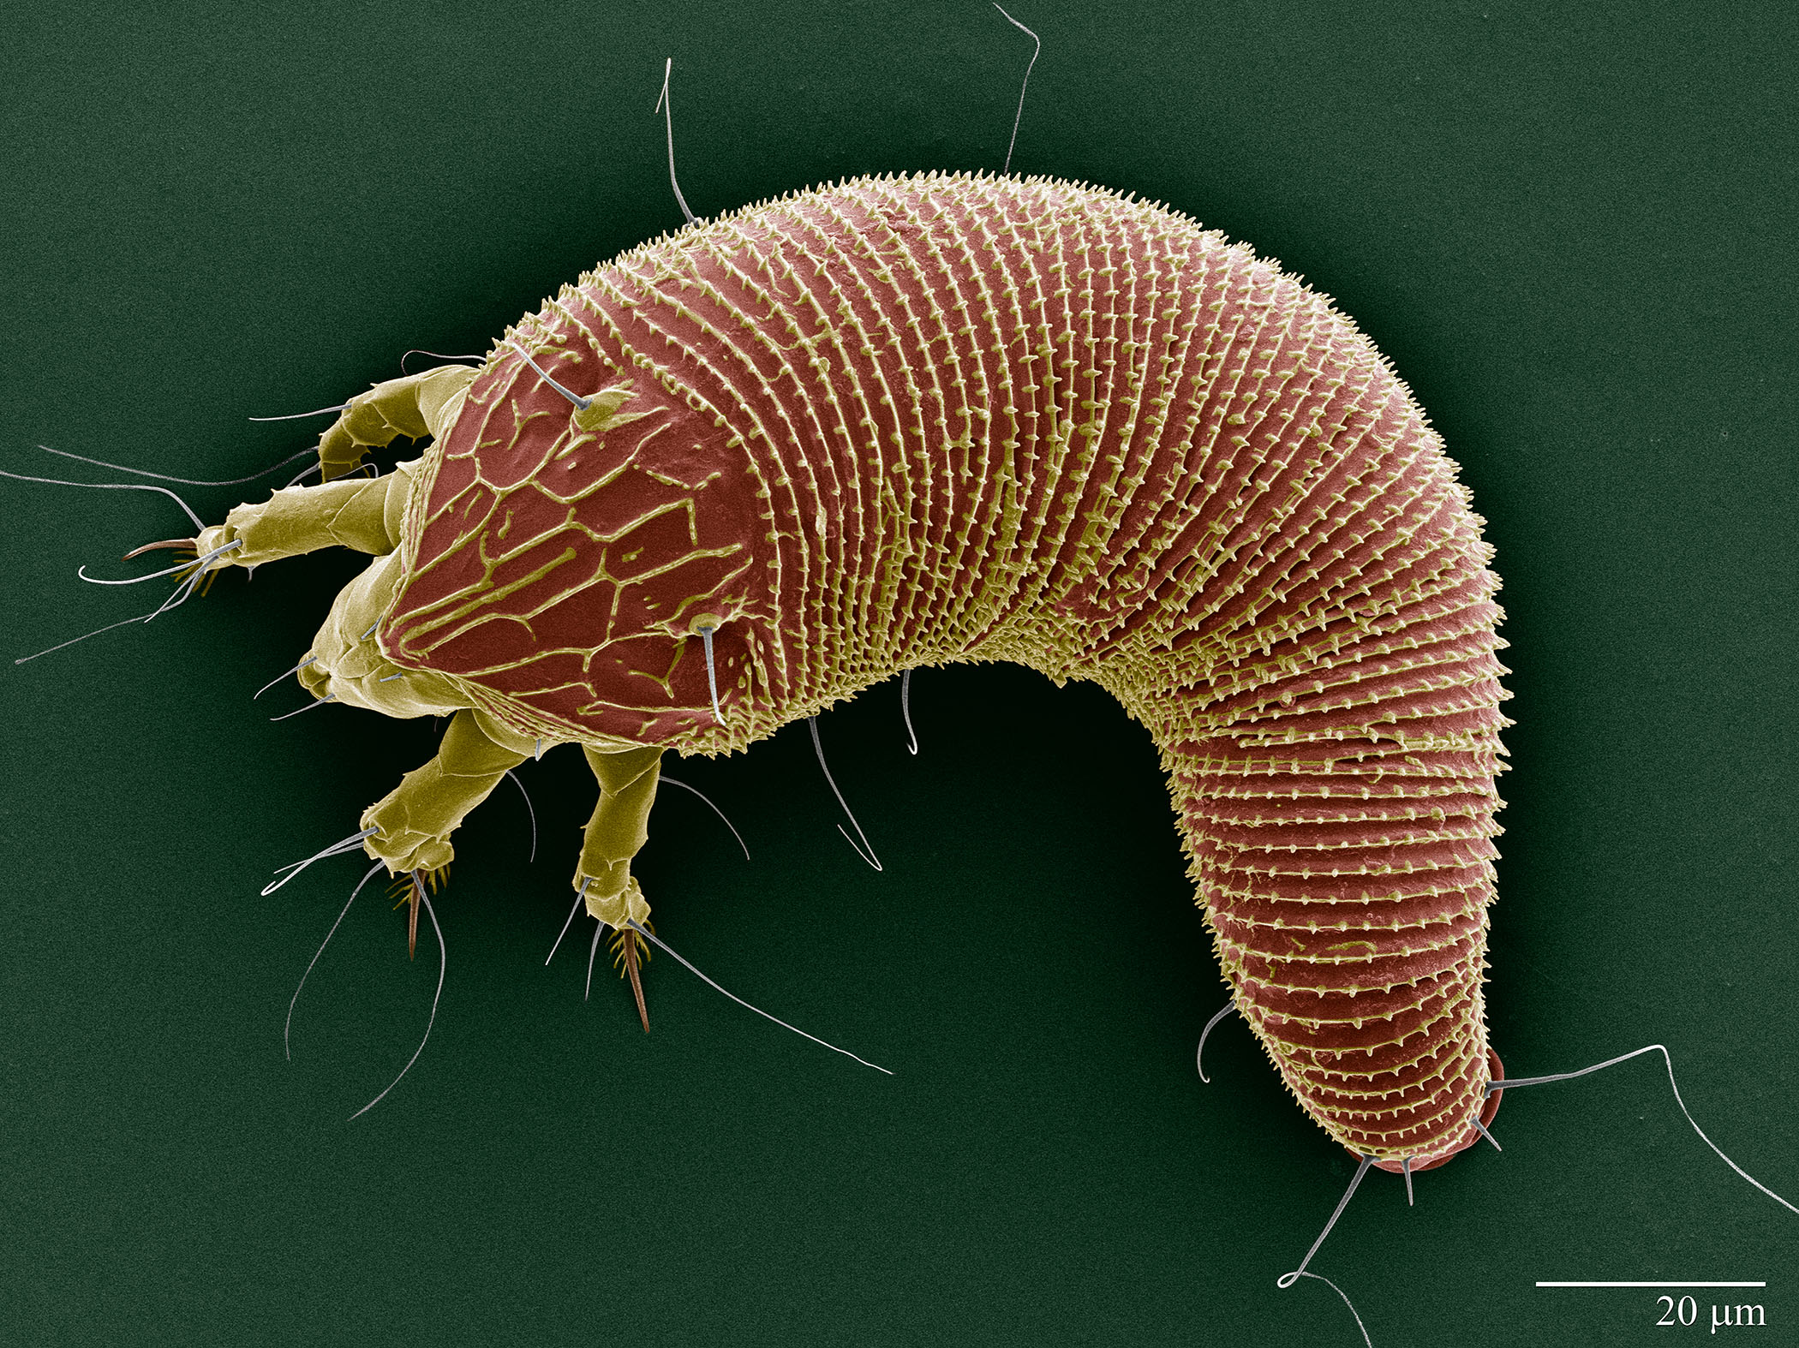

^{CAN YOU HELP US?}
^{Rose rosette virus}
^{A threat to roses}
Image: Patrick Di Bello, Oregon State University (US). EPPO Global database, https:\\gd.eppo.int
What is it?
Rose rosette disease is caused by a virus (Rose rosette virus) transmitted by a tiny eriophyoid mite (Phyllocoptes fructiphilus). It originates in the USA where it has high economic and social impact. All species and cultivars of Rosa are susceptible to the virus and its vector, both in commercial production and in the wild. Infected plants lose their aesthetic value and gradually display a general decline leading to plant death,
How to recognize it?
Symptoms of rose rosette include unusual reddening and distortion of leaves, rapid shoot elongation, red shoots, witches’ broom, excessive thorn production, dieback, reduced flowering and flower malformation
The mite vector (0.1 mm long) cannot be seen with the naked eye.
Image: Patrick Di Bello, Oregon State University (US). EPPO Global database, https:\\gd.eppo.int
Contact us!
Your contact details, logos, links, QR codes …
Learn more about Rose rosette: https://gd.eppo.int
This poster has been prepared in collaboration with EPPO (www.eppo.int)

