Slide 1
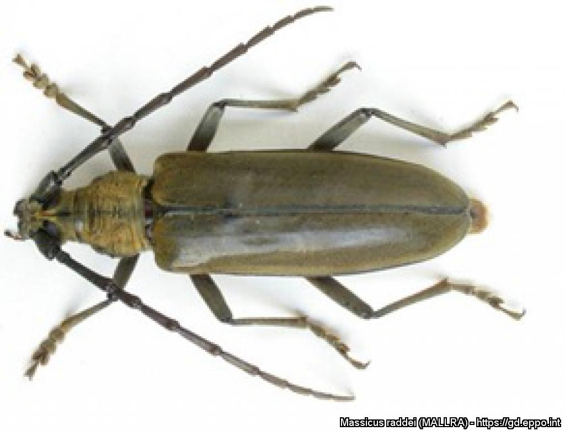
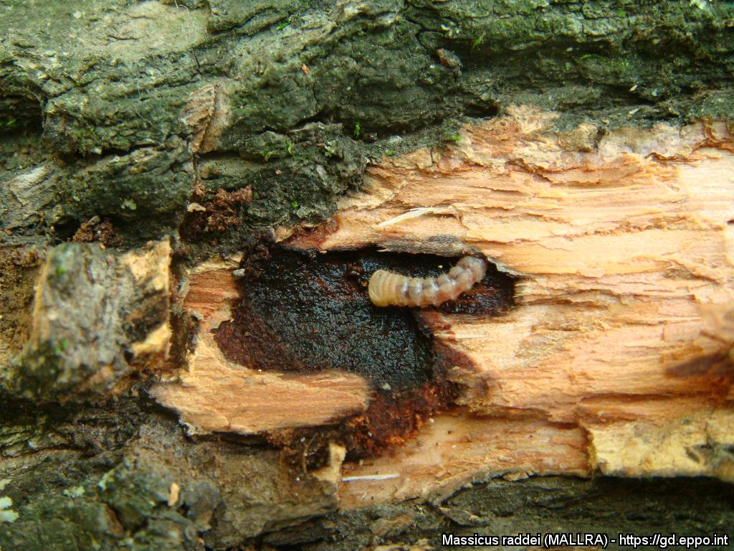
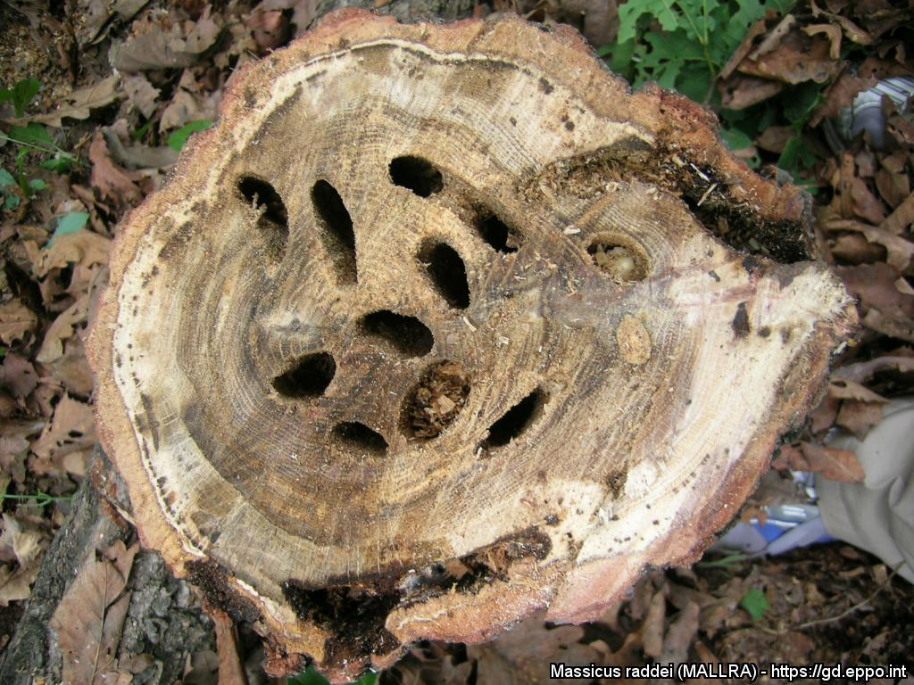


^{BE AWARE!}
^{Massicus raddei}
A threat to oak and chestnut trees
All images: Wang Xioa-Yi, Chinese Academy of Forestry. EPPO Global database, https:\\gd.eppo.int
What is it?
Massicus raddei is a longhorn beetle (Coleoptera: Cerambycidae). It is a major pest of oaks (Quercus spp.) in Northeast China, and is also recorded on other hosts such as chestnuts (Castanea spp.) in East Asia. It is not yet present in the EPPO region. It could enter in Europe as larvae with ornamental trees, wood and wood packaging material from East Asia.
It poses a serious threat to horticulture, forestry and native trees in the EPPO region.
Damage
Larvae feed undetected on the inside of trees, affecting tree growth and wood quality
There may be numerous
larvae in one tree.
Adults emerge after 3 years. They are large (35-63 mm long)
Contact us!
Your contact details, logos, links, QR codes …
Learn more about oak longhorn beetle : https://gd.eppo.int
This poster has been prepared in collaboration with EPPO (www.eppo.int)

