Slide 1

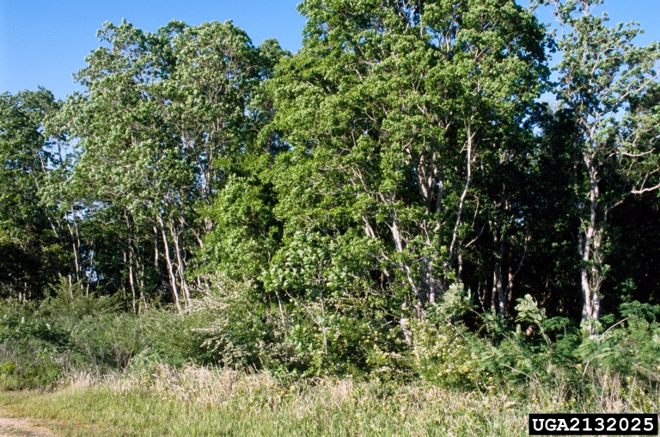
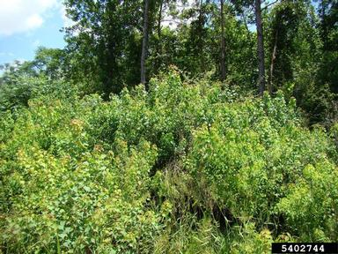
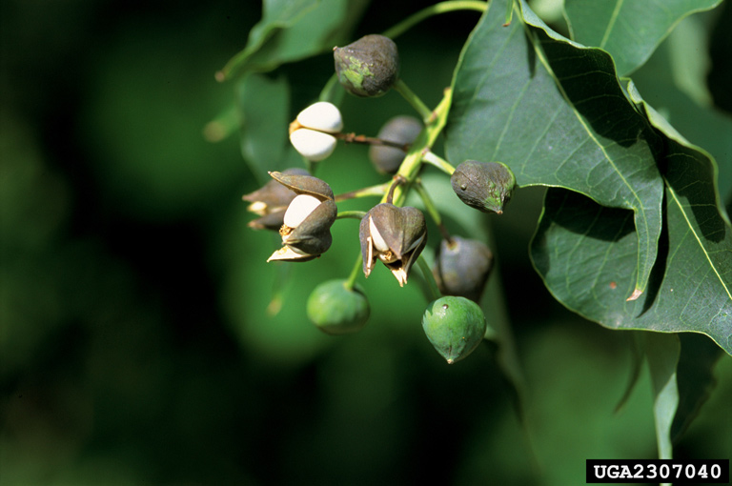



^{BE AWARE!}
^{Triadica sebifera}
^{A threat to the EPPO region}
Image: James H. Miller, USDA Forest Service, Bugwood.org
What is it?
Triadica sebifera is a deciduous medium sized tree species which is native to Asia. The species is a major invasive species in the Southern States in the US, and presently, the species is absent from the natural environment in the EPPO region. In North America, T. sebifera has a wide environmental tolerance and can thrive in many different habitats including forests, wetlands, grasslands, coastal prairie, mesic sites, disturbed sites, low-lying fields, swamp, and scrubby flatlands.
T. sebifera has a long history of deliberate planting within the EPPO region. Seeds can be bought on the internet and shipped nearly anywhere in the EPPO region. In the USA, T. sebifera displaces native plant species and establishes dominant stands and can transform areas of prairie and grassland to woody thickets within ten years. T. sebifera can decrease water quality. The species can also displace native species reducing genetic resources. When leaf material becomes incorporated into the water body, this has shown to be toxic to amphibians.
What's the problem?
Infestation of T. sebifera
in N. America
Seeds of T. sebifera
Image: Rebekah D. Wallace, University of Georgia, Bugwood.org
Image: James H. Miller, USDA Forest Service, Bugwood.org
Contact us!
Your contact details, logos, links, QR codes …
Learn more about Triadica sebifera: https://gd.eppo.int
This poster has been prepared within the LIFE funded project LIFE15 PRE FR 001

