Slide 1

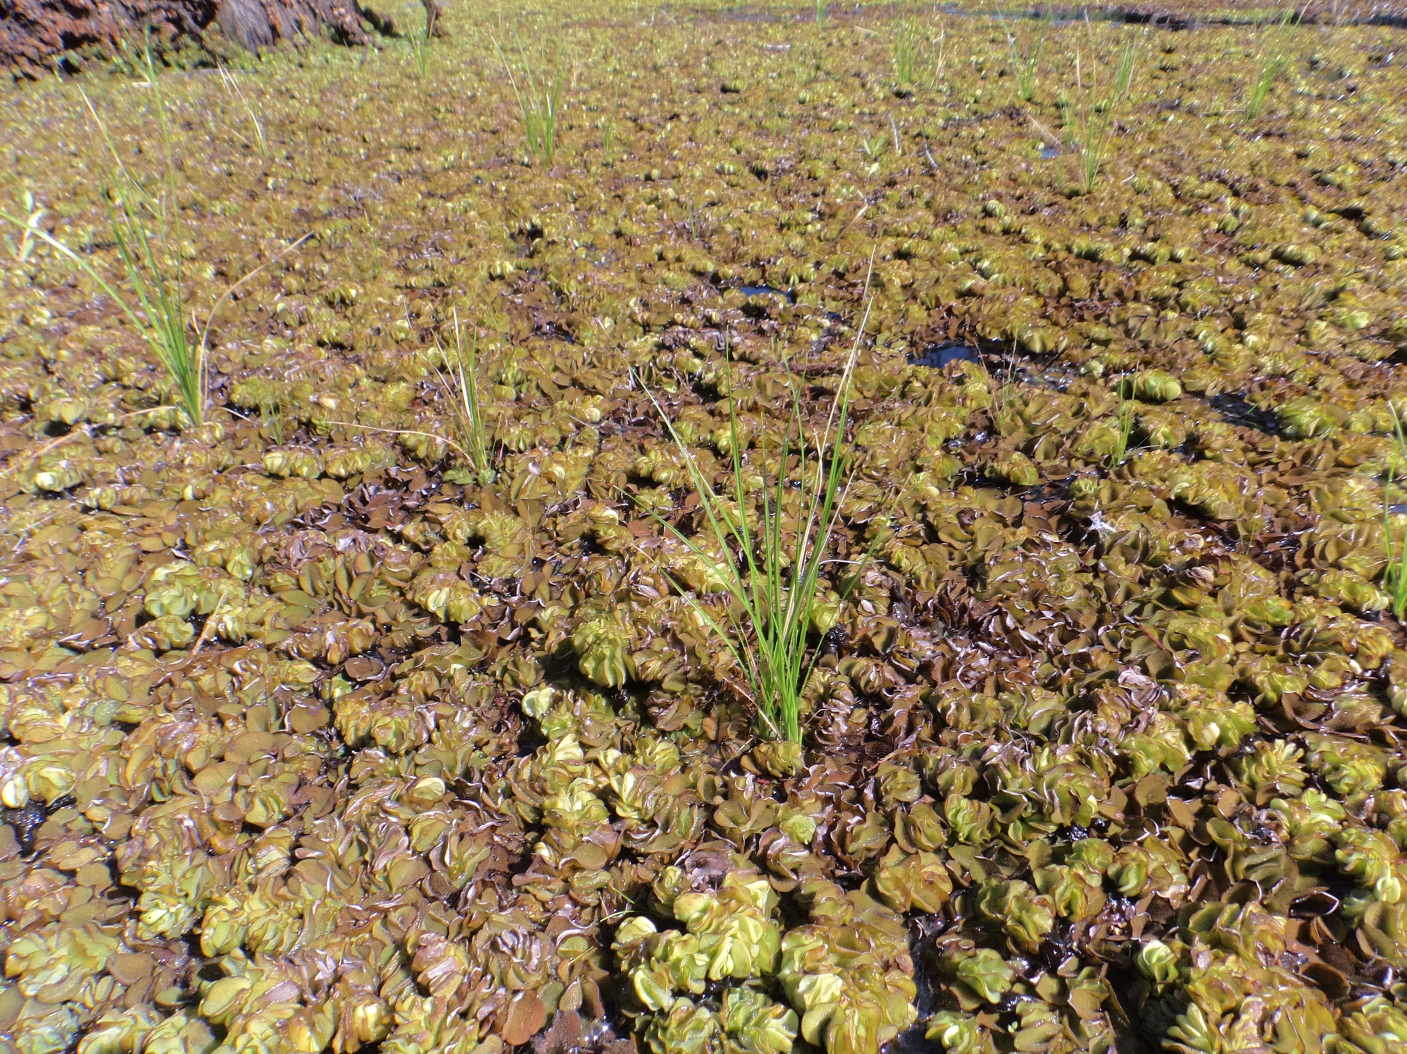
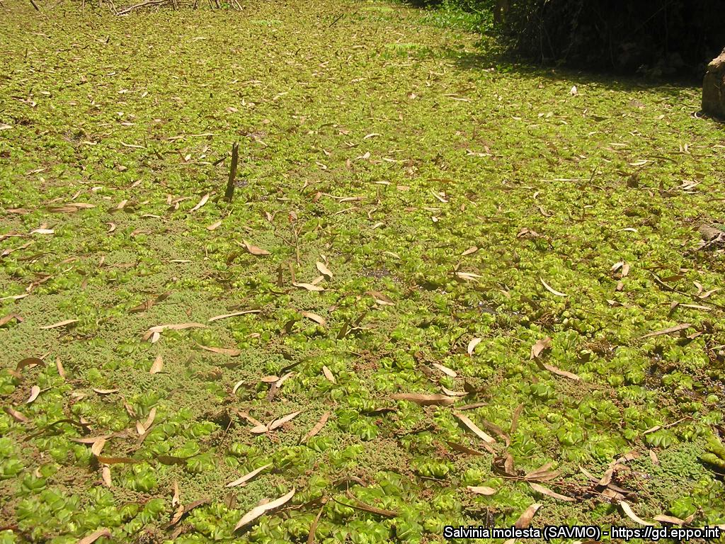
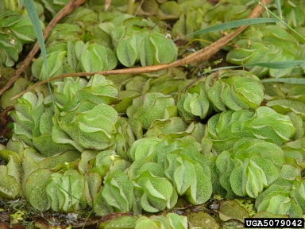



^{BE AWARE!}
^{Salvinia molesta}
A threat to waterways in the EPPO region
Image: Michael Netherland: US Army Engineer Research and Development Center, US.
What is it?
Salvinia molesta is a perennial floating aquatic fern, native to South America and is an EPPO A2 pest, recommended for regulation as a quarantine pest. In the EPPO region, S. molesta has been found in Austria, Belgium, France (Corsica), Germany, Italy, Israel, the Netherlands and Portugal, but it is not clear if reports represent established populations. Salvinia molesta is most often found in stagnant or slow-flowing waters such as lakes, slow-flowing rivers or streams, wetlands, rice paddies, irrigation channels, ditches, ponds and canals.
Mats of S. molesta can cause similar problems to those caused by excessive growth of other floating plants; for example, they can reduce access to the water for recreation; interfere with various engineering structures such as weirs, floodgates or locks; block drains and cause flooding; stop livestock reaching water; prevent photosynthesis in the water below the mat; degrade water; have negative impacts on native animals and plants more generally by significantly altering aquatic ecosystems; reduce the aesthetic appeal of water bodies; and favour the spread of certain diseases spread by mosquitos and snails.
What's the problem?
Dense mat of Salvinia molesta
Close up of Salvinia molesta showing the fronds
Image: Michael Netherland: US Army Engineer Research and Development Center, US.
Troy Evans, Great Smoky Mountains National Park, Bugwood.org
Contact us!
Your contact details, logos, links, QR codes …
Learn more about Salvinia molesta: https://gd.eppo.int
This poster has been prepared within the LIFE funded project LIFE15 PRE FR 001

