Slide 1

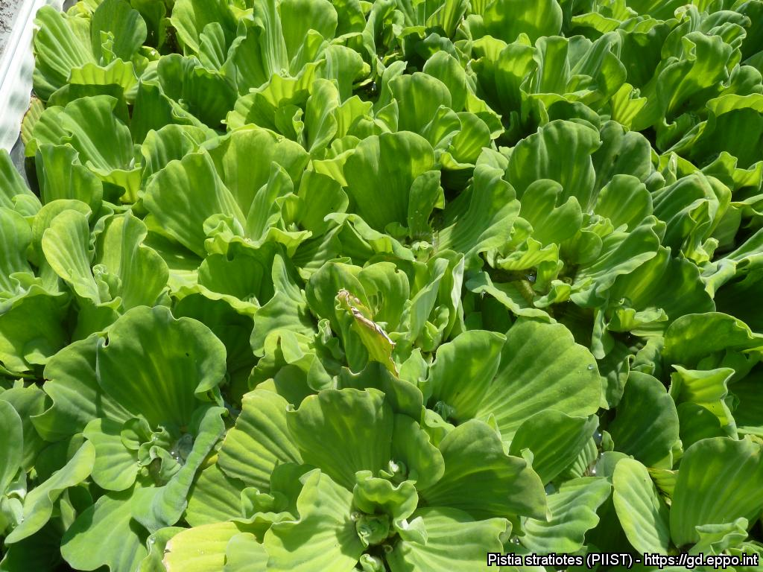
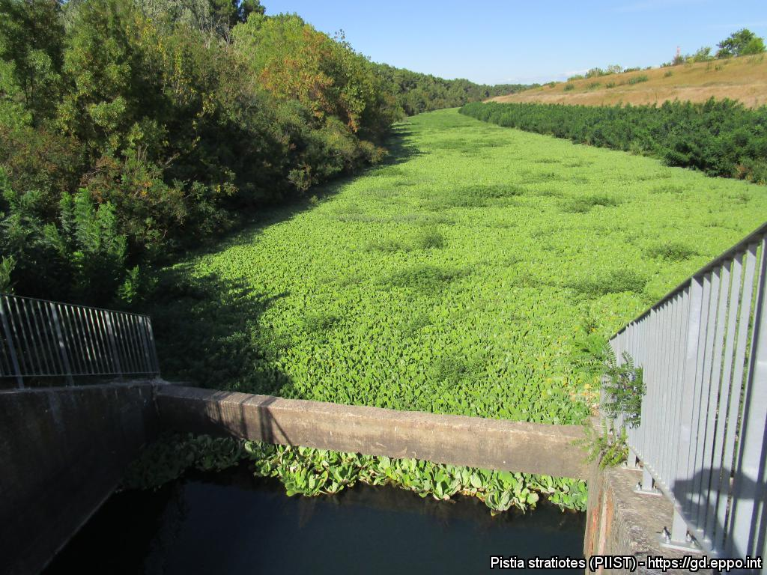
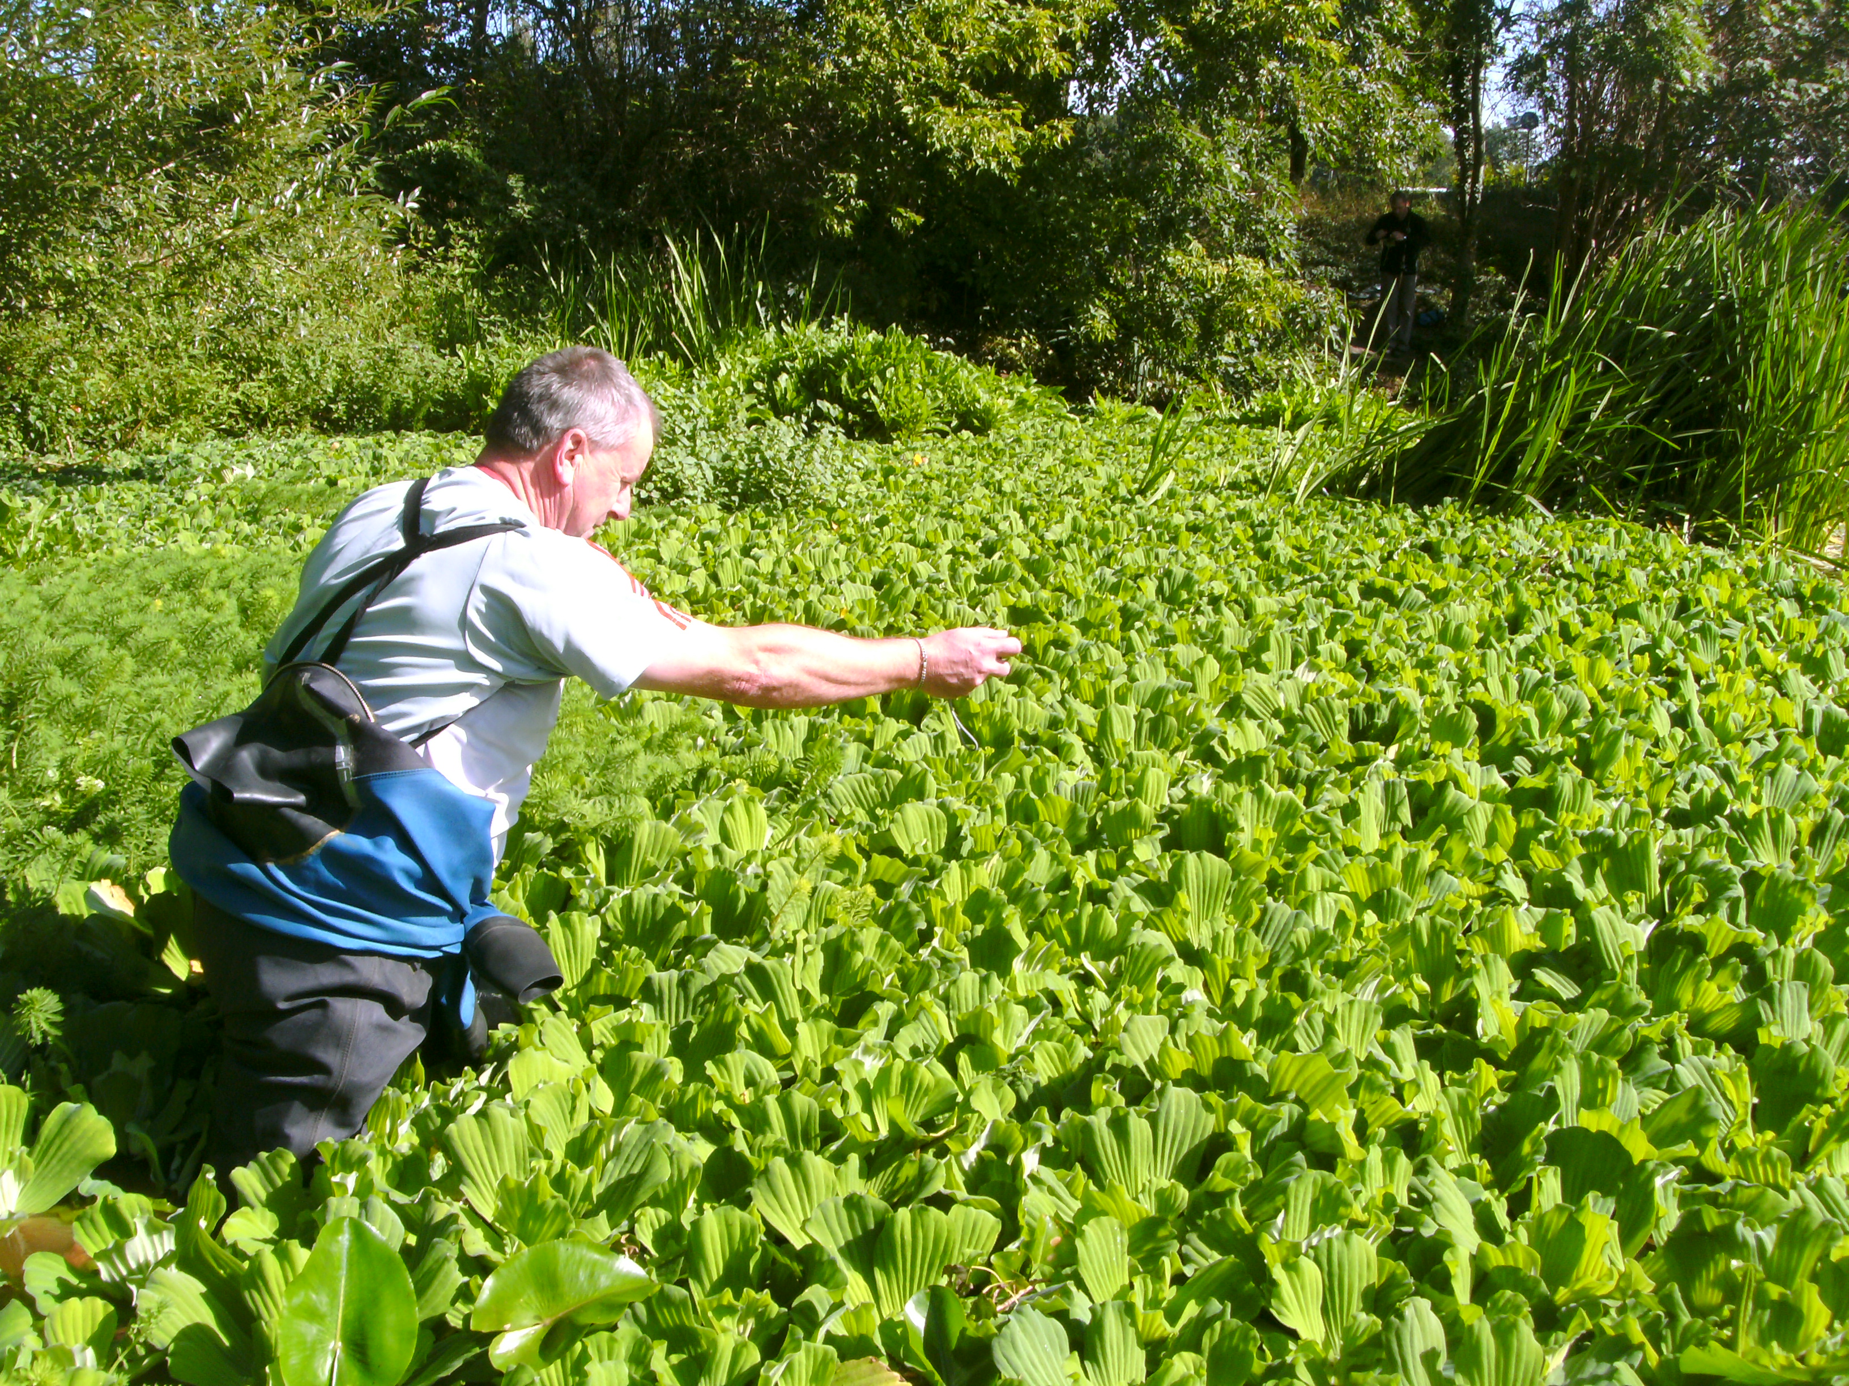



^{BE AWARE!}
^{Pistia stratiotes}
A threat to waterways in the EPPO region
What is it?
Image: Anne-Sophie Roy (EPPO). EPPO Global database, https:\\gd.eppo.int
Pistia stratiotes is an aquatic water plant, native to South America and is an EPPO A2 pest, recommended for regulation as a quarantine pest. In the EPPO region, Pistia stratiotes is recorded from Austria, Belgium, Czech Republic, France, Germany, Hungary, Israel, Italy, Morocco, Netherlands, Norway, Portugal, Romania, Russia, Slovenia, Spain, United Kingdom. Pistia stratiotes grows in slow moving rivers and reservoirs, irrigation channels, ponds, lakes, canals and ditches.
Plants for planting is considered the main pathway for entry into the EPPO region. From this pathway, the individual plants can be transferred to suitable habitats through either intentional introductions into the environment or unintentionally through the disposal of aquarium material. Dense mats of P. stratiotes can block sunlight, reducing primary production, decreasing water turbidity and outcompete native plant species. Furthermore, the water shaded by P. stratiotes shows decreased levels of oxygen and increased levels of nitrate, ammonium and phosphorus. As a result of the altered habitat, submerged vegetation has been shown to decrease under dense mats along the river Erft in western Germany.
What's the problem?
Dense monoculture along the river Rhône river, France.
Monoculture of P. stratiotes in Germany
Image: Jean-Philippe Reygrobellet (SMAGE des Gardons). EPPO Global database, https:\\gd.eppo.int
Image: Andreas Hussner: Fa. Jackels Umweltdienste GmbH Siemensstr
Contact us!
Your contact details, logos, links, QR codes …
Learn more about Pistia stratiotes: https://gd.eppo.int
This poster has been prepared within the LIFE funded project LIFE15 PRE FR 001

