Slide 1

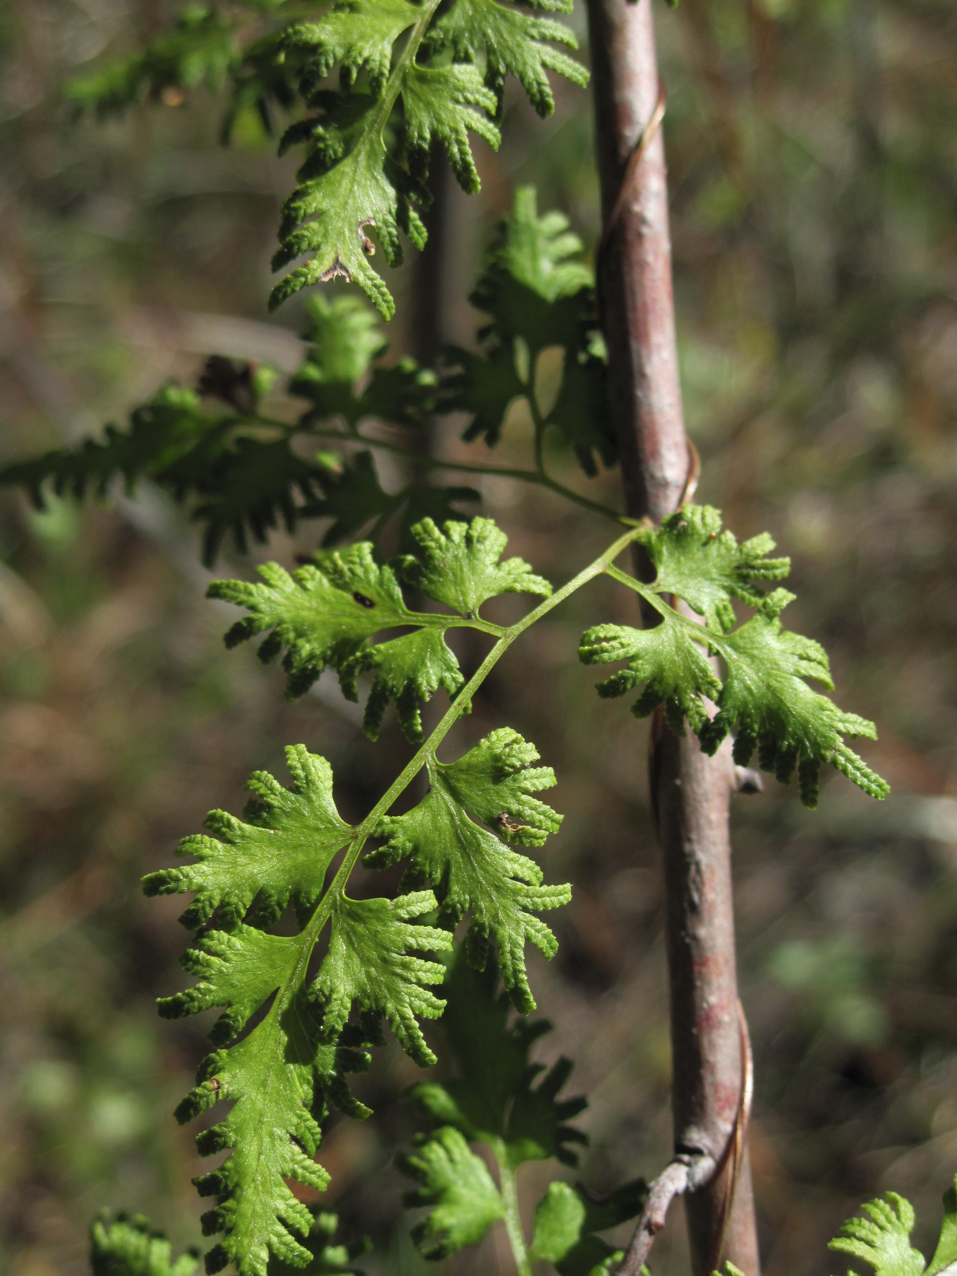
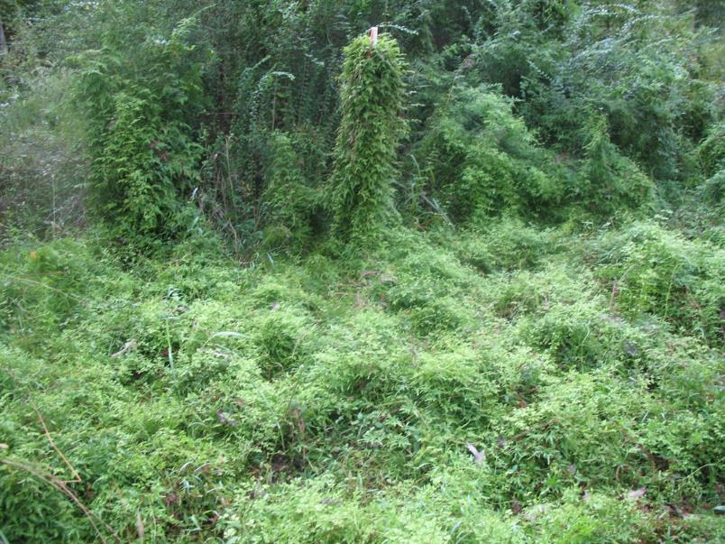
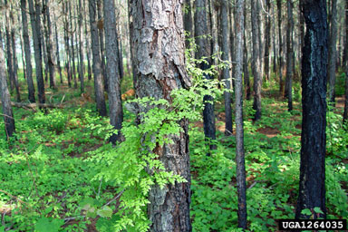


^{BE AWARE!}
^{Lygodium japonicum}
^{A threat to the EPPO region}
What is it?
Image: Kimberly Bohn (Penn State Extension)
Lygodium japonicum is a broadleaved, herbaceous perennial climbing fern native to Asia. Lygodium japonicum is a true fern that reproduces by spores (homosporous fern), which then germinate and develop through gametophyte and sporophyte stages. The species is currently absent from the natural environment in the EPPO region. In its invasive range, in particular in North America, it invades a diverse range of habitats including floodplain forests, swamps, marshes, river and stream banks and upland woodlands.
The pathway plants for planting is considered the main entry pathway into the EPPO region. In North America,
L. japonicum was introduced as an ornamental plant. In the Netherlands gametophytes have been detected in growing media of bonsai plants imported from China. L. japonicum can grow in sun or shade, damp, disturbed or undisturbed areas in the US. It can grow so dense that it forms a living ‘wall’, leading to the elimination of seedlings and other native vegetation. The species has been shown to reduce native plant species richness and diversity.
What's the problem?
Smothering habit of Lygodium japonicum growing over native vegetation in North America
Image: Kimberly Bohn (Penn State Extension)
Image: Chris Evans, (University of Illinois, Bugwood.org)
Contact us!
Your contact details, logos, links, QR codes …
Learn more about Lygodium japonicum: https://gd.eppo.int
This poster has been prepared within the LIFE funded project LIFE15 PRE FR 001

