Slide 1

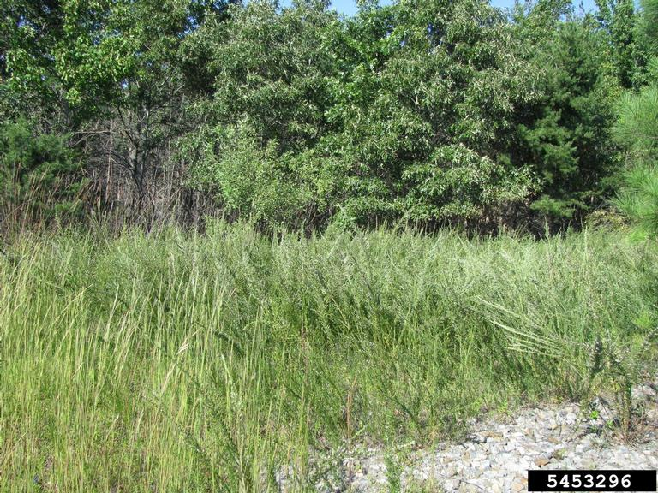
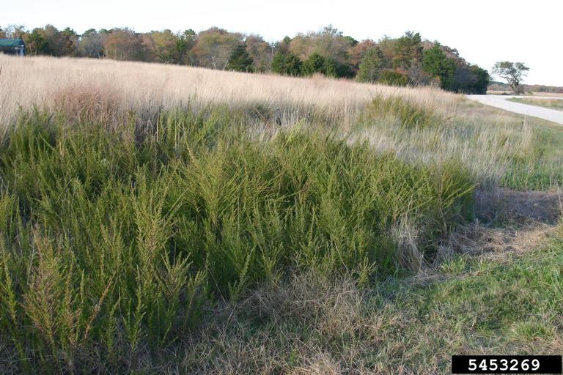
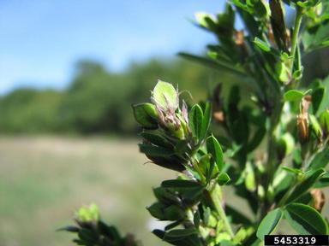



^{BE AWARE!}
^{Lespedeza cuneata}
^{A threat to the EPPO region}
Image: Leslie J. Mehrhoff, University of Connecticut, Bugwood.org
What is it?
Lespedeza cuneata is an erect or sub-erect perennial herbaceous legume native to Asia. The species is currently absent from the natural environment in the EPPO region. Throughout its invasive range, the species invades habitats such as grassland, woodland, forests, edges of wetlands, pastures, and disturbed sites. The species may be grown on a small scale and is available from horticultural suppliers in the EPPO region. The species is also utilised as a forage species outside of the EPPO region and could be imported into the region for this purpose in the search for new protein plants in the future.
Lespedeza cuneata can thrive under a variety of conditions, crowding out native species in natural areas. The species forms dense stands in areas where it invades, reducing light availability and potentially increasing competition for soil water. Invasions into oak savannas in southeastern Kansas (US) have reduced native plant species richness and reduced the abundance of invertebrate species. L. cuneata may also have impacts on native plant communities through allelopathic effects. Allelopathic chemicals have been found to reduce native grass species’ performance by up to 60%.
What's the problem?
L. cuneata encroaching into grassland in N. America
Close up of leaves
Image: Leslie J. Mehrhoff, University of Connecticut, Bugwood.org
Image: Leslie J. Mehrhoff, University of Connecticut, Bugwood.org
Contact us!
Your contact details, logos, links, QR codes …
Learn more about Lespedeza cuneata: https://gd.eppo.int
This poster has been prepared within the LIFE funded project LIFE15 PRE FR 001

