Slide 1

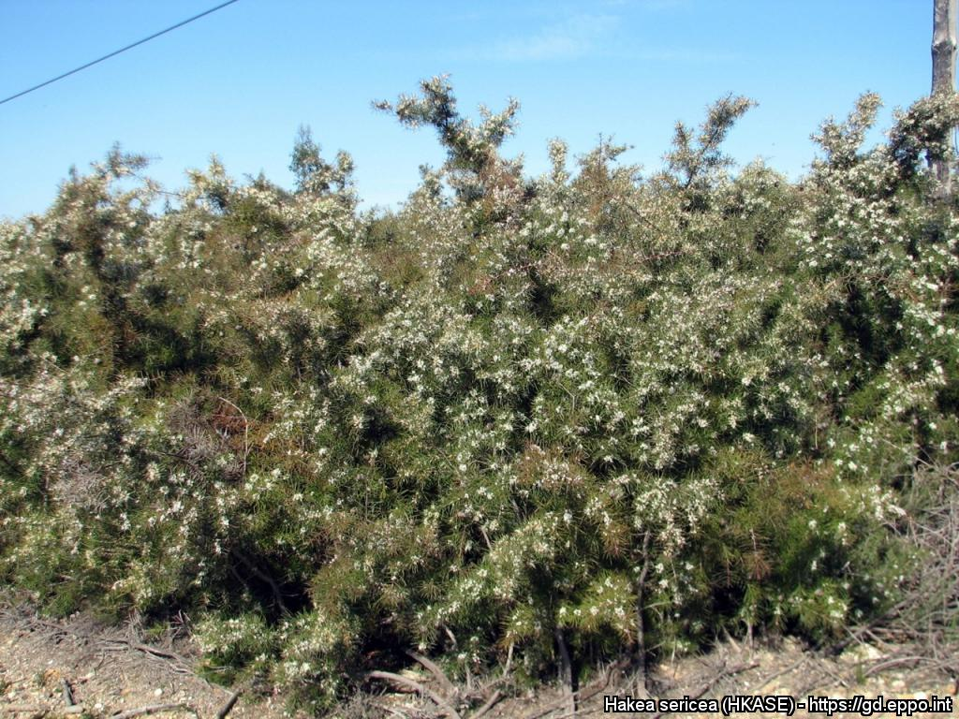
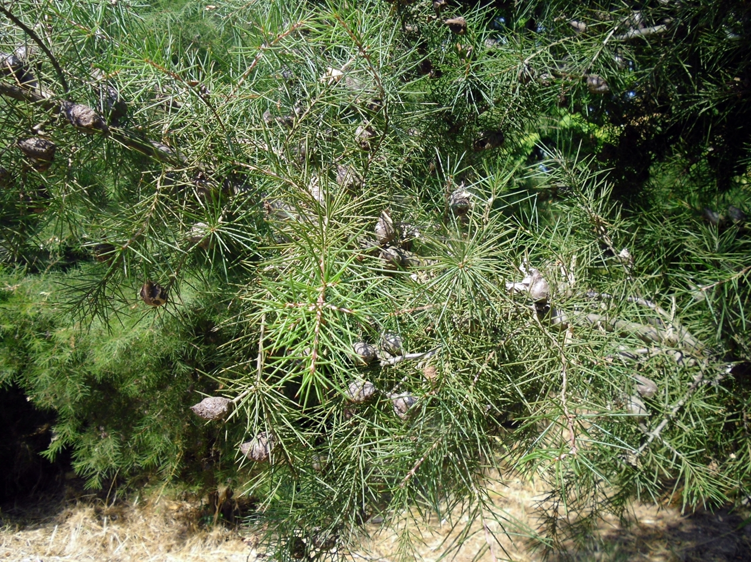
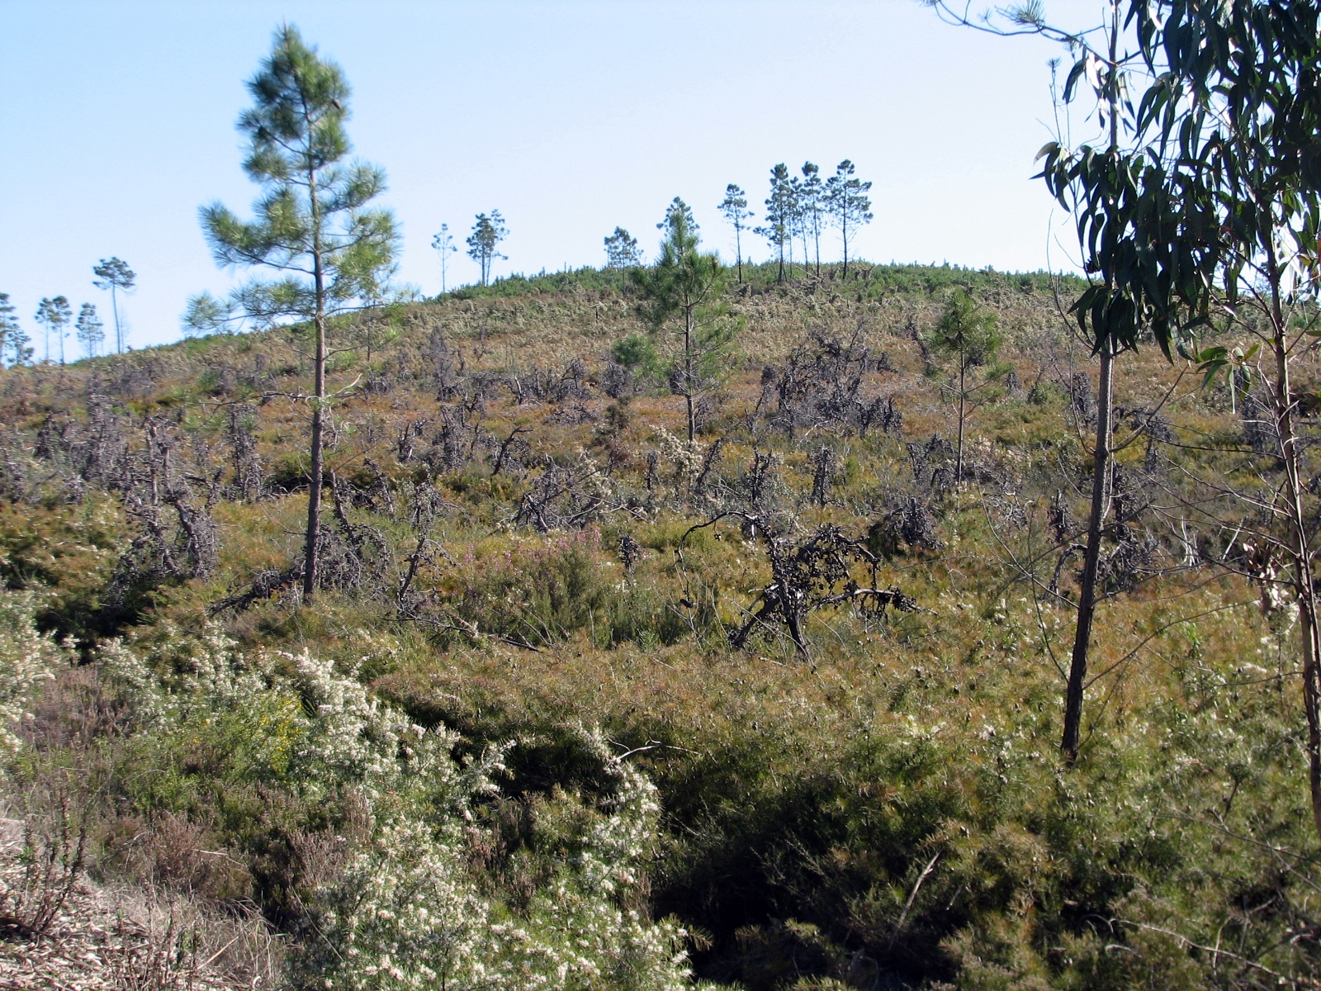



^{BE AWARE!}
^{Hakea sericea}
^{A threat to the EPPO region}
Image: Elizabete Marchante (Universtiy of Coimbra) EPPO Global database, https:\\gd.eppo.int
What is it?
Hakea sericea (EPPO List of invasive alien plants) is an evergreen shrub or small tree native to Australia. In the EPPO region, H. sericea is recorded from France, Madeira, Portugal and Spain. In the EPPO region, disturbed areas (particularly road margins), forest margins, coastal grasslands and pine forest are all highlighted as additional habitats. Plants for planting has been the main pathway for entry into the EPPO region. The plant is known to be used as an ornamental and hedging species, and therefore could be imported as seeds or plants for this purpose.
In Portugal, H. sericea forms extensive dense monospecific stands which can exclude native plant species and/or change community composition, including associated fauna. Areas highly susceptible to invasion by H. sericea in the north of Portugal, are coincident with the distribution area of Succisa pinnatifida Lange, a rare endemic of the Iberian Peninsula. The high spread potential of the species acts to threaten and reduce the biodiversity of the Esterel Mountains in France, by eliminating less competitive native species of maquis and forest.
What's the problem?
Mature seed pods
Infestation of H. sericea in Portugal
Image: Elizabete Marchante (Universtiy of Coimbra) EPPO Global database, https:\\gd.eppo.int
Image: Elizabete Marchante (Universtiy of Coimbra) EPPO Global database, https:\\gd.eppo.int
Contact us!
Your contact details, logos, links, QR codes …
Learn more about Hakea sericea: https://gd.eppo.int
This poster has been prepared within the LIFE funded project LIFE15 PRE FR 001

