Slide 1

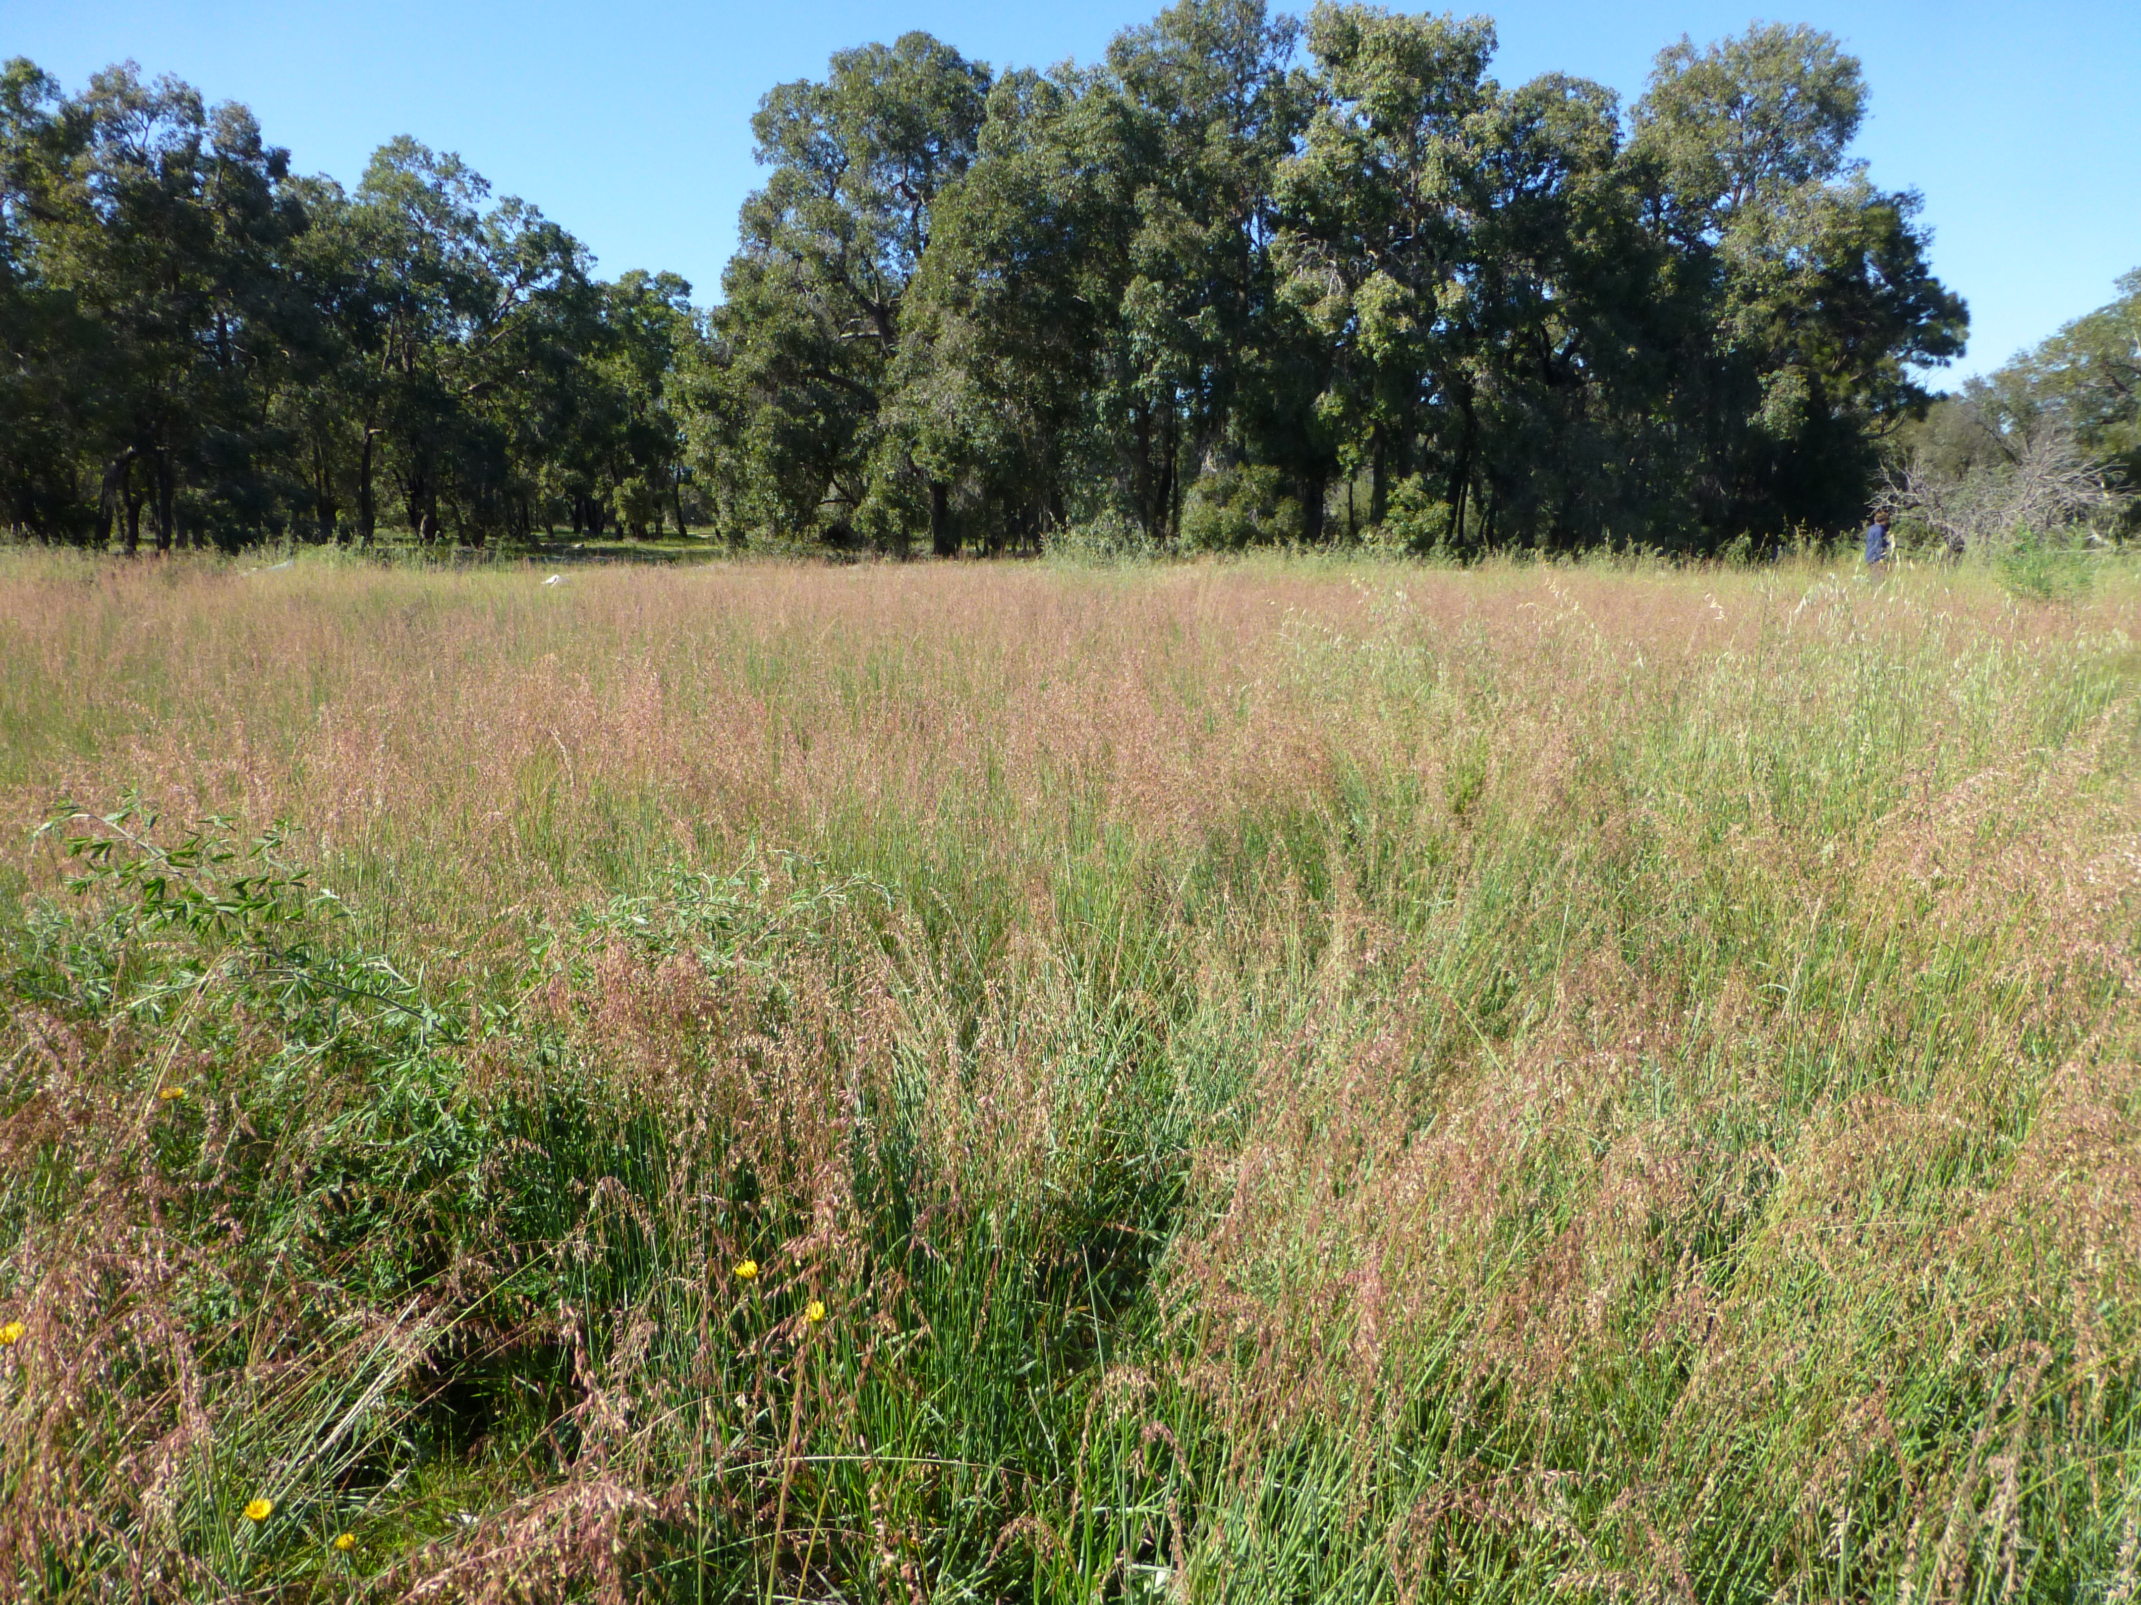
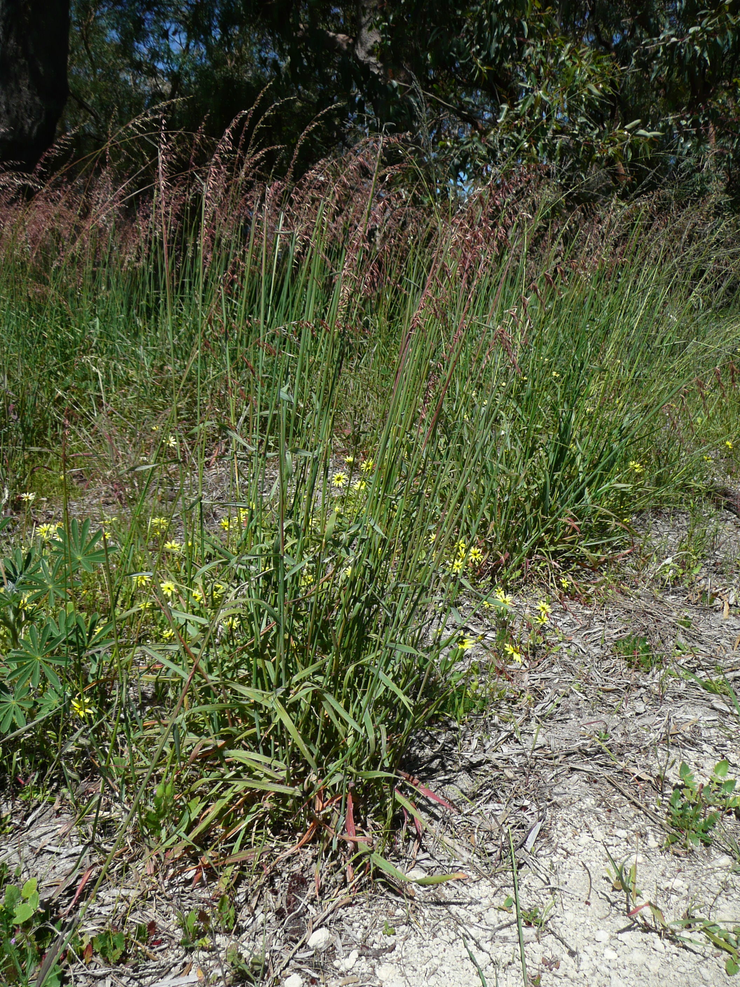
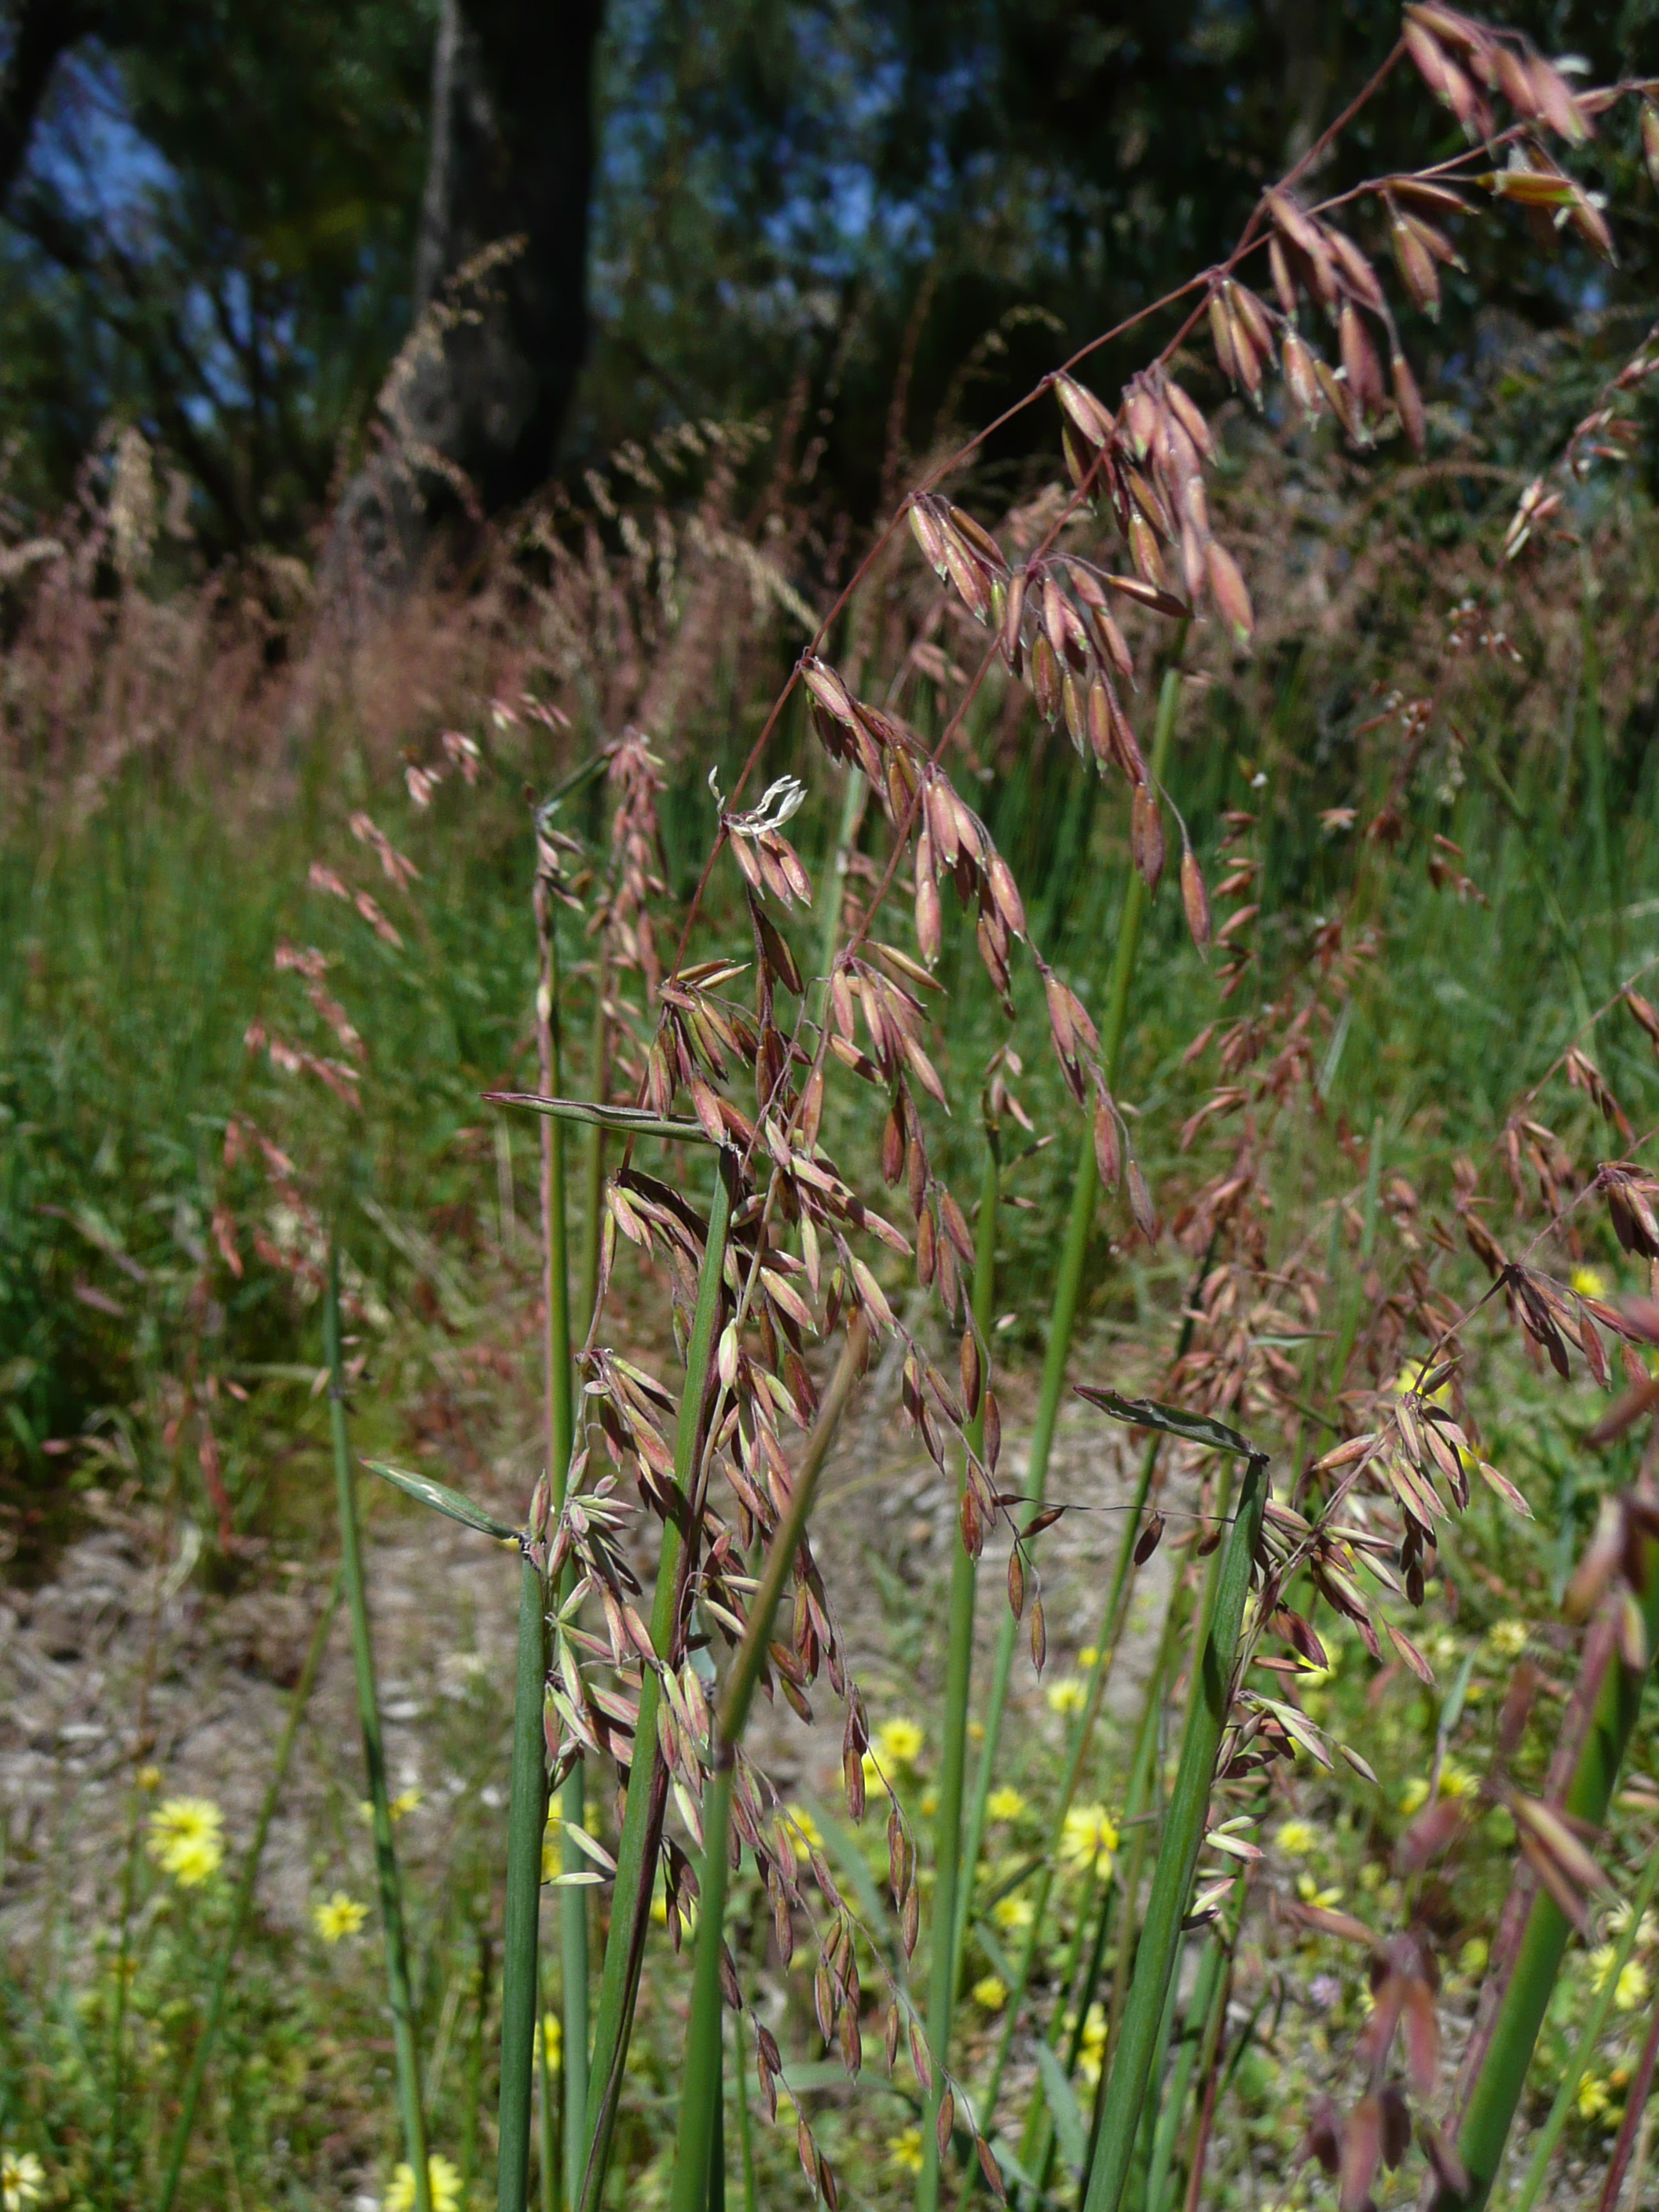



^{BE AWARE!}
^{Ehrharta calycina}
^{A threat to the EPPO region}
Image: Sian Mawson, Friends of Queens Park Bushland
What is it?
Ehrharta calycina is a perennial grass species native to South Africa. In the EPPO region, the species is recorded from Portugal, Spain and Tunisia. It is a tussock grass, with culms generally varying in height from 300 to 70 cm high. In Spain, it has been found in dunes and dry pastures, in Portugal along roadsides and open woodland, and in Tunisia in pastures.
There is no evidence that the species is currently promoted as a forage grass within the EPPO region but this is how it entered Tunisia where it was introduced as a fodder and pasture grass, almost certainly as seed. In California and Australia, E. calycina can dominate plant communities, excluding native plant species and transforming shrubland into grasslands. E. calycina either prevents the germination of native plants or prevents their establishment and survival through promotion of more frequent fires.
What's the problem?
Infestation of E. calycina
Flowers of E. calycina
Image: Sian Mawson, Friends of Queens Park Bushland
Image: Sian Mawson, Friends of Queens Park Bushland
Contact us!
Your contact details, logos, links, QR codes …
Learn more about Ehrharta calycina: https://gd.eppo.int
This poster has been prepared within the LIFE funded project LIFE15 PRE FR 001

