Slide 1

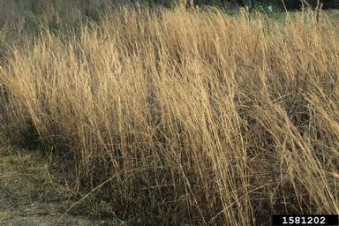
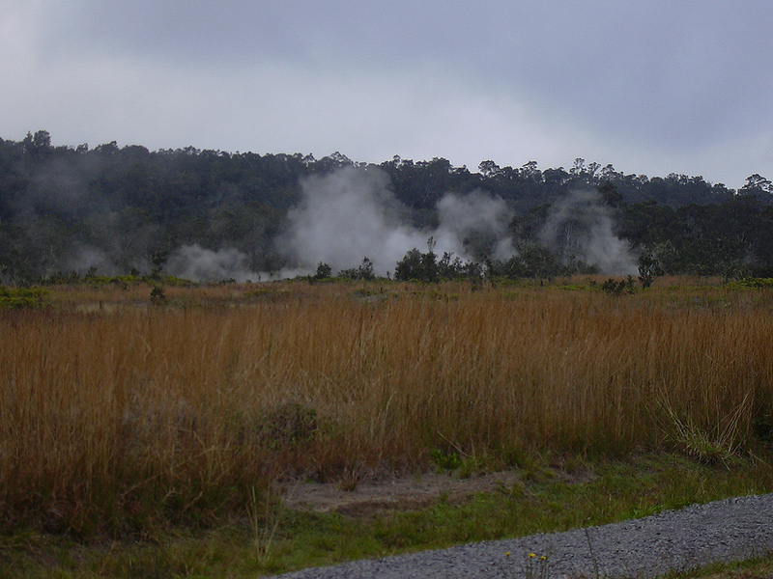

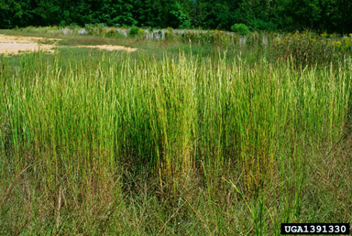


^{BE AWARE!}
^{Andropogon virginicus}
^{A threat to the EPPO region}
Image: John D. Byrd, Mississippi State University, Bugwood.org
What is it?
Andropogon virginicus (EPPO Observation List of invasive alien plants) is an erect perennial grass which is native to South and Central America. The species is present in the EPPO region, recorded from France, the Russian Federation and Georgia. A. virginicus invades a wide variety of habitats from disturbed to relatively intact habitats including ruderal areas, wetlands, open pastures, grasslands, and open woodlands. There is evidence that A. virginicus has entered the EPPO region as a contaminant of machinery and equipment. In France, it is suspected that A. virginicus was introduced into a military camp with munitions in the years 1950-1967.
Andropogon virginicus stands can be dense, widespread, and highly competitive suggesting the species reduces biodiversity. The species is reported to be able to dominate within the grass layer. Although present in the EPPO region, there are no reported studies that have evaluated the ecological or economic impact of A. virginicus in the region. However, due to its aggressive spread in natural areas in Georgia, and around the Black Sea, and due to the rapid expanse of the plant in France, potential impacts are likely to be high.
What's the problem?
Infestation of
A. virginicus in
N. America
Image: Forest & Kim Starr, Bugwood.org
Image: John D. Byrd, Mississippi State University, Bugwood.org
Contact us!
Your contact details, logos, links, QR codes …
Learn more about Andropogon virginicus: https://gd.eppo.int
This poster has been prepared within the LIFE funded project LIFE15 PRE FR 001

