Slide 1
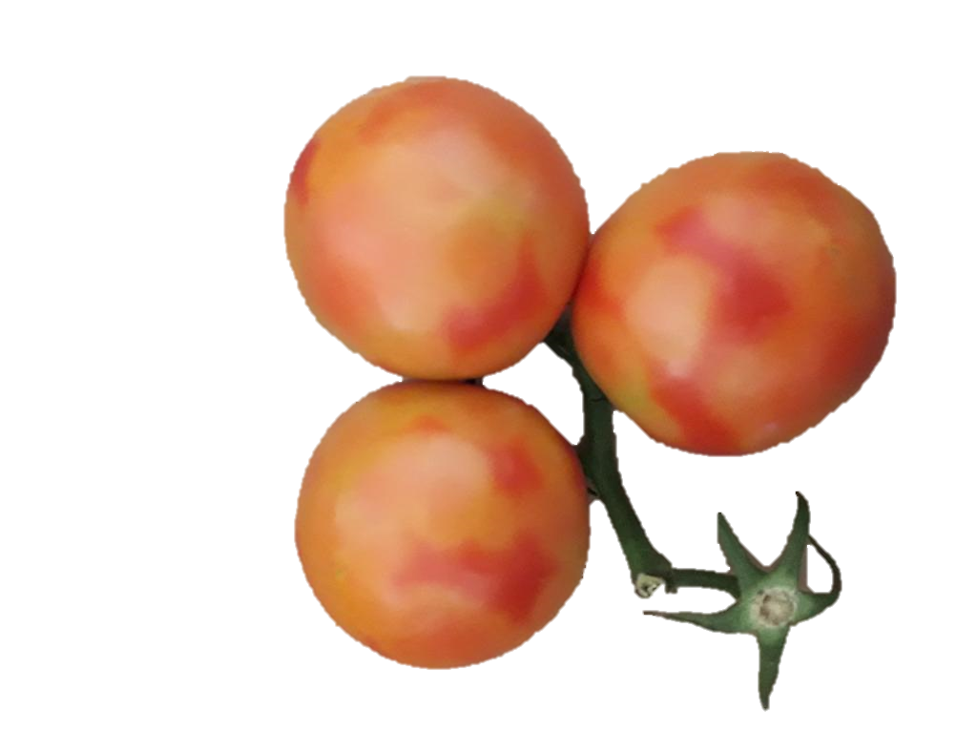
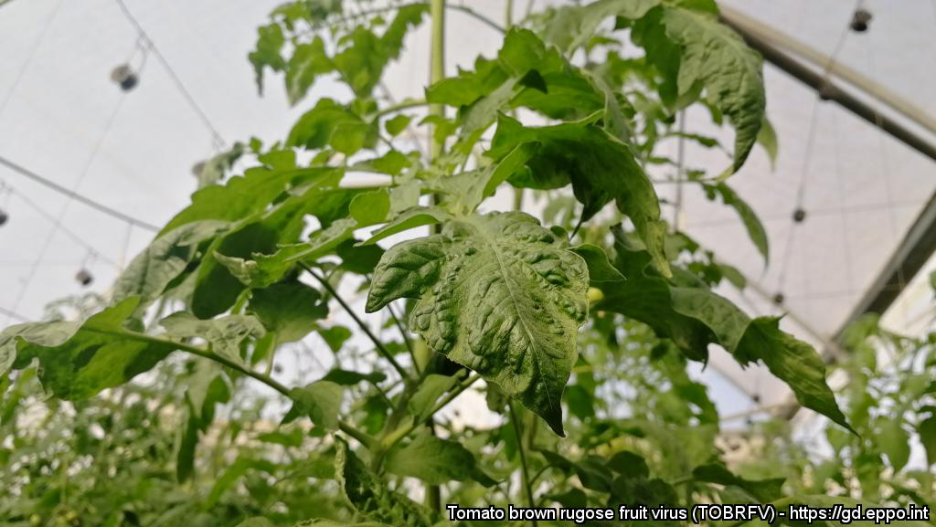
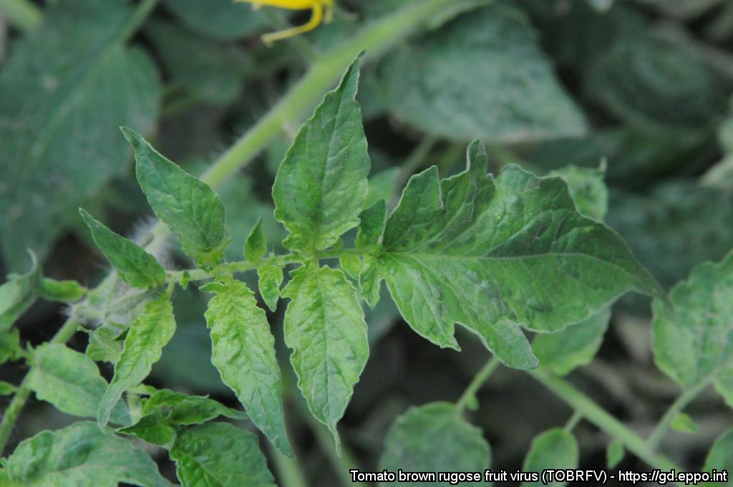
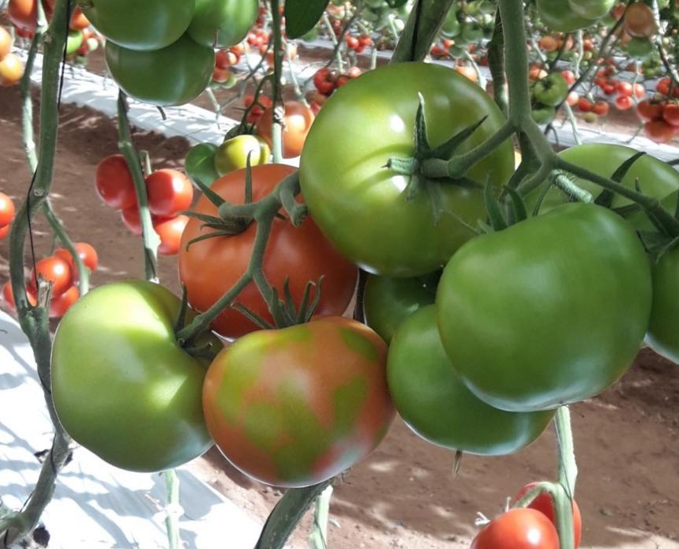
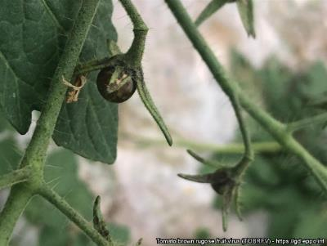

^{BE AWARE!}
Tomato brown rugose fruit virus (ToBRFV)
^{A threat to tomato and pepper}
2
1
Image: 1,3. C. Picard. 2,5. A. Dombrovsky. 4. S. Davino. EPPO Global Database, https://gd.eppo.int
What is it?
ToBRFV is a virus which is relatively new-to-science and which has overcome long-lasting resistance genes to tobamoviruses in tomato. This virus can be associated with seed and is easily transmitted mechanically by contact. It can survive on many surfaces. The virus can cause 30-70% loss of tomato yield, reducing plant vigour and the length of the production period during which fruits are harvested, as well as fruit quality. As the symptoms can be confused with other viruses, laboratory analysis is required to confirm suspicions. This virus is a threat to tomato and pepper production in the EPPO region.
How to recognize it
3
Its wide range of symptoms includes:
Chlorotic/mosaic pattern [3], deformation, blistering [1] and narrowing of leaves, in particular younger leaves in the head and side shoots
Brown necrotic lesions on pedicles, calyces, and petioles [4]
Chlorotic spotting and marbling [2,5], deformation, uneven ripening [5] and dark coloration spots on green fruits.
5
4
Contact us!
Your contact details, logos, links, QR codes …
Learn more about ToBRFV: www.your.website
This poster has been prepared in collaboration with EPPO (www.eppo.int)

