Slide 1
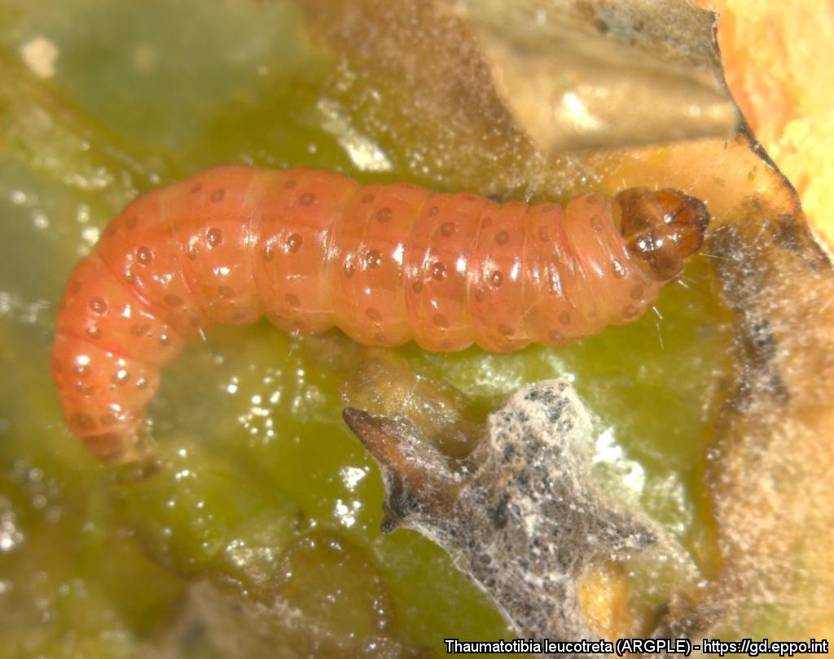
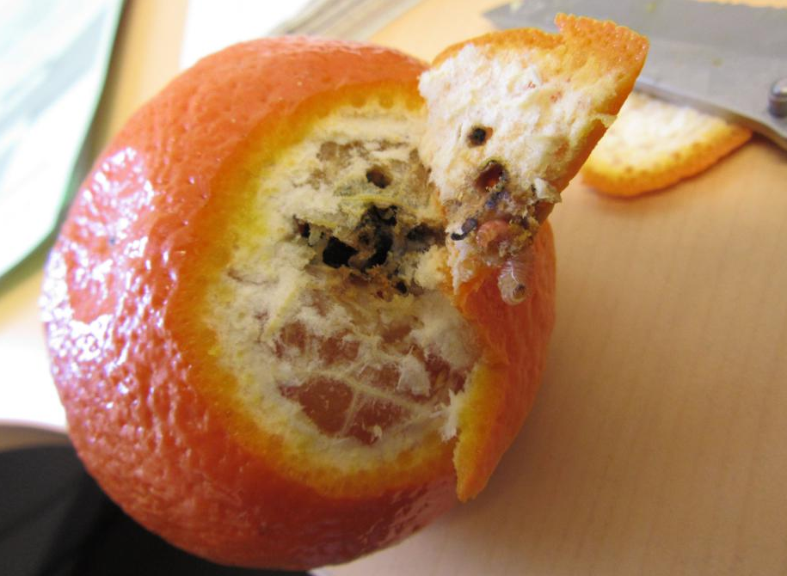
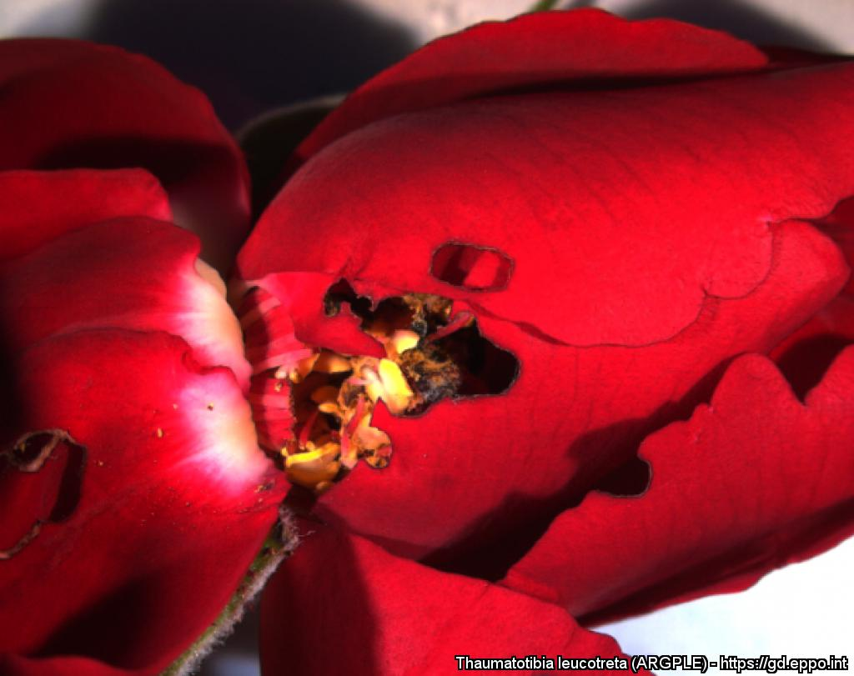


^{HELP US STOP THIS PEST!}
^{Thaumatotibia leucotreta}
A threat to citrus and sweet pepper
Larva in sweet pepper. Courtesy: M. van der Straten. EPPO Global Database, https://gd.eppo.int
What is it?
The false codling moth, Thaumatotibia leucotreta, is a pest of many economically important crops in Africa and Israel. Larvae feed in fruit of more than 130 plant species. This pest is regularly intercepted during import inspections in consignments of citrus fruit, sweet peppers as well as in roses.
If it was introduced into the EPPO region, this pest is likely to establish around the Mediterranean basin, where it could cause high yield losses and require application of insecticides. It is important to prevent the introduction and establishment of this pest in the EPPO region.
How to recognize it?
Larva inside a tangerine fruit (detection at import)
Damage on a rose
(detection at import)
Courtesy: M. van der Straten.
EPPO Global Database. https://gd.eppo.int
Courtesy: M. van der Straten.
EPPO Global Database. https://gd.eppo.int
Contact us!
Your contact details, logos, links, QR codes …
Learn more about Thaumatotibia leucotreta: www.your.website
This poster has been prepared in collaboration with EPPO (www.eppo.int)

