Slide 1
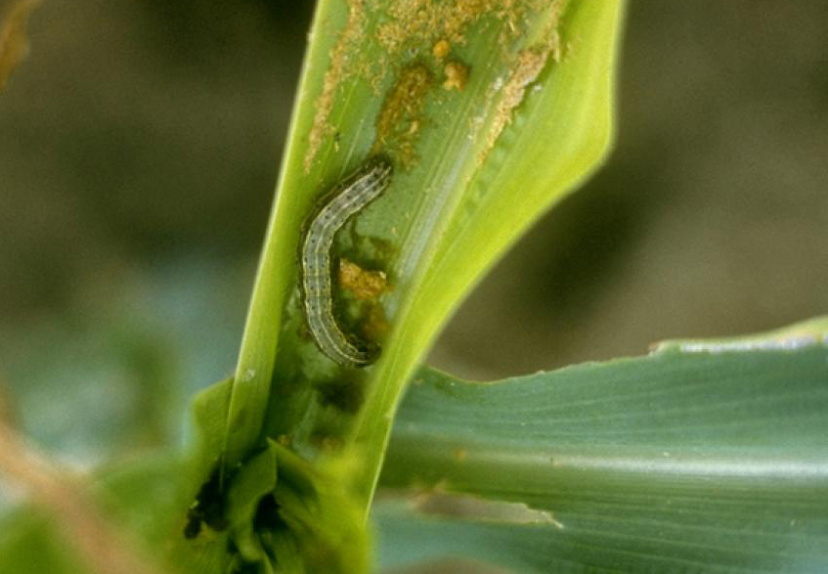
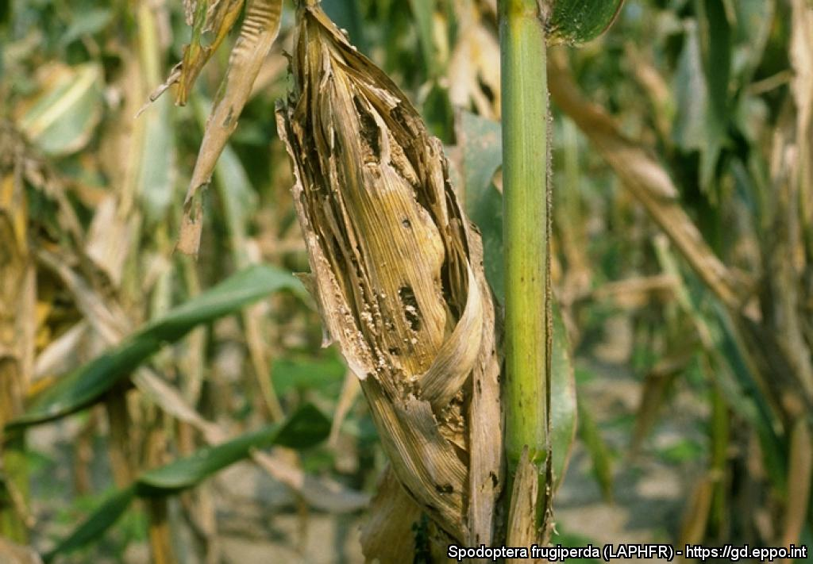
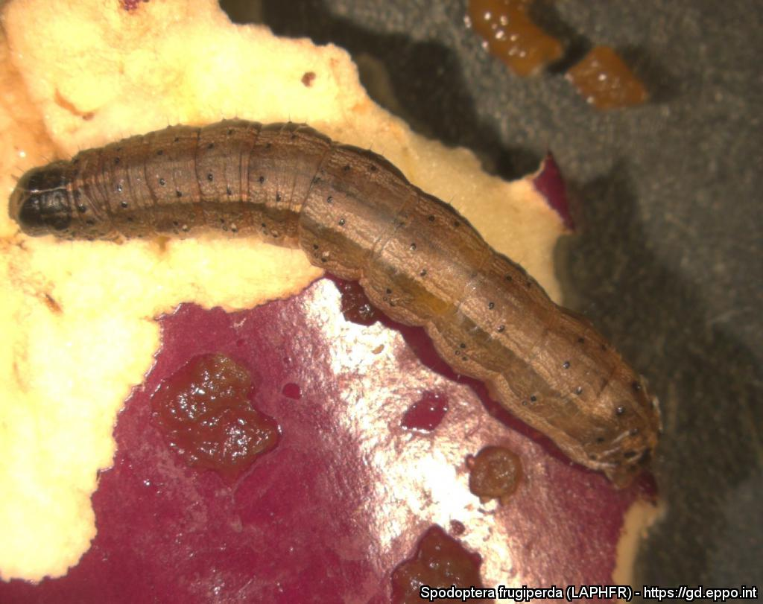
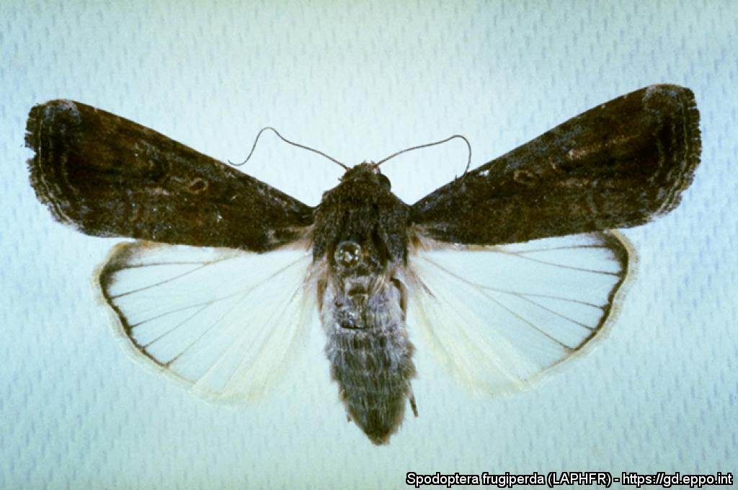
^{BE AWARE!}
^{Fall armyworm}
A threat to maize and many other crops
Larva on maize. Courtesy: B.R. Wiseman - USDA/ARS, Tifton (US). EPPO Global Database, https://gd.eppo.int
What is it?
Fall armyworm (Spodoptera frugiperda- Lepidoptera: Noctuidae) originates from tropical and sub-tropical America. It has been inadvertently introduced into other continents (Africa, Asia, Oceania) where it rapidly spread and caused severe economic losses to maize and other food crops. In 2019, it was discovered in the Mediterranean region in Egypt, and in 2020 in Israel and Jordan. In 2020, the pest was also found in the Canary Islands (Spain). As its spread is threatening maize crops and many other plants, it is important to detect this invasive and polyphagous species as early as possible.
Larval damage
Adult moth
Damaged maize ear B.R. Wiseman - USDA/ARS, Tifton (US)
Larva on aubergine Marja van der Straten, Dutch NPPO
Adult female B.R. Wiseman - USDA/ARS, Tifton (US)
Contact us !
Contact us!
Your contact details, logos, links, QR codes …
^{Learn more about} ^{the} fall armyworm: www.your.website
This poster has been prepared in collaboration with EPPO (www.eppo.int)

