Slide 1
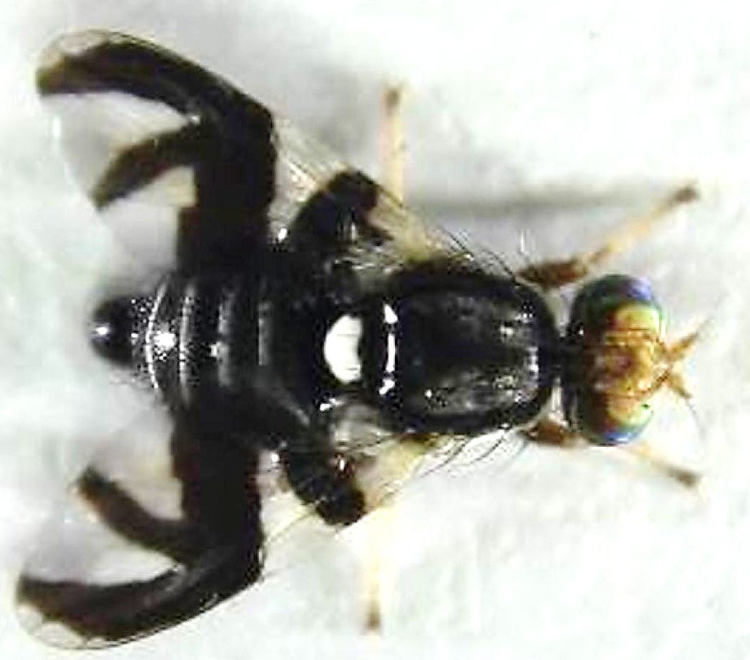
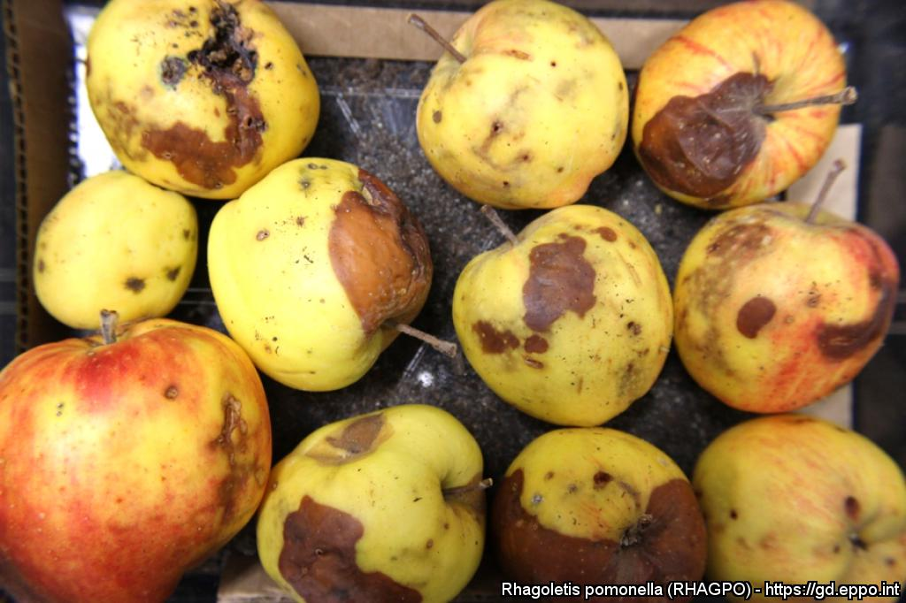
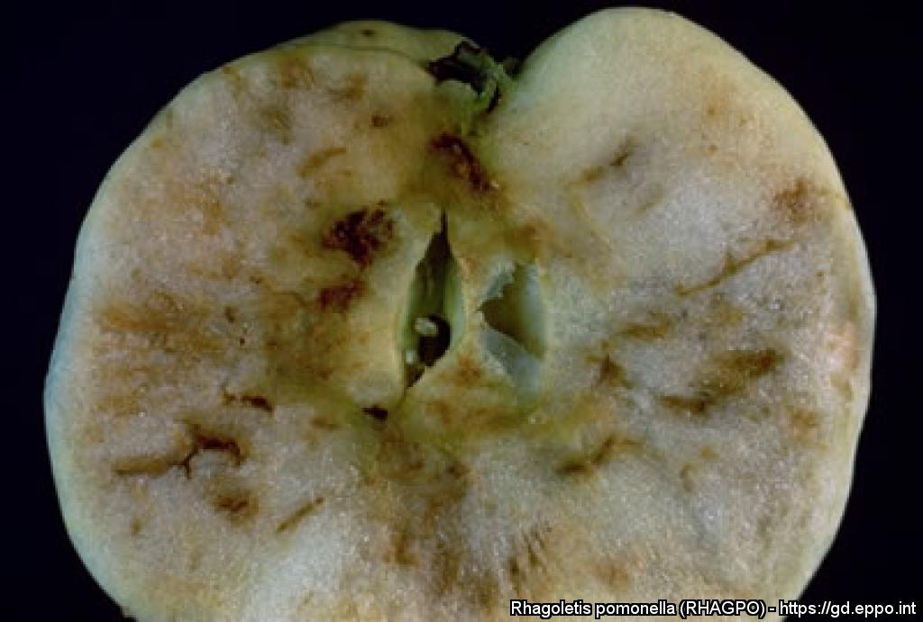
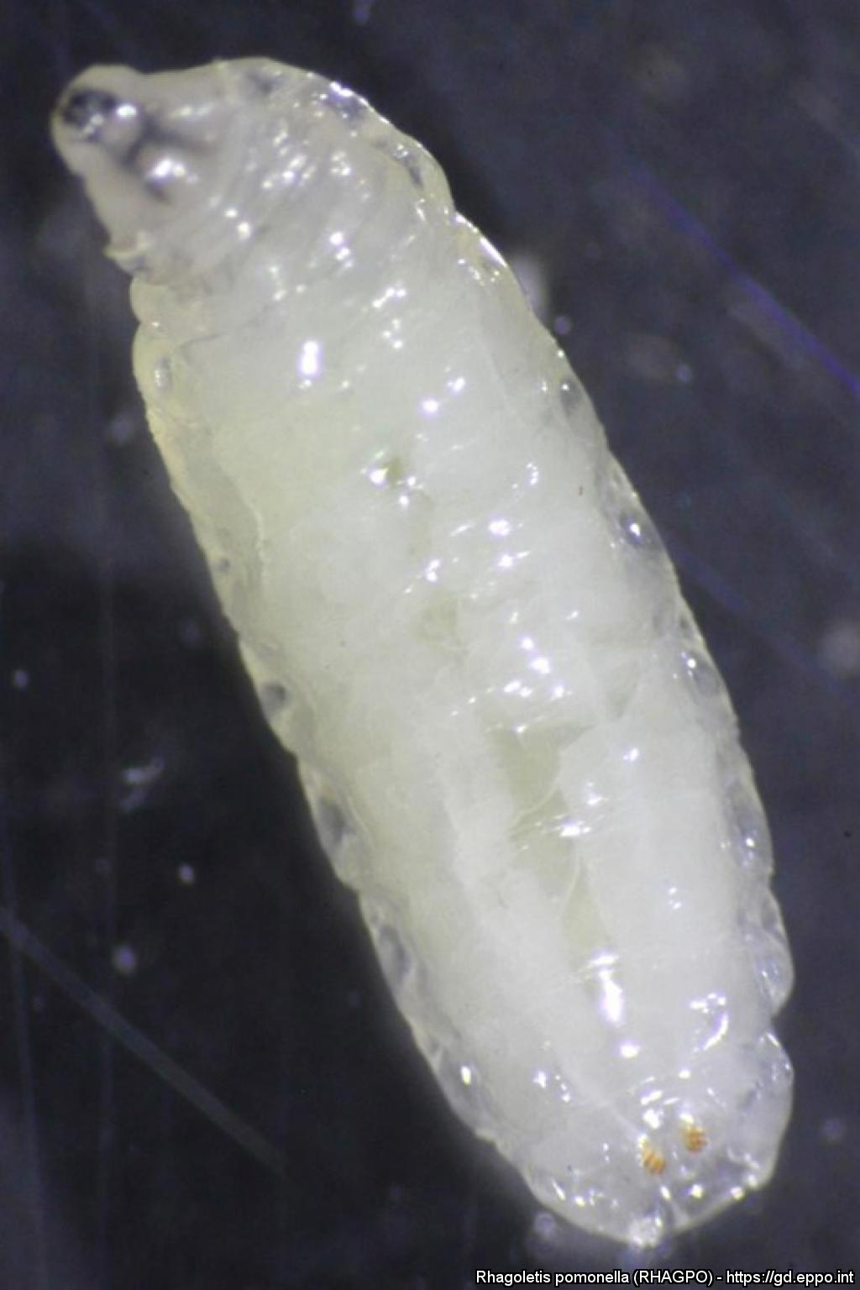

^{BE AWARE!}
^{Rhagoletis pomonella}
^{A threat to apple}
Adult (4-5 mm in length)
Courtesy: Wee L. Yee. EPPO Global Database, https://gd.eppo.int
What is it?
The apple maggot, Rhagoletis pomonella, is a fruit fly that feeds on apples, as well as on wild and ornamental Rosaceae. It is only present in North America where it is considered as a serious pest. It has spread, probably with infested apples, from eastern to western North America.
If it was introduced into the EPPO region, it is likely to cause high yield losses and require application of insecticides. It is important to prevent the introduction and establishment of this pest in the EPPO region.
Damage
Feeding larvae (maggots) damage the flesh of the fruit.
Damage on apples due to the larvae
Courtesy: Wee L. Yee, E.H. Glass. EPPO Global Database, https://gd.eppo.int
Contact us!
Your contact details, logos, links, QR codes …
Learn more about Rhagoletis pomonella: www.your.website
This poster has been prepared in collaboration with EPPO (www.eppo.int)

