Slide 1

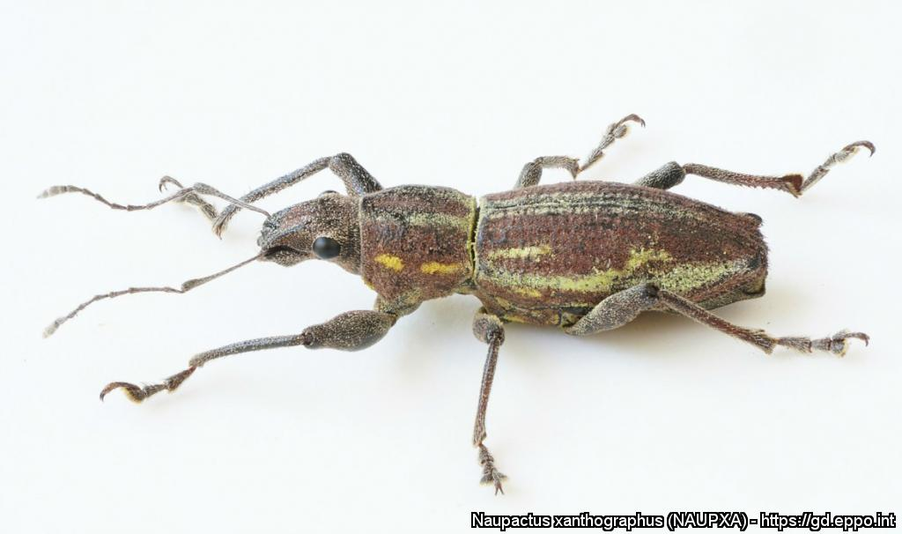
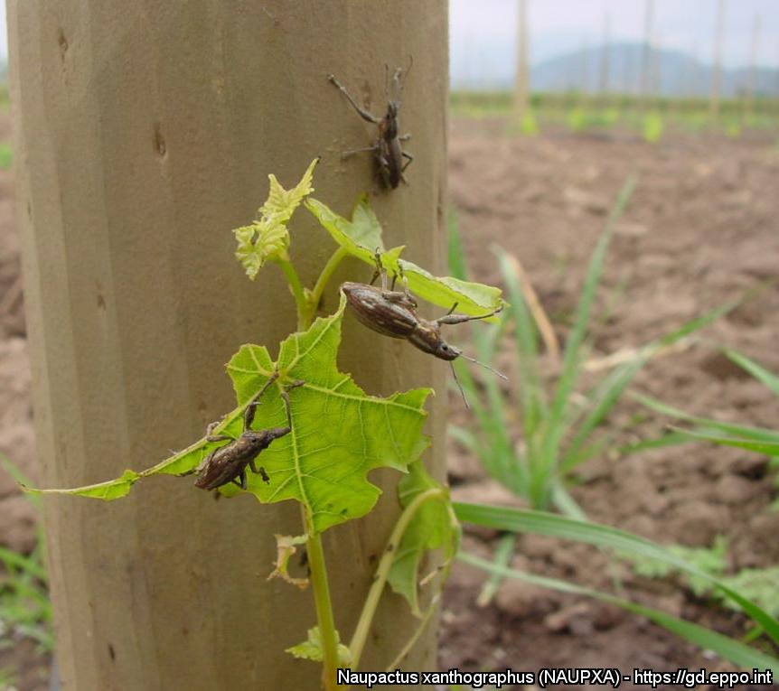
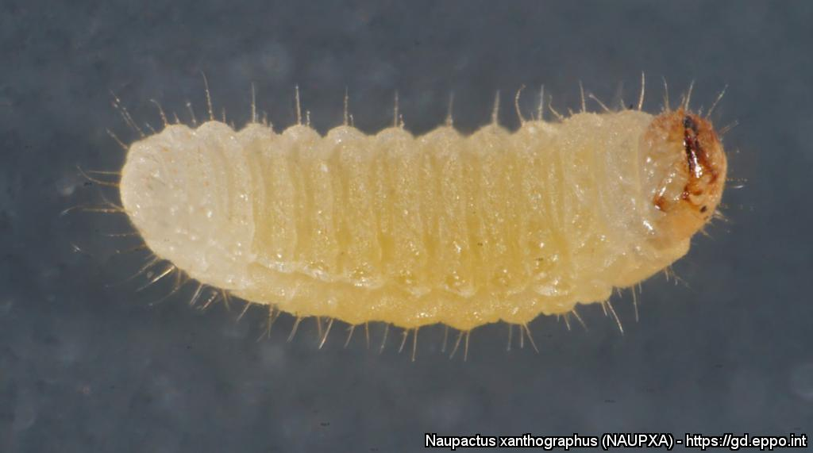

^{HELP US STOP THIS PEST!}
South American fruit tree weevil
A threat to fruit trees and grapevine
Adult. All photos by Renato Ripa (BIOCEA Ltda), EPPO Global Database, https://gd.eppo.int
What is it?
The South American fruit tree weevil, Naupactus xanthographus (Coleoptera: Curculionidae) is a highly polyphagous weevil which causes economic damage in grapevine and fruit trees in South America. It has the potential to establish in the warmer areas of the EPPO region, in particular the Mediterranean region. Adult weevils are regularly intercepted in trade of fruits. Larvae could also be introduced with the importation of host plants for planting with growing medium.
Damage
Larvae feed on roots, which causes wilting of the foliage
and may kill the plant.
Adult feeding causes superficial damage to leaves (irregular leaf margins) and fruit. Here the pest is seen on young grapevine.
Contact us !
Contact us!
Your contact details, logos, links, QR codes …
^{Learn more about} ^{the} South American fruit tree weevil : www.your.website
This poster has been prepared in collaboration with EPPO (www.eppo.int)

