Slide 1
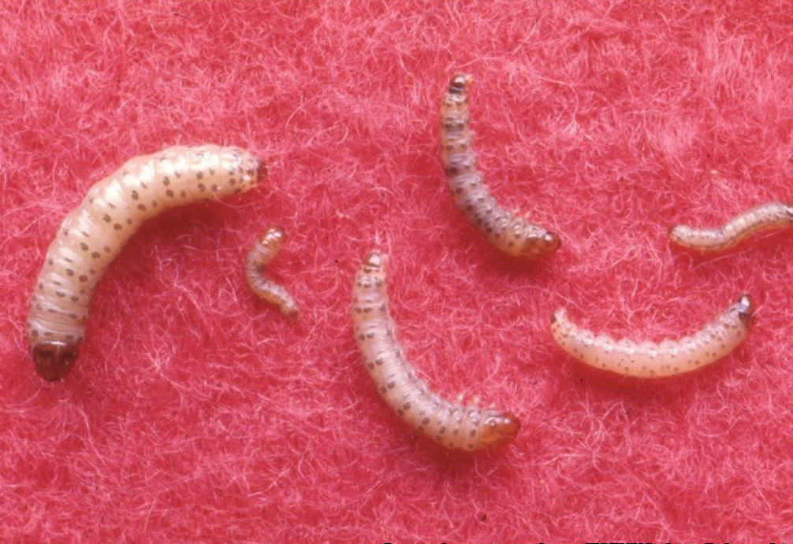
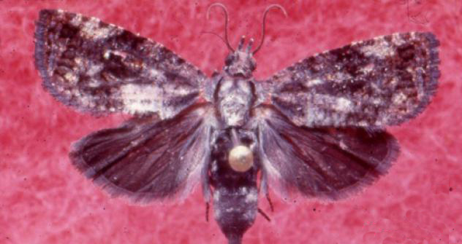
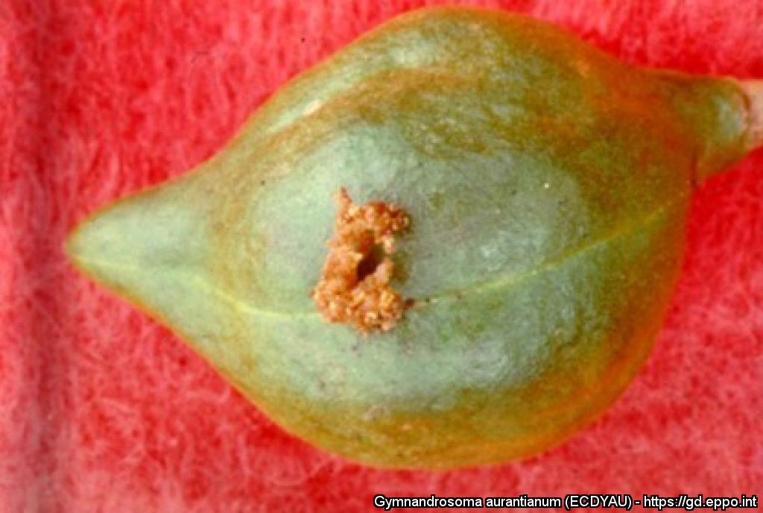
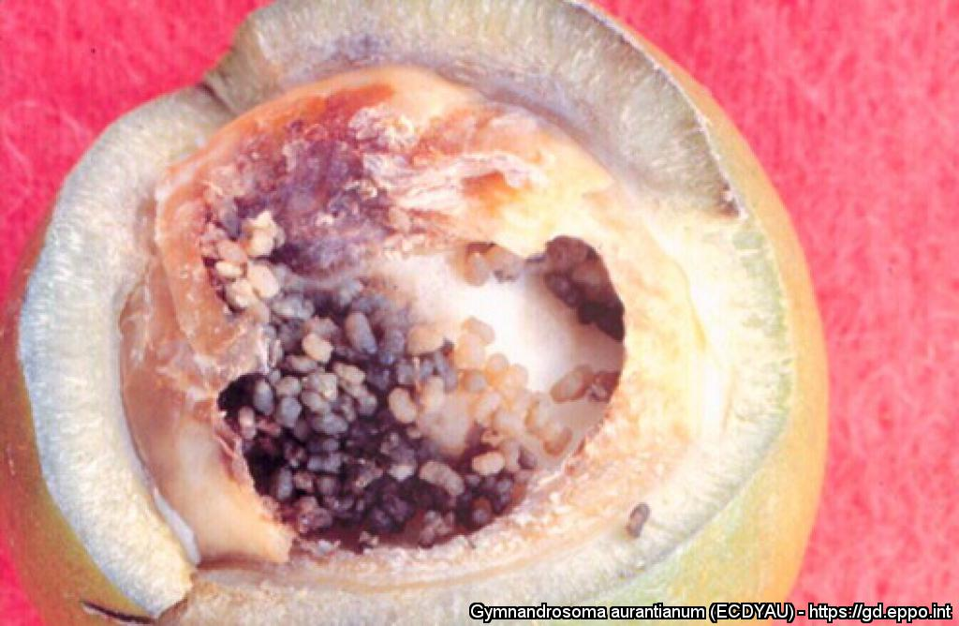

^{BE AWARE!}
^{Gymnandrosoma aurantianum}
A threat to citrus and other fruit crops
Various larval stages and adult female. All pictures were kindly provided by: H. Blanco Metzler (Universidad de Costa Rica).
EPPO Global Database, https://gd.eppo.int
What is it?
Gymnandrosoma aurantianum (Lepidoptera: Tortricidae) is a pest of citrus and other fruit crops such as avocado, loquat, macadamia, peach, pomegranate. It occurs in Central America, South America and the Caribbean. It is absent from the EPPO region, but it has been intercepted on several occasions on orange fruit imported from South America. Considering the damage that G. aurantianum could inflict to citrus and other host fruit crops, it is important to prevent the introduction and establishment of this pest in our region.
Damage
Damage is caused by larvae feeding inside fruit. Attacked fruit are also prone to secondary infections (e.g. fungi, bacteria). As a result, fruit are unusable for fresh consumption and industrial processing.
Oviposition site on macadamia nut.
Damage on macadamia nut.
Contact us!
Your contact details, logos, links, QR codes …
Learn more about Gymnandrosoma aurantianum: www.your.website
This poster has been prepared in collaboration with EPPO (www.eppo.int)

