Slide 1
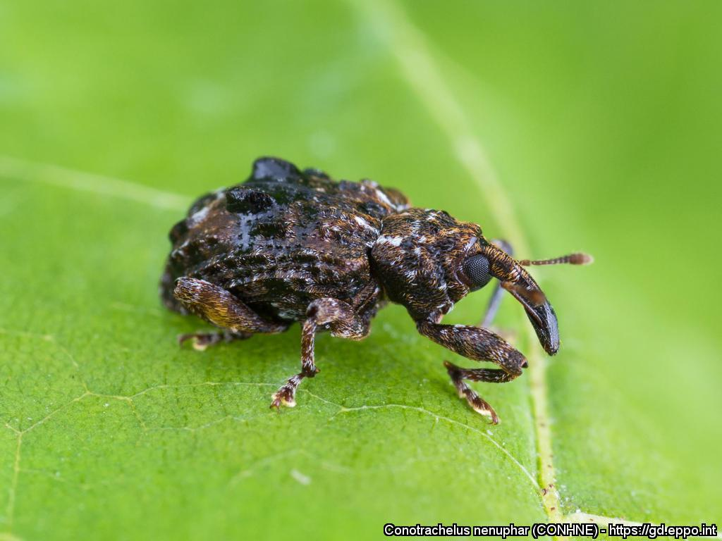
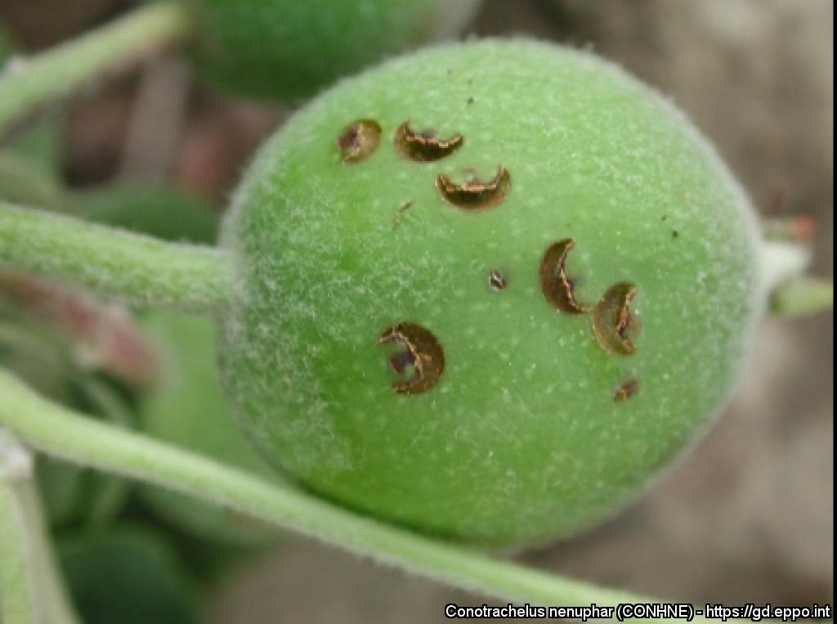
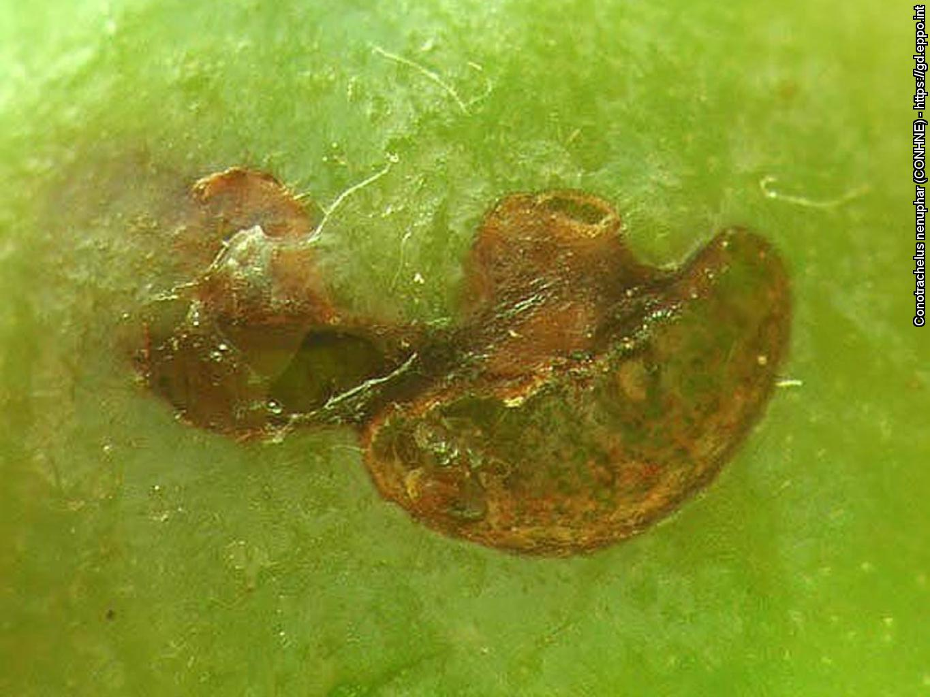
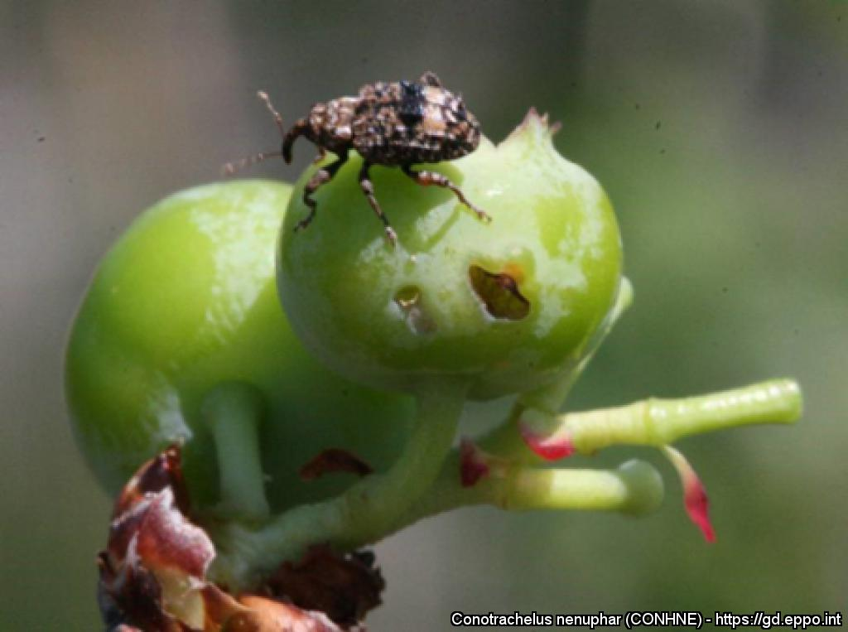
^{BE AWARE!}
^{Conotrachelus nenuphar}
^{A threat to fruit crops}
Plum weevil. Courtesy: Laboratoire d'expertise et de diagnostic en phytoprotection – MAPAQ (CA). EPPO Global Database, https://gd.eppo.int
What is it?
Conotrachelus nenuphar is a weevil native to North America which does not occur in the EPPO region. It is a pest of stone and pome fruits (apples, cherries, pears, peaches, plums), as well as of blueberries. Damage is caused by adults feeding on fruit. In North America, control programmes are necessary to protect fruit crops against C. nenuphar. It is important to avoid the introduction and establishment of this pest in our region.
Damage
Damage on apple
Courtesy: Peter Jentsch. EPPO Global Database. https://gd.eppo.int
Damage on apple (close-up)
Courtesy: Laboratoire d'expertise et de diagnostic en phytoprotection – MAPAQ (CA). EPPO Global Database. https://gd.eppo.int
Damage on blueberry
Courtesy: Dean Polk. EPPO Global Database. https://gd.eppo.int
Contact us!
Your contact details, logos, links, QR codes …
Learn more about Conotrachelus nenuphar: www.your.website
This poster has been prepared in collaboration with EPPO (www.eppo.int)

