Slide 1
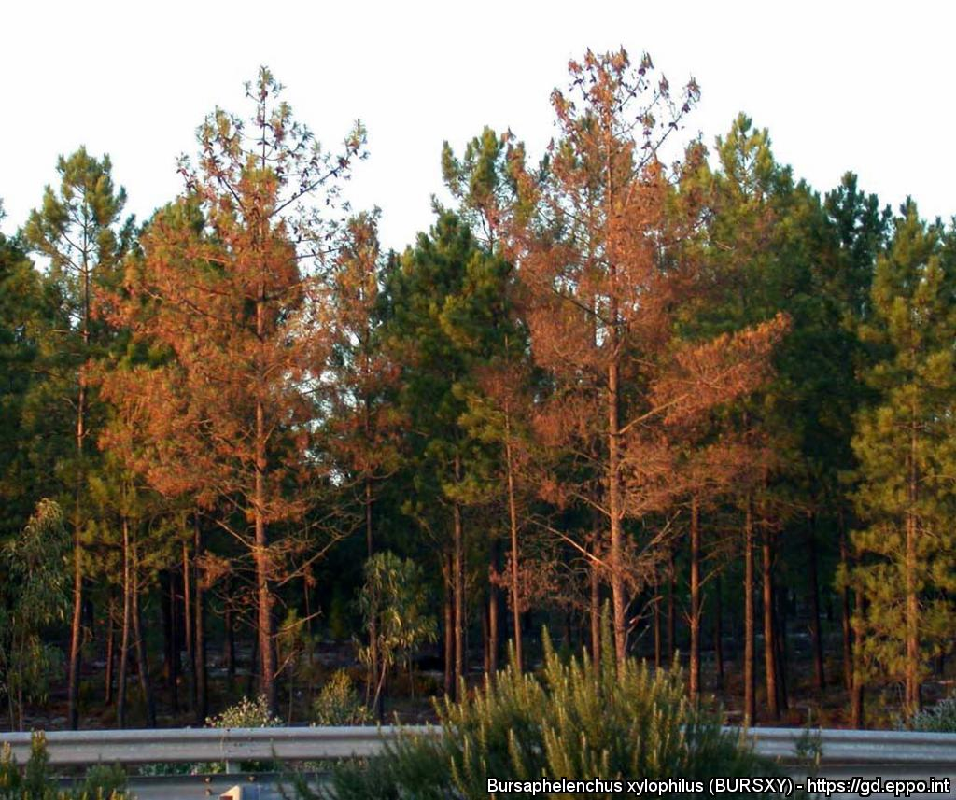
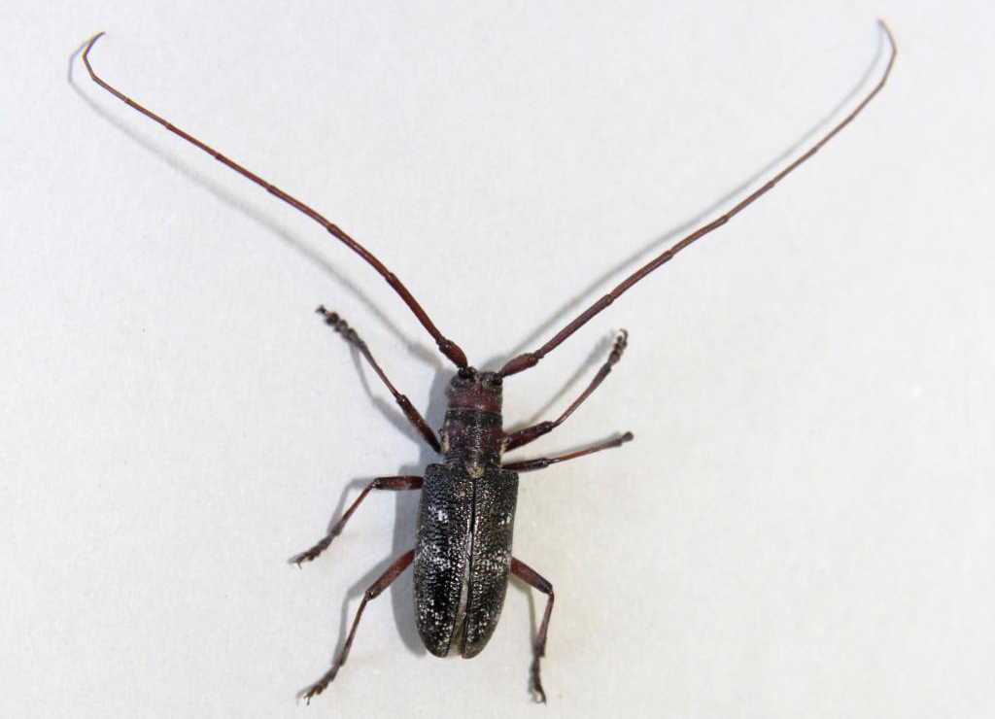
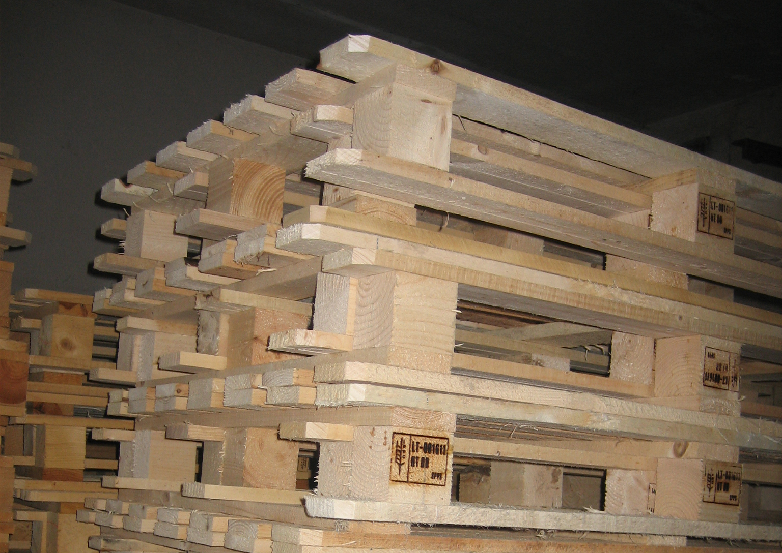


^{CAN YOU HELP US?}
^{Pine wilt disease}
^{A threat to pine trees}
Wilting pine trees. Courtesy: Manuel Manuel Galvão de Melo e Mota (Universidade de Evora, PT).
What is it?
Pine wilt disease is caused by a nematode, Bursaphelenchus xylophilus, and is transmitted by insect vectors (Monochamus spp.) from tree to tree. This nematode, probably originating from North America, has been introduced into parts of Asia and Europe (Portugal and small areas in Spain) where it causes severe damage and tree mortality. As B. xylophilus is a serious threat to pine trees grown for forestry or amenity purposes, it is important to prevent any further spread.
Insect vectors and pathways
In Europe, Bursaphelenchus xylophilus is transmitted by Monochamus galloprovincialis.
In trade, B. xylophilus can be moved in wood and wood products, including wood packaging material.
Adult Monochamus galloprovincialis. Courtesy: Pedro Naves, National Institute for Agrarian & Veterinary Research, Oeiras. https://gd.eppo.int
Wood pallets. EPPO Gallery. http://photos.eppo.int/
Contact us!
Your contact details, logos, links, QR codes …
Learn more about pine wilt disease: www.your.website
This poster has been prepared in collaboration with EPPO (www.eppo.int)

