Slide 1

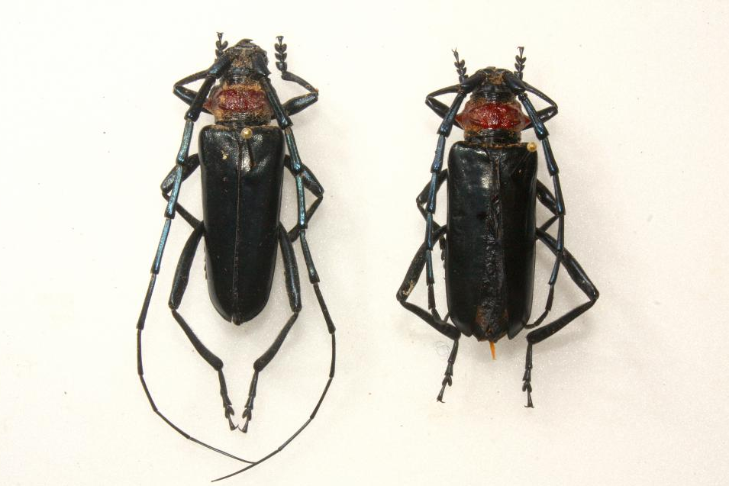
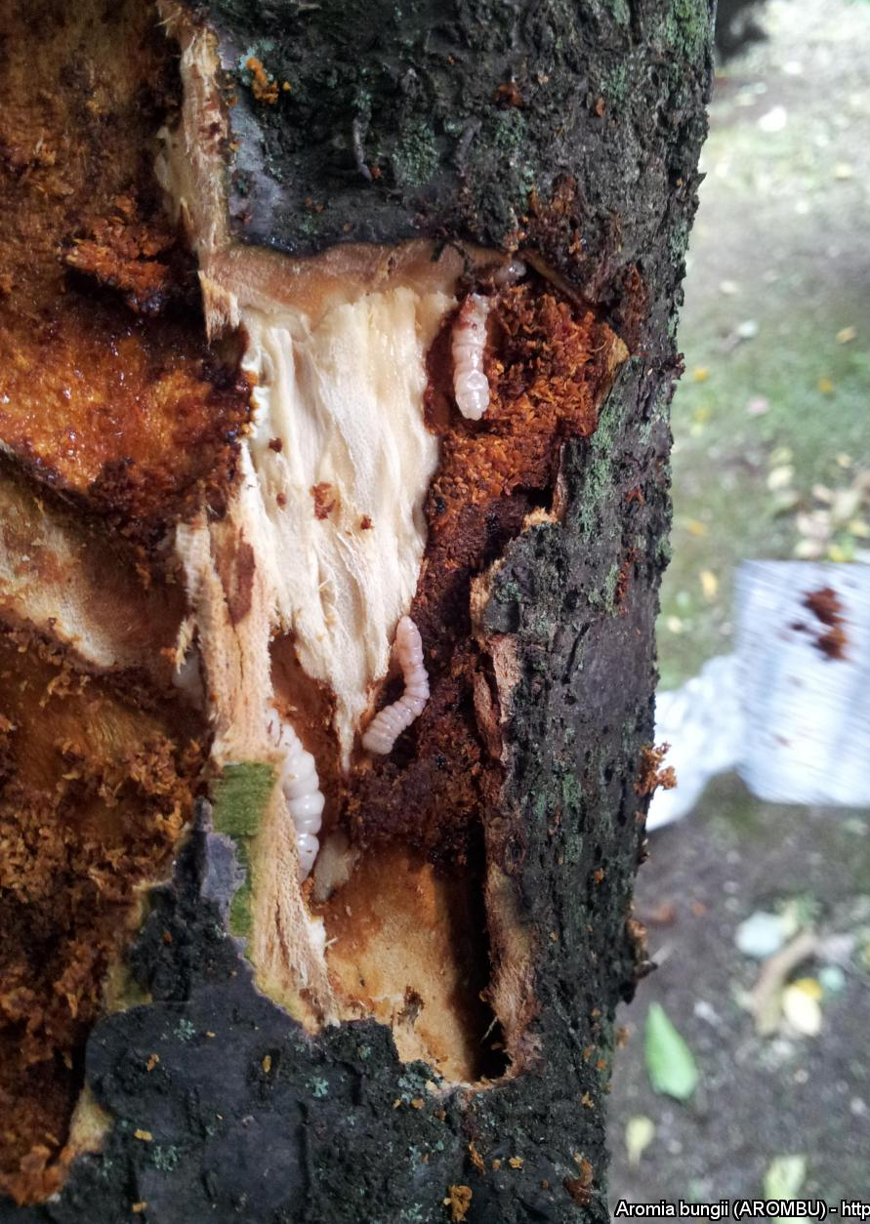
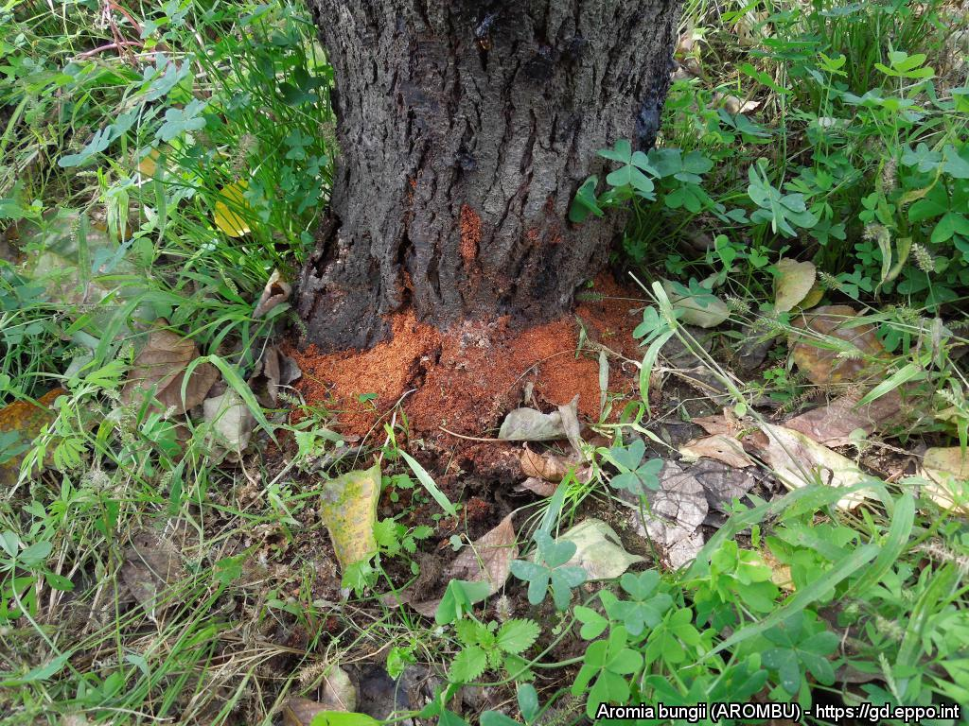


^{HELP US STOP THIS PEST!}
^{Aromia bungii}
^{A threat to stone fruits}
Adult = 22 – 38 mm long.
All images on this poster: Courtesy M. Maspero. EPPO Global Database, https://gd.eppo.int
What is it?
The peach borer, Aromia bungii, is a longhorn beetle. It is a major pest of peach and apricot, as well as plums and cherry in Asia. It was introduced into Italy (Campania) and Germany (Bavaria) and containment and eradication measures are being applied. Larvae develop in the trunk and branches and may be transported with plants for planting or wood.
Damage
Larvae feed inside Prunus trees, affecting tree growth and fruit production, killing branches and eventually the entire tree.
Reddish frass (looking like sawdust) may be observed at the base of the trunk.
Contact us !
All images on this poster: Courtesy M. Maspero.
EPPO Global Database, https://gd.eppo.int
Contact us!
Your contact details, logos, links, QR codes …
^{Learn more about} Aromia bungii : www.your.website
This poster has been prepared in collaboration with EPPO (www.eppo.int)

