Slide 1
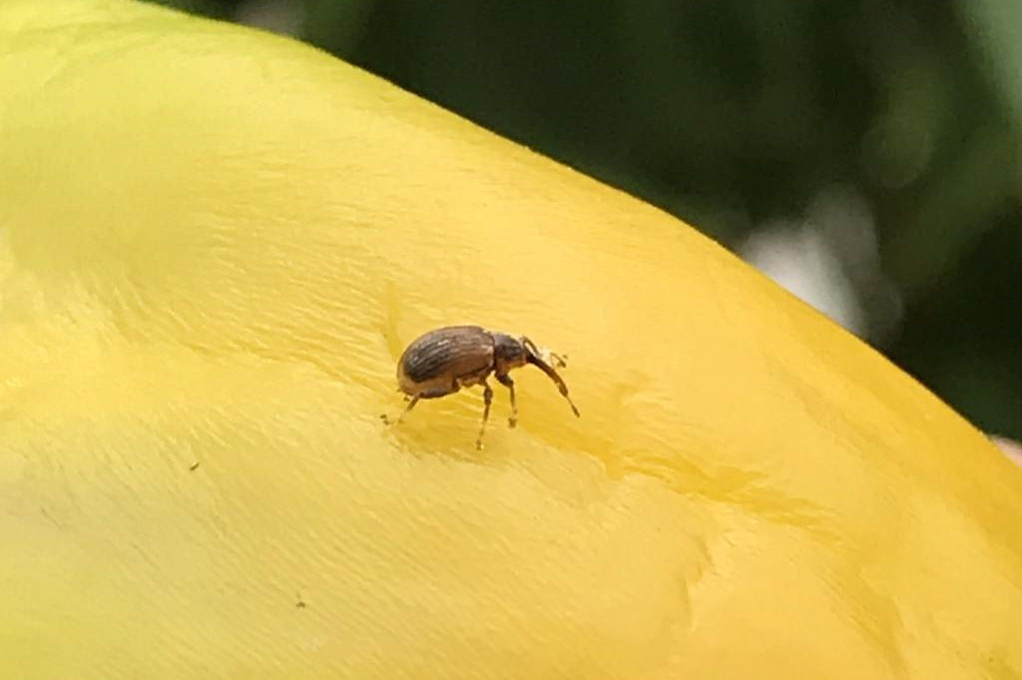
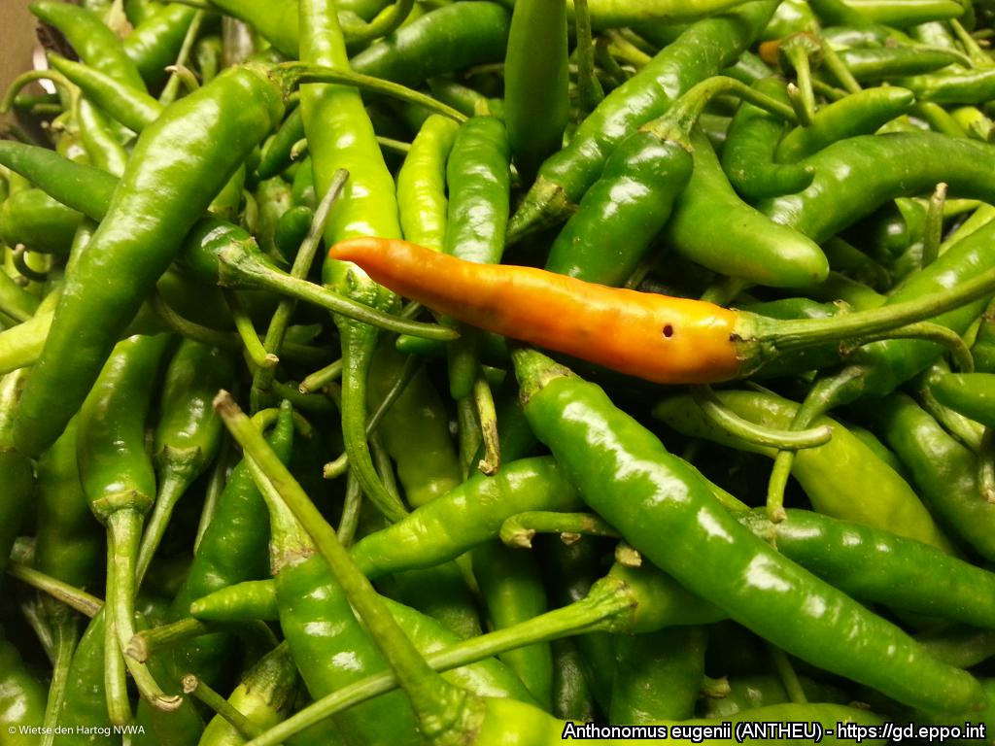
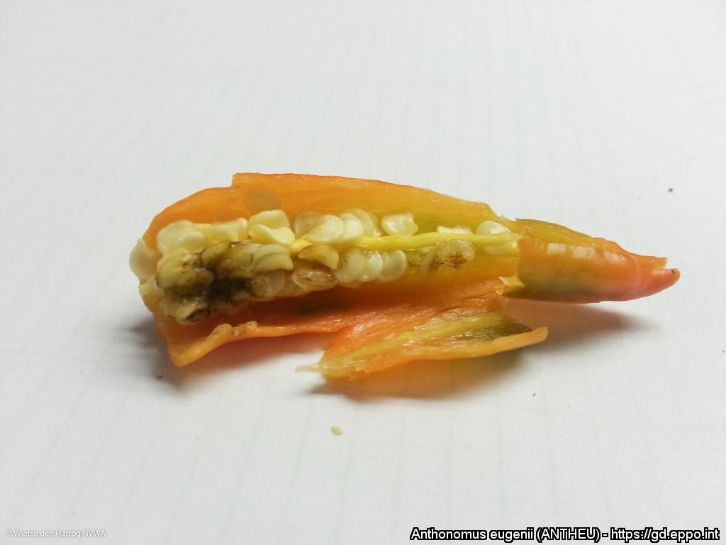
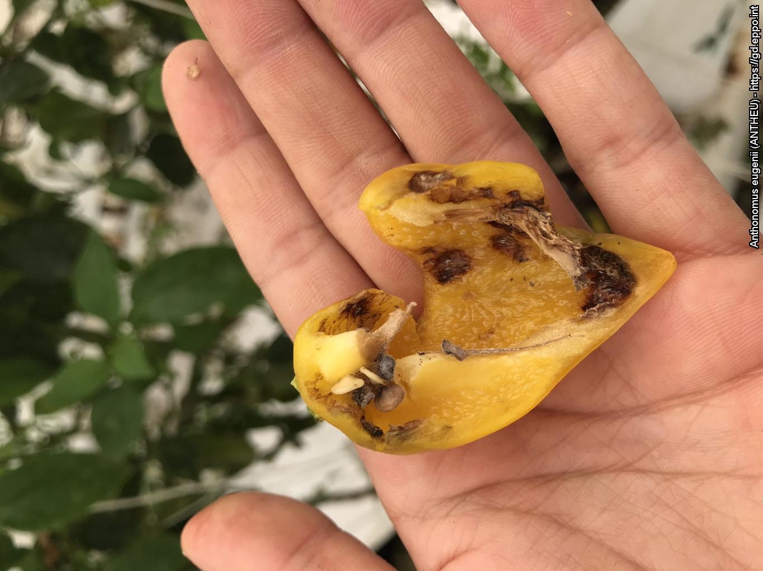
^{HELP US STOP THIS PEST!}
^{Anthonomus eugenii}
^{A threat to capsicums}
Adult pepper weevil. Courtesy: Laura Martinez. EPPO Global Database, https://gd.eppo.int
What is it?
Anthonomus eugenii is a weevil which attacks capsicum fruit (both hot and sweet peppers). Adults enter fruit and their feeding activity causes internal fruit damage. A. eugenii is native to Mexico and has spread to other parts of the Americas and the Caribbean. In the EPPO region, isolated outbreaks have been reported in glasshouse crops but were successfully eradicated. This pest is occasionally intercepted on imported capsicum fruit. It is important to prevent the introduction and establishment of A. eugenii in our region.
Damage
Damage: exit hole
Courtesy: W. den Hartog NVWA (NPPO the Netherlands). EPPO Global Database. https://gd.eppo.int
Internal fruit damage
Courtesy: W. den Hartog NVWA (NPPO the Netherlands). EPPO Global Database. https://gd.eppo.int
Internal fruit damage
Courtesy: Laura Martinez. EPPO Global Database. https://gd.eppo.int
Contact us !
Contact us!
Your contact details, logos, links, QR codes …
^{Learn more about} Anthonomus eugenii: www.your.website
This poster has been prepared in collaboration with EPPO (www.eppo.int)

