Slide 1
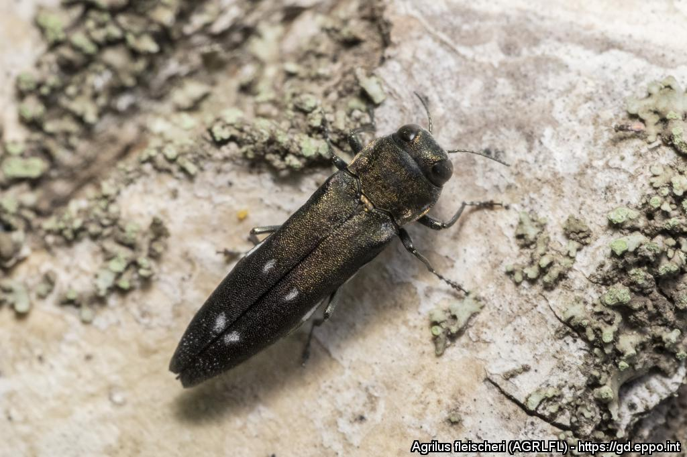
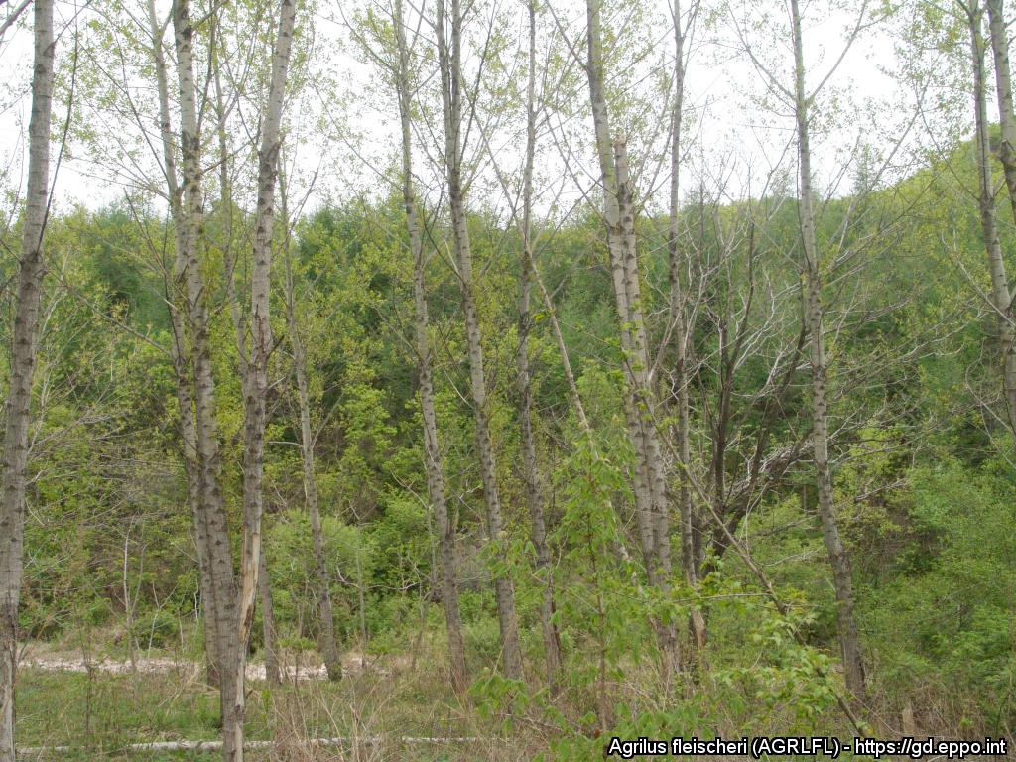
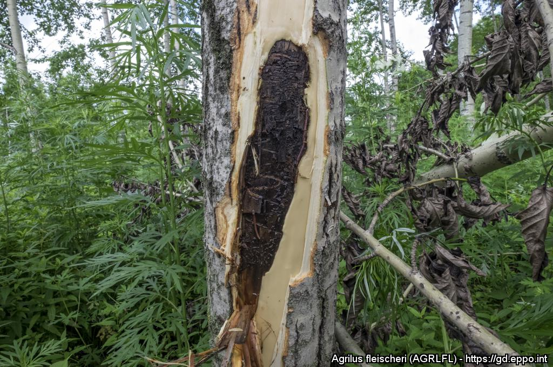
^{CAN YOU HELP US?}
^{Agrilus fleischeri}
A threat to poplars and willows
Image: E. Jendek. EPPO Global Database, https://gd.eppo.int Adult = 8 – 12 mm long
What is it?
Agrilus fleischeri (Coleoptera: Buprestidae) is an Asian pest of poplars and willows, which has caused some tree mortality on Lombardy poplar (Populus nigra var. italica) plantations in parts of China. It is not yet present in the European and Mediterranean region but could pose a threat to forestry where the host plants are grown. As this species is morphologically and biologically very similar to Agrilus ater, a common native pest on poplars and willows in Europe, distinguishing A. fleischeri from A. ater should be done by experts.
Damage
Be aware of unusual tree mortality and dieback associated with tortuous larval galleries in the wood and D-shaped exit holes on poplar and willows.
After
Image: S. Cecchini. EPPO Global Database,
https://gd.eppo.int – ‘D-shape exit holes’.
Image: Z. Kai. EPPO Global Database,
https://gd.eppo.int – ‘Dieback in infested plot’.
Image: E. Jendek. EPPO Global Database,
https://gd.eppo.int – ‘galleries (bark removed)’.
Contact us !
Contact us!
Your contact details, logos, links, QR codes …
^{Learn more about} Agrilus fleischeri: www.your.website
This poster has been prepared in collaboration with EPPO (www.eppo.int)

