Slide 1
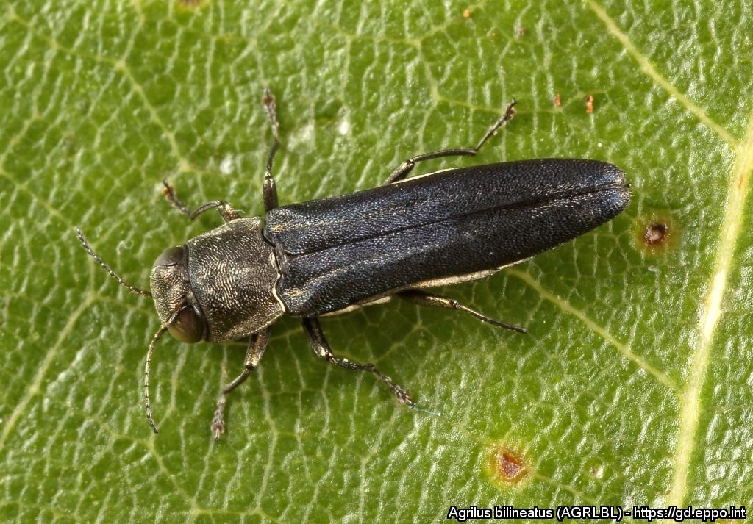
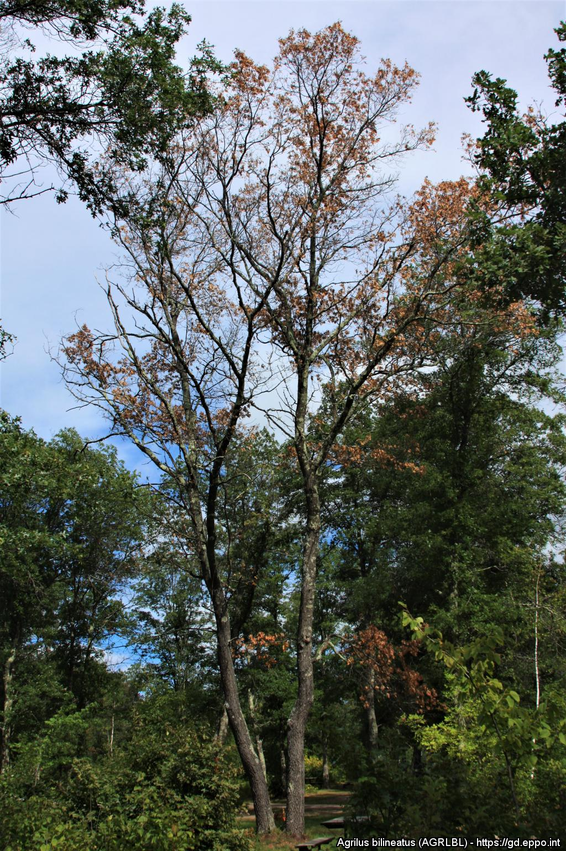
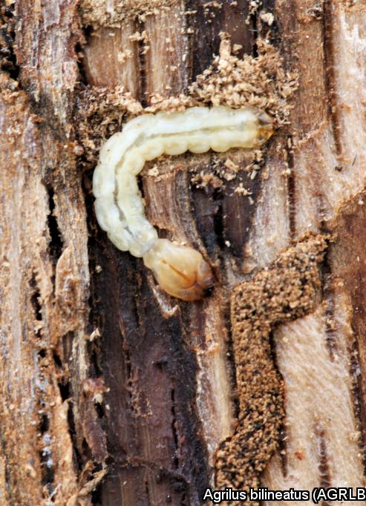
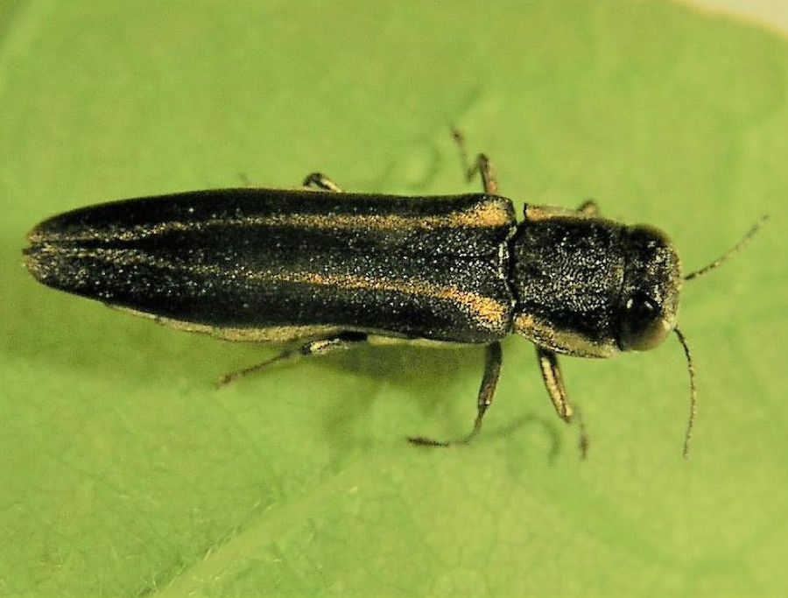


^{BE AWARE!}
^{Agrilus bilineatus}
A threat to oak and chestnut trees
Image: E. Jendek. EPPO Global Database, https://gd.eppo.int
What is it?
The two-lined chestnut borer (Agrilus bilineatus - Coleoptera: Buprestidae) originates from eastern North America where it is generally a secondary pest infesting and killing oak and chestnut trees weakened by various stress events. This pest, which has been introduced into Turkey, could become a devastating pest in the EPPO region given the importance of oak and chestnut trees in our forests.
How to recognize it?
Signs of infestation include
tortuous larval galleries in the wood as well as dieback and death of trees
The yellow stripes along the thorax and elytron are not present on any other Agrilus species colonizing oaks in Europe
Adult: 5 – 13 mm long
Photos: S. A. Katovich (USA). EPPO Global Database,
https://gd.eppo.int
Photo: D. L. Miller (USA). EPPO Global Database. https://gd.eppo.int
Contact us!
Your contact details, logos, links, QR codes …
Learn more about the two-lined chestnut borer: www.your.website
This poster has been prepared in collaboration with EPPO (www.eppo.int)

