Slide 1
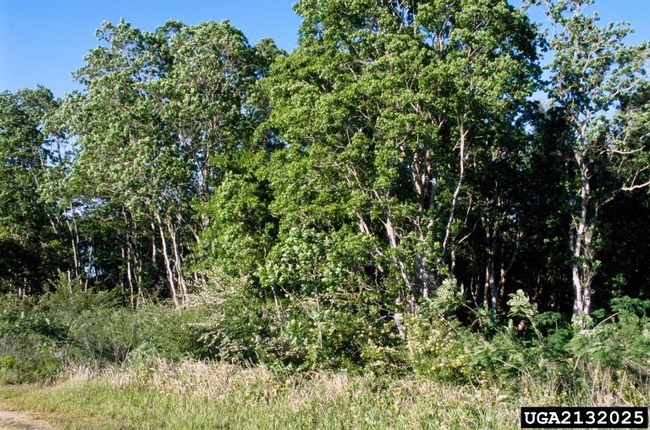
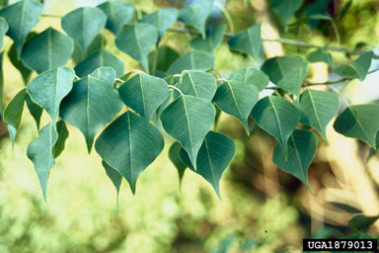
BE AWARE!
Triadica sebifera
A threat to the EPPO region
How to recognize it? Can you help us?
A deciduous tree 20 to 30 meters tall. Low-spreading and multi-forked to tall and columnar. Stem often crooked and gnarled. Bark is grey, brown, and rough. Exudes a milky sap. Twigs slender. Petioles 2-6 cm long, with 2 sessile disc-shaped glands at the apex. Leaf-blades broadly rhombic-ovate, 2-7.5 x 1.5-7 cm, abruptly acutely acuminate, broadly cuneate to rounded, subtruncate at the base, entire, lateral nerves 7-12 pairs, glaucous beneath. Stipules 1-2 mm long, obtuse. T. sebifera flowers from April to June, producing both male and female flowers. Fruits are 1 cm three-lobed capsules expected to mature in the autumn.
Because Triadica sebifera has the potential to impact the habitats it invades, including native plant species and important ecosystem services, it is important to report any sightings to plant protection authorities. Early detection will allow a rapid implementation of appropriate measures against Triadica sebifera.
If you see Triadica sebifera:
Check the identification of the species with other tree species.
Whenever possible, take a picture of the plant, record exact location, date and habitat where it was observed.
Contact us.
Image: Chris Evans, University of Illinois, Bugwood.org
Contact us
Your contact details
Your institution name
Logo
Image: Cheryl McCormick, University of Florida, Bugwood.org
This leaflet has been prepared within the LIFE funded project LIFE15 PRE FR 001 in collaboration with the NERC Centre for Ecology and Hydrology
Prepared in collaboration with EPPO – www.eppo.int

Slide 2
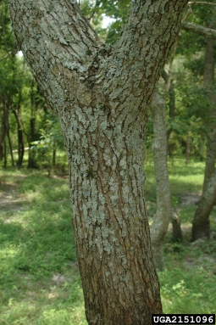
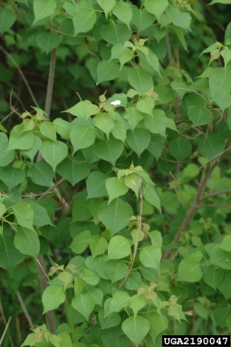
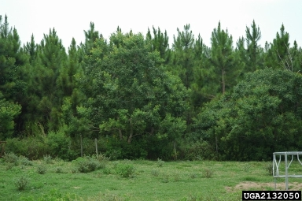
What is T. sebifera? What is the problem? Where is it found?
Triadica sebifera is a deciduous medium sized tree species which is native to Asia.
As Triadica sebifera is considered to be a threat to native biodiversity, its appearance in the natural environment should be reported immediately to us.
T. sebifera has a long history of deliberate planting within the EPPO region. Seeds can be bought on the internet and shipped nearly anywhere in the EPPO region.
In the USA, T. sebifera displaces native plant species and establishes dominant stands and can transform areas of prairie and grassland to woody thickets within ten years. T. sebifera can decrease water quality. The species can also displace native species reducing genetic resources. When leaf material becomes incorporated into the water body, this has shown to be toxic to amphibians.
The species is a major invasive species in the Southern States in the US, and presently, the species is absent from the natural environment in the EPPO region.
In North America, T. sebifera has a wide environmental tolerance and can thrive in many different habitats including forests, wetlands, grasslands, coastal prairie, mesic sites, disturbed sites, low-lying fields, swamp, and scrubby flatlands.
Image: Chris Evans, University of Illinois, Bugwood.org
Image: David J. Moorhead, University of Georgia, Bugwood.org
Image: Chris Evans, University of Illinois, Bugwood.org

