Slide 1
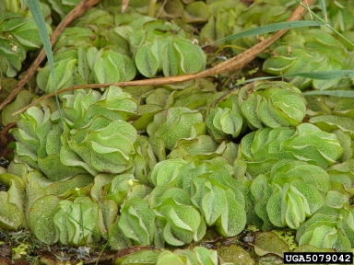
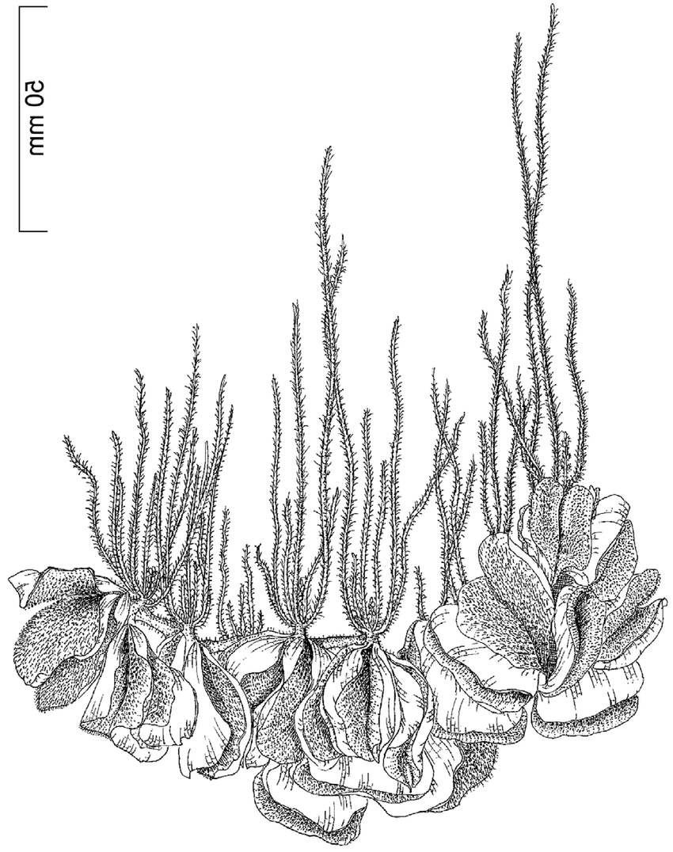



BE AWARE!
Salvinia molesta
A threat to waterways in the EPPO region
How to recognize it? Can you help us?
Salvinia molesta is a free-floating fern. The three growth stages (primary, secondary and tertiary), may make identification of the species difficult. The small-leafed primary stage is typical of plants invading open water. The secondary form is slightly larger with leaves slightly folded, and the tertiary stage is typical of mature stands with larger deeply folded and densely packed leaves. The species’ fronds are positioned in whorls of three along a rhizome, with individual plants growing up to 30 cm.
Because Salvinia molesta has the potential to seriously impact the habitats it invades, including native plant species, associated insects and important ecosystem services, it is important to report any sightings to plant protection authorities. Early detection will allow a rapid implementation of appropriate measures against Salvinia molesta .
If you see Salvinia molesta :
Check the identification of the species with other aquatic native plants.
Whenever possible, take a picture of the plant, record exact location, date and habitat where it was observed.
Contact us.
Contact us
Image: Robert Vidéki, Doronicum Kft., Bugwood.org
Your contact details
Your institution name
Logo
This leaflet has been prepared within the LIFE funded project LIFE15 PRE FR 001 in collaboration with the NERC Centre for Ecology and Hydrology
Prepared in collaboration
with EPPO – www.eppo.int

Slide 2
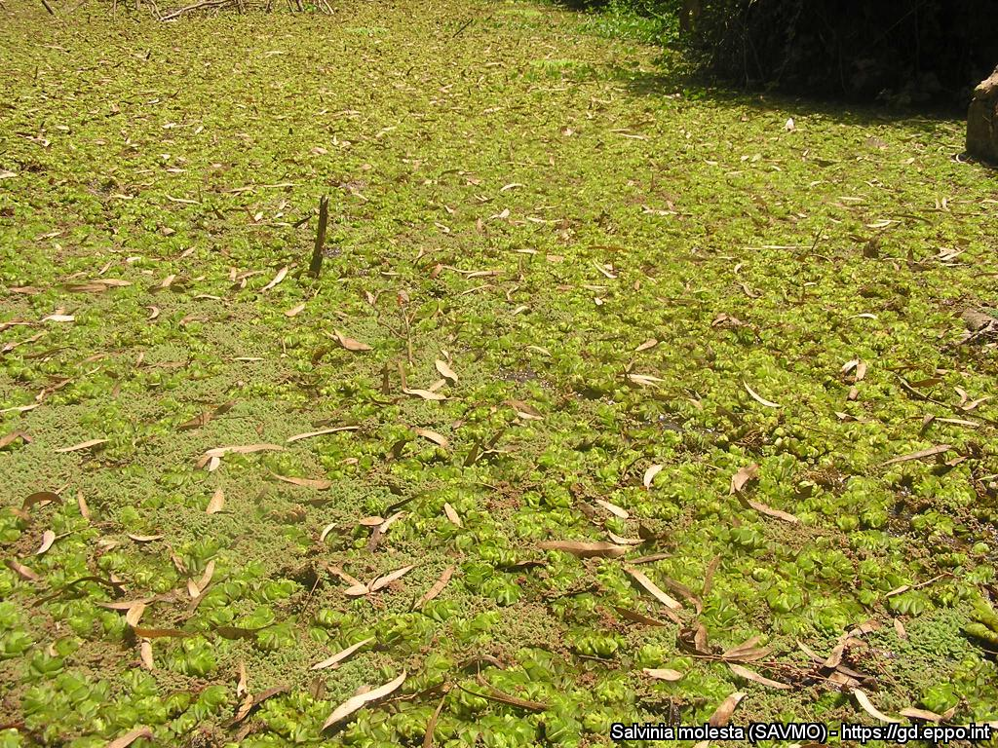
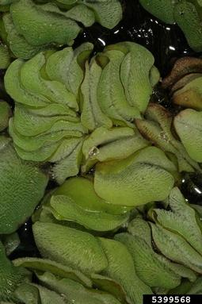
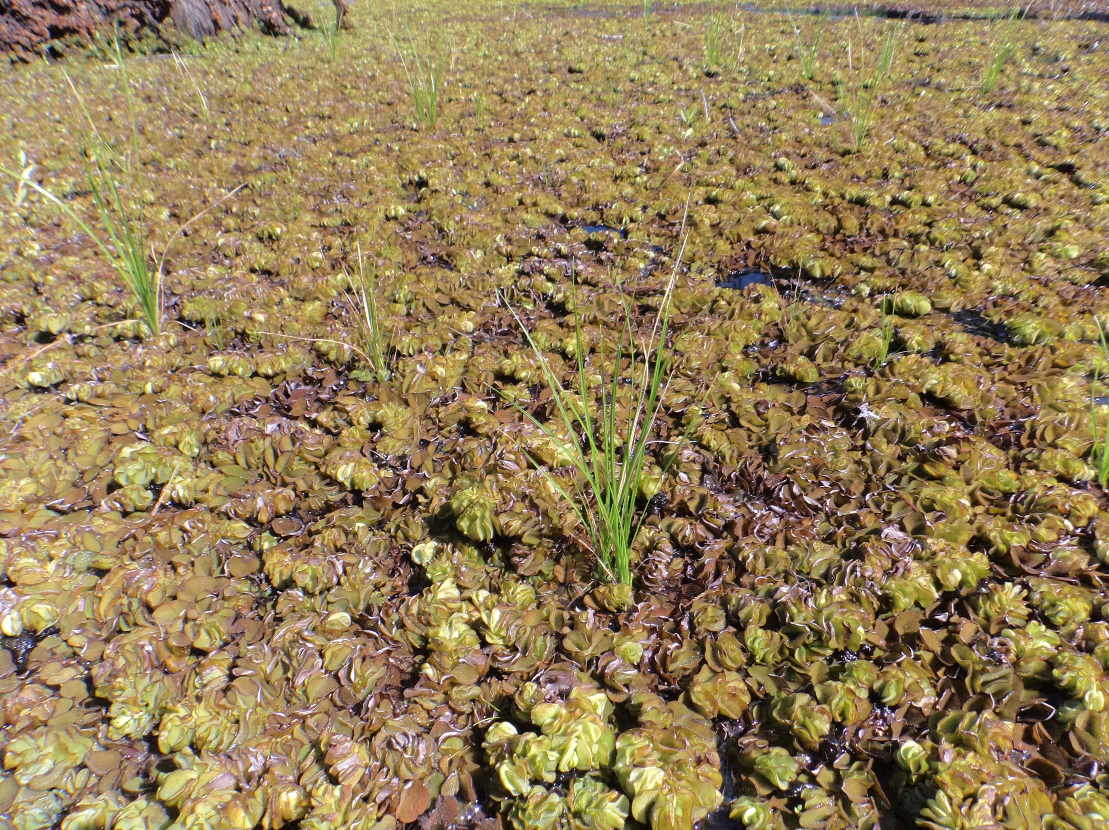
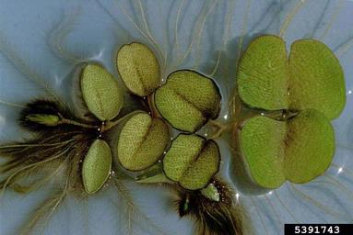
What is Salvinia molesta? What is the problem? Where is it found?
Mats of S. molesta can cause similar problems to those caused by excessive growth of other floating plants; for example, they can reduce access to the water for recreation; interfere with various engineering structures such as weirs, floodgates or locks; block drains and cause flooding; stop livestock reaching water; prevent photosynthesis in the water below the mat; degrade water; have negative impacts on native animals and plants more generally by significantly altering aquatic ecosystems; reduce the aesthetic appeal of water bodies; and favour the spread of certain diseases spread by mosquitos and snails.
Salvinia molesta is most often found in stagnant or slow-flowing waters such as lakes, slow-flowing rivers or streams, wetlands, rice paddies, irrigation channels, ditches, ponds and canals.
In the EPPO region, S. molesta has been found in Austria, Belgium, France (Corsica), Germany, Italy, Israel, the Netherlands and Portugal, but it is not clear if reports represent established populations.
Image: Jean-Marc Dufour-Dror, EPPO Global Database
Salvinia molesta is a perennial floating aquatic fern, native to South America and is an EPPO A2 pest, recommended for regulation as a quarantine pest.
As Salvinia molesta is considered to be a serious threat to waterways, its appearance in new areas should be reported immediately to us.
Image: Barry Rice, sarracenia.com, Bugwood.org
Image: Robert Vidéki, Doronicum Kft., Bugwood.org
Image: Michel Netherland, US Army Engineer Research and Development Center

