Slide 1
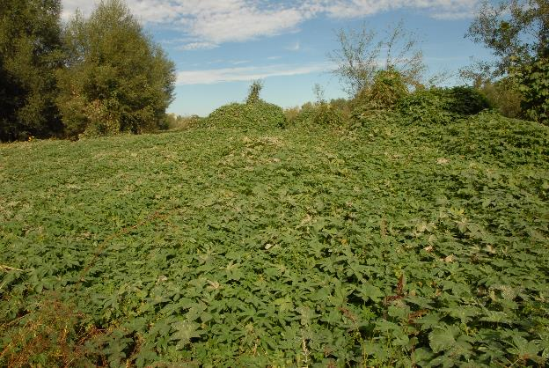
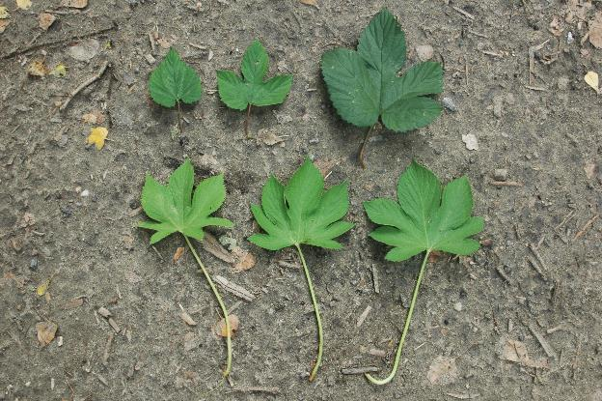
BE AWARE!
Humulus scandens
A threat to the EPPO region
How to recognize it? Can you help us?
Leaves are opposite, blades are light green, cordate, palmately lobed with 5-7(-9) lobes, 5-12 cm long with petioles longer than the blade. Inflorescences the male inflorescences form an erected branched panicle, 15-25 cm, flower anthers without glands, female inflorescences are ovoid cone-like spikes; bracteole ovate-orbiculate, 7-10 mm, pilose, margins densely ciliate-hairy.
Three 7-lobed leaves of H. scandens (below) compared to 1-4 lobed leaves of H. lupulus (above). See the petiole longer than the leaf for H. scandens and the lighter green colour of the leaves.
Because Humulus scandens has the potential to impact the habitats it invaded, including native plant species and important ecosystem services, it is important to report any sightings to plant protection authorities. Early detection will allow a rapid implementation of appropriate measures against Humulus scandens.
If you see Humulus scandens:
Check the identification of the species with other vine like species.
Whenever possible, take a picture of the plant, record exact location, date and habitat where it was observed.
Contact us.
Contact us
Your contact details
Your institution name
Logo
All images © Guillaume FRIED (Anses) © Guillaume FRIED (Anses)
This leaflet has been prepared within the LIFE funded project LIFE15 PRE FR 001 in collaboration with the NERC Centre for Ecology and Hydrology
Prepared in collaboration with EPPO – www.eppo.int

Slide 2
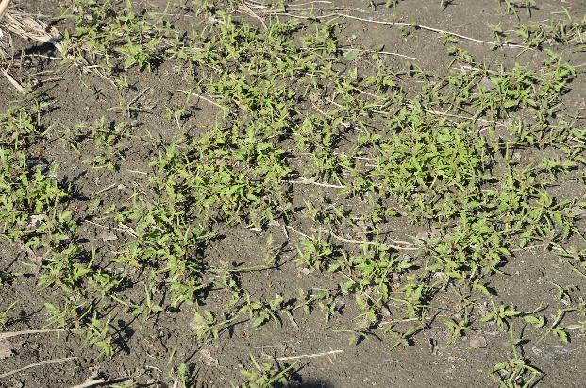
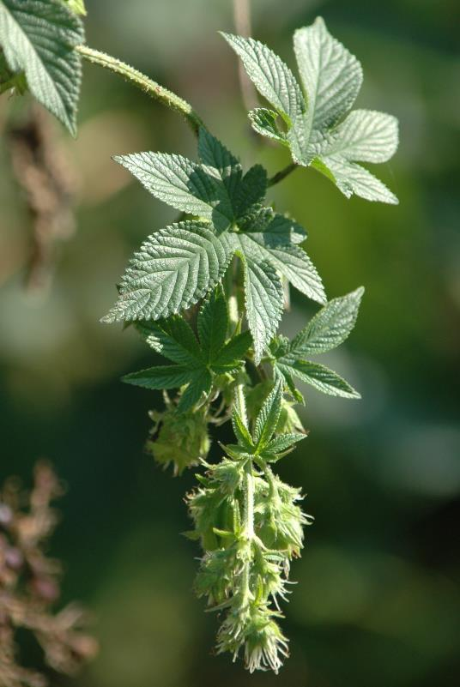
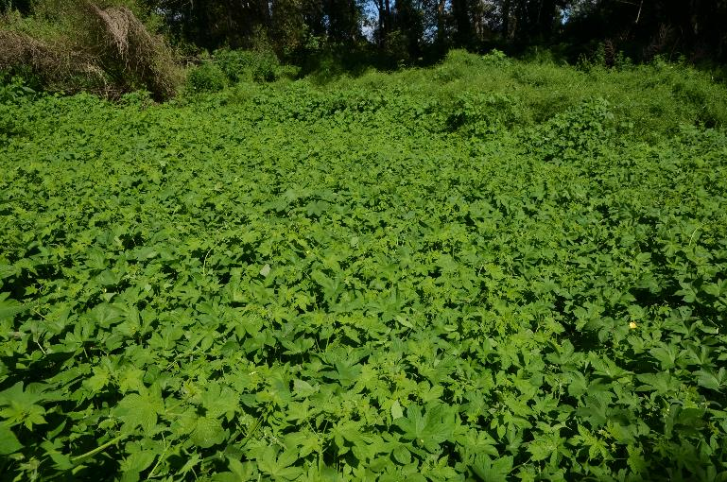
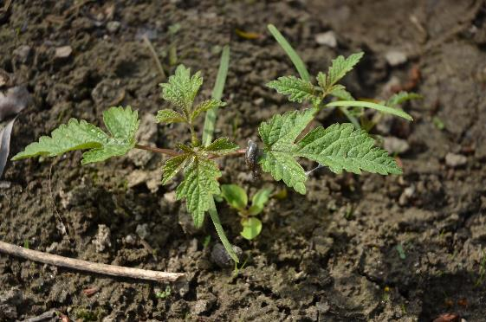
What is H. scandens? What is the problem? Where is it found?
The pathway plants for planting is considered the main entry pathway into the EPPO region. H. scandens has been introduced in Europe as an ornamental species for growing over trellises, arbours or fences. It can outcompete native species and is considered as a transformer species, that threatens plant communities. Dense mats of the species can persist along riverbanks for several years. Ecosystem functioning (for example, reduced species richness and decrease functional richness) is altered when the species invade riparian habitats.
The species is recorded in the EPPO region from Austria, Belgium, Czech Republic, France, Germany, Italy, Hungary, Romania, Serbia, Slovakia, Slovenia, Switzerland, Ukraine.
In both its native range and its introduced range, H. scandens is a plant of riverside, particularly on the loose, bare surfaces of alluvial bars formed by river and stream-sides by temporary floods. The plant can also invade ruderal areas under climates with no dry seasons.
Humulus scandens is a herbaceous annual vine native to Asia.
As Humulus scandens is considered to be a threat to native biodiversity, its appearance in new areas should be reported immediately to us.

