Slide 1
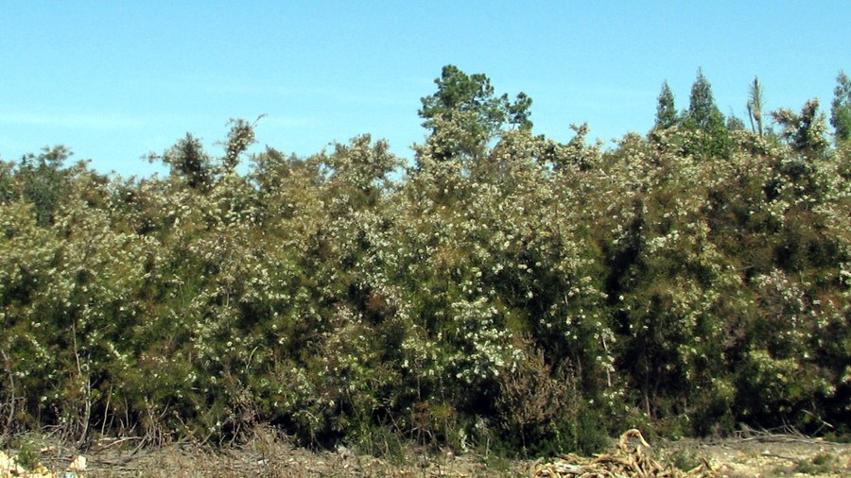
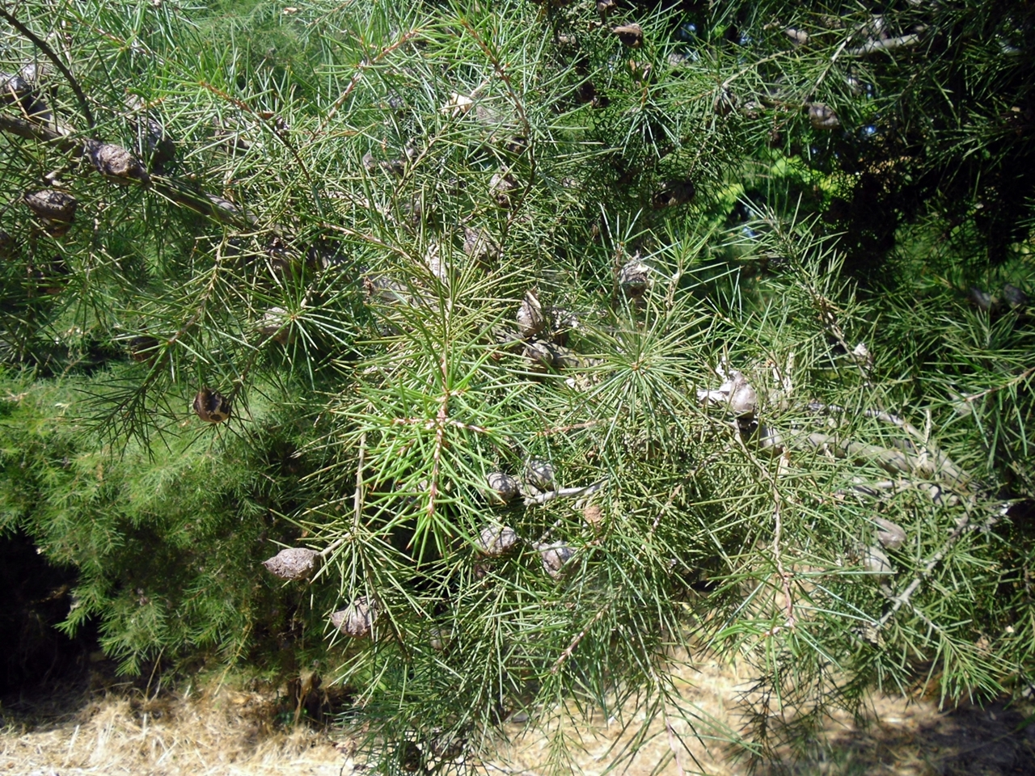
BE AWARE!
Hakea sericea
A threat to the EPPO region
How to recognize it? Can you help us?
Hakea sericea is an erect, single-stemmed, woody shrub or small tree, 0.6-4.5 m in height, with somewhat angular stems. It has simple, needle-like leaves, which are terete (i.e. circular in cross section), spiny, and moderately appressed silky-hairy when young, but quickly becoming glabrous; these leaves are (1.3)2-4.3-(5.3) cm long and 0.7-1(1.1) mm wide, with a longitudinal groove on the lower side. The inflorescence is an axillary umbel, consisting of (1)4-5(6) cream-coloured flowers, each with a moderately to densely white-hairy pedicel (2.2-5.0 mm long). One to two woody follicles or fruits, sometimes also referred to as capsules, are formed in each axil; the fruits are (2)2.5-3(4) cm long and 2-2.5 cm in diameter.
Because Hakea sericea has the potential to impact the habitats it invades, including native plant species and important ecosystem services, it is important to report any sightings to plant protection authorities. Early detection will allow a rapid implementation of appropriate measures against Hakea sericea.
If you see Hakea sericea:
Check the identification of the species with other shrub like species.
Whenever possible, take a picture of the plant, record exact location, date and habitat where it was observed.
Contact us.
Contact us
Image: Elizabete Marchante, EPPO Global Database
Your contact details
Your institution name
Logo
Image: Elizabete Marchante, EPPO Global Database
This leaflet has been prepared within the LIFE funded project LIFE15 PRE FR 001 in collaboration with the NERC Centre for Ecology and Hydrology
Prepared in collaboration with EPPO – www.eppo.int

Slide 2
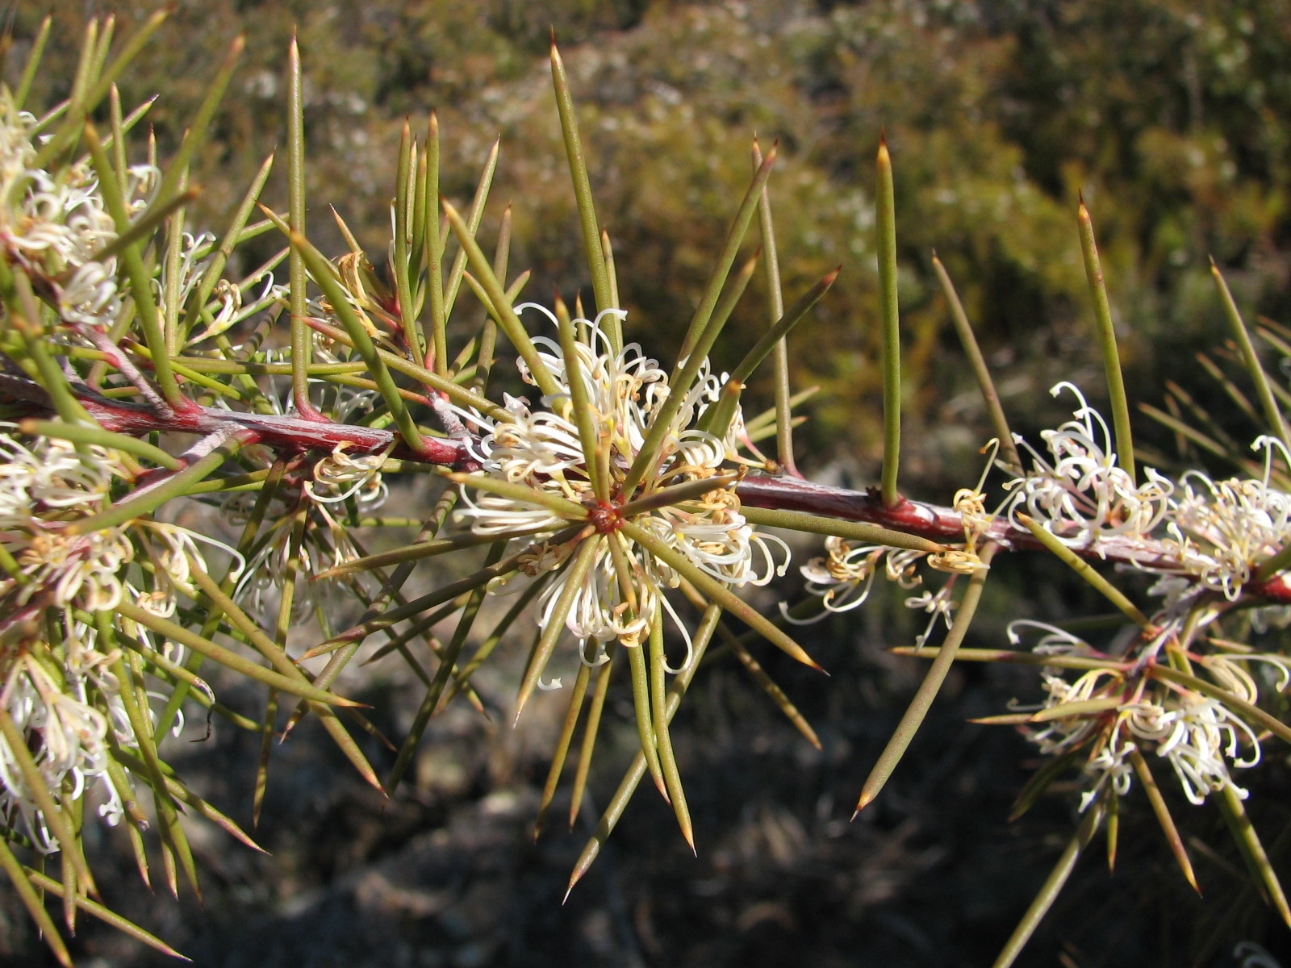
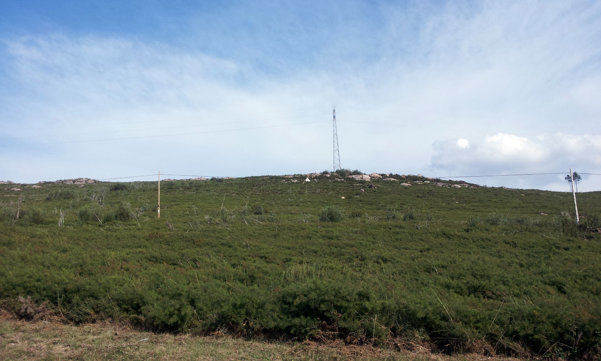
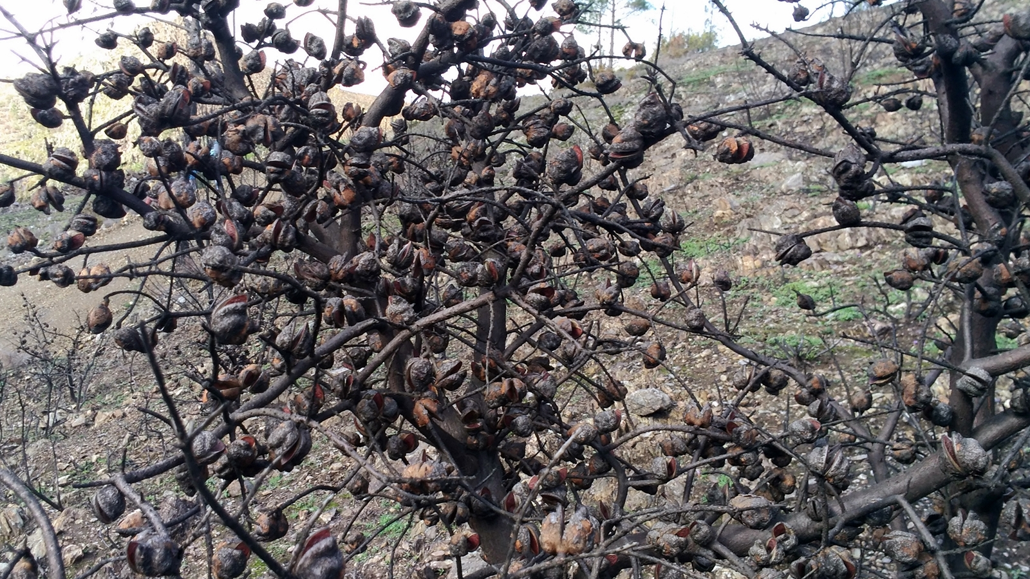
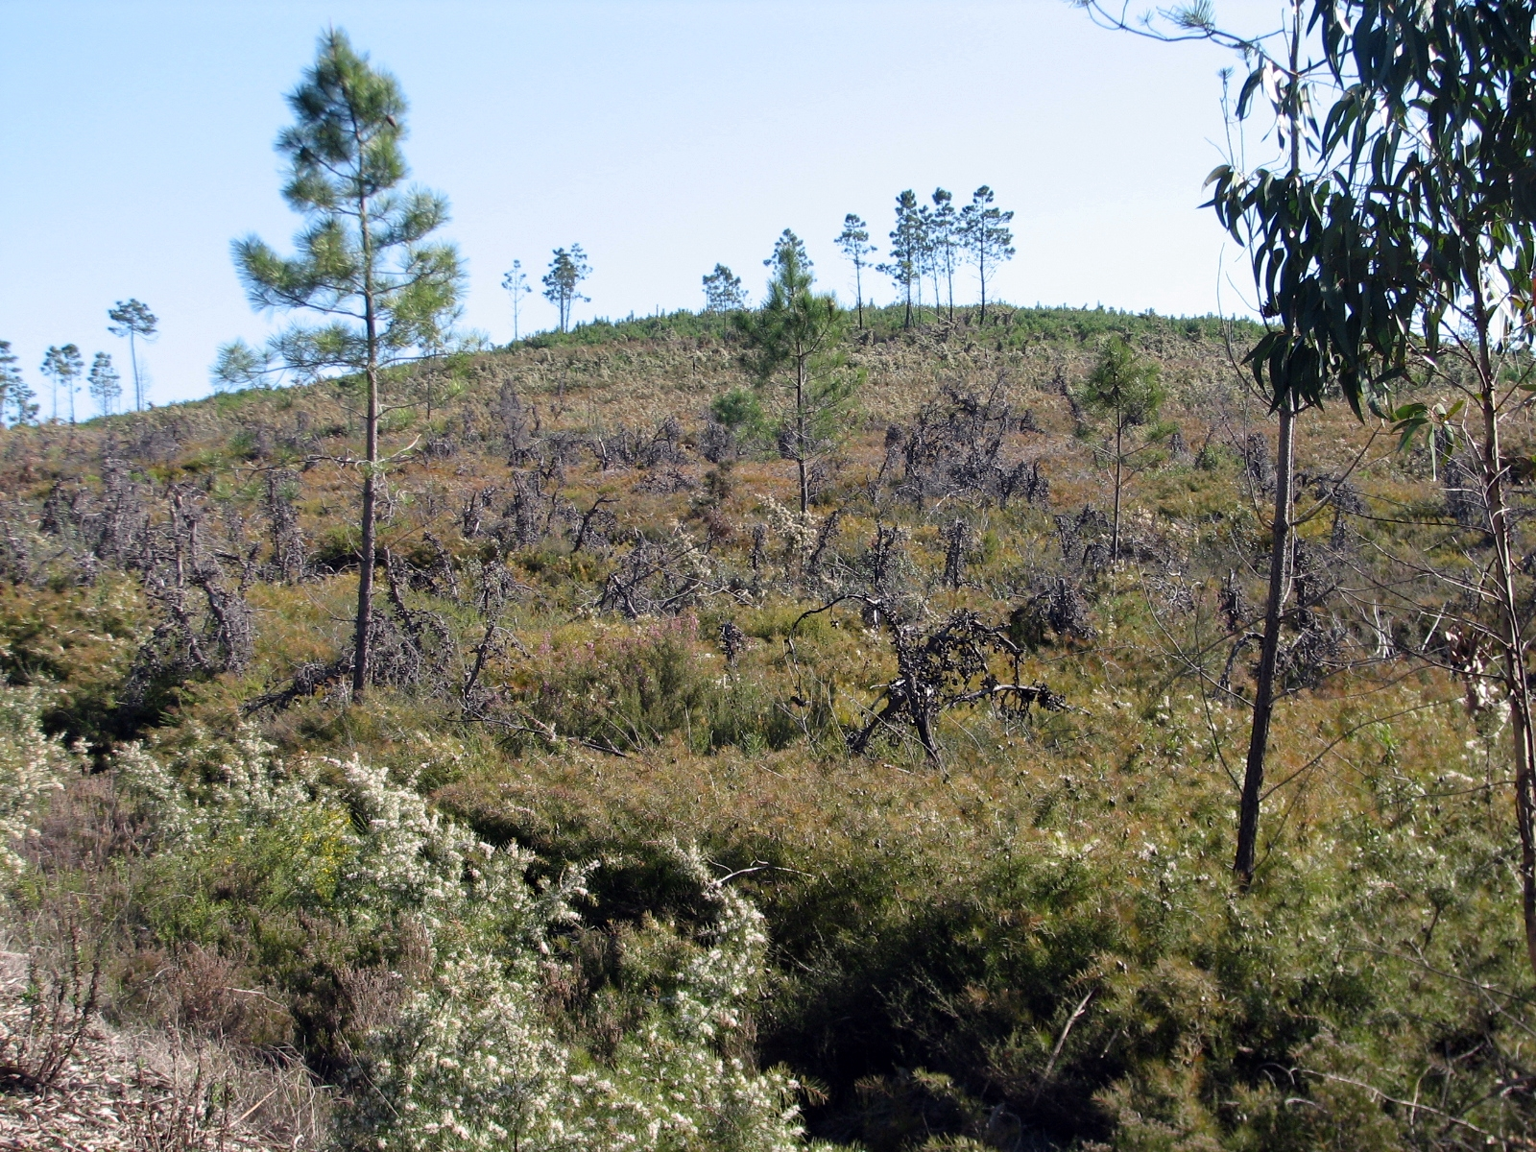
What is Hakea sericea? What is the problem? Where is it found?
In Portugal, H. sericea forms extensive dense monospecific stands which can exclude native plant species and/or change community composition, including associated fauna. Areas highly susceptible to invasion by H. sericea in the north of Portugal, are coincident with the distribution area of Succisa pinnatifida Lange, a rare endemic of the Iberian Peninsula. The high spread potential of the species acts to threaten and reduce the biodiversity of the Esterel Mountains in France, by eliminating less competitive native species of maquis and forest.
Thickets of H. sericea increase fire hazard, particularly fire intensity. Dense thickets of the plant are likely to restrict access for livestock, grazing, hunting and recreation in Mediterranean regions, thus having potential economic impact.
In the EPPO region, H. sericea is recorded from France, Madeira, Portugal and Spain.
In the EPPO region, disturbed areas (particularly road margins), forest margins, coastal grasslands and pine forest are all highlighted as additional habitats. Plants for planting has been the main pathway for entry into the EPPO region. The plant is known to be used as an ornamental and hedging species, and therefore could be imported as seeds or plants for this purpose.
Image: Elizabete Marchante, EPPO Global Database
Hakea sericea (EPPO List of invasive alien plants) is an evergreen shrub or small tree native to Australia.
As Hakea sericea is considered to be a threat to native biodiversity, its appearance in new areas should be reported immediately to us.
Image: Elizabete Marchante, EPPO Global Database
Fire is a key part of the life cycle of H. sericea, with the heat-resistant fruits accumulating on a plant throughout its lifetime. The plant itself is absolutely fire sensitive. However, after plant death, typically through fire, the fruits release their seeds.
Image: Elizabete Marchante, EPPO Global Database
Image: Elizabete Marchante, EPPO Global Database

