Slide 1
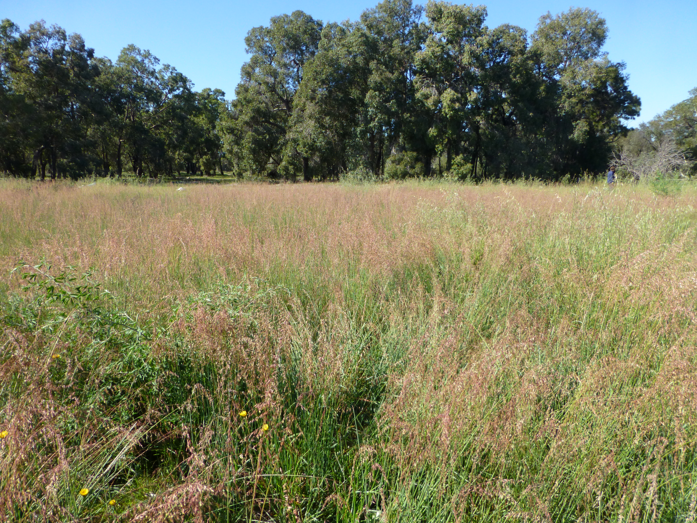
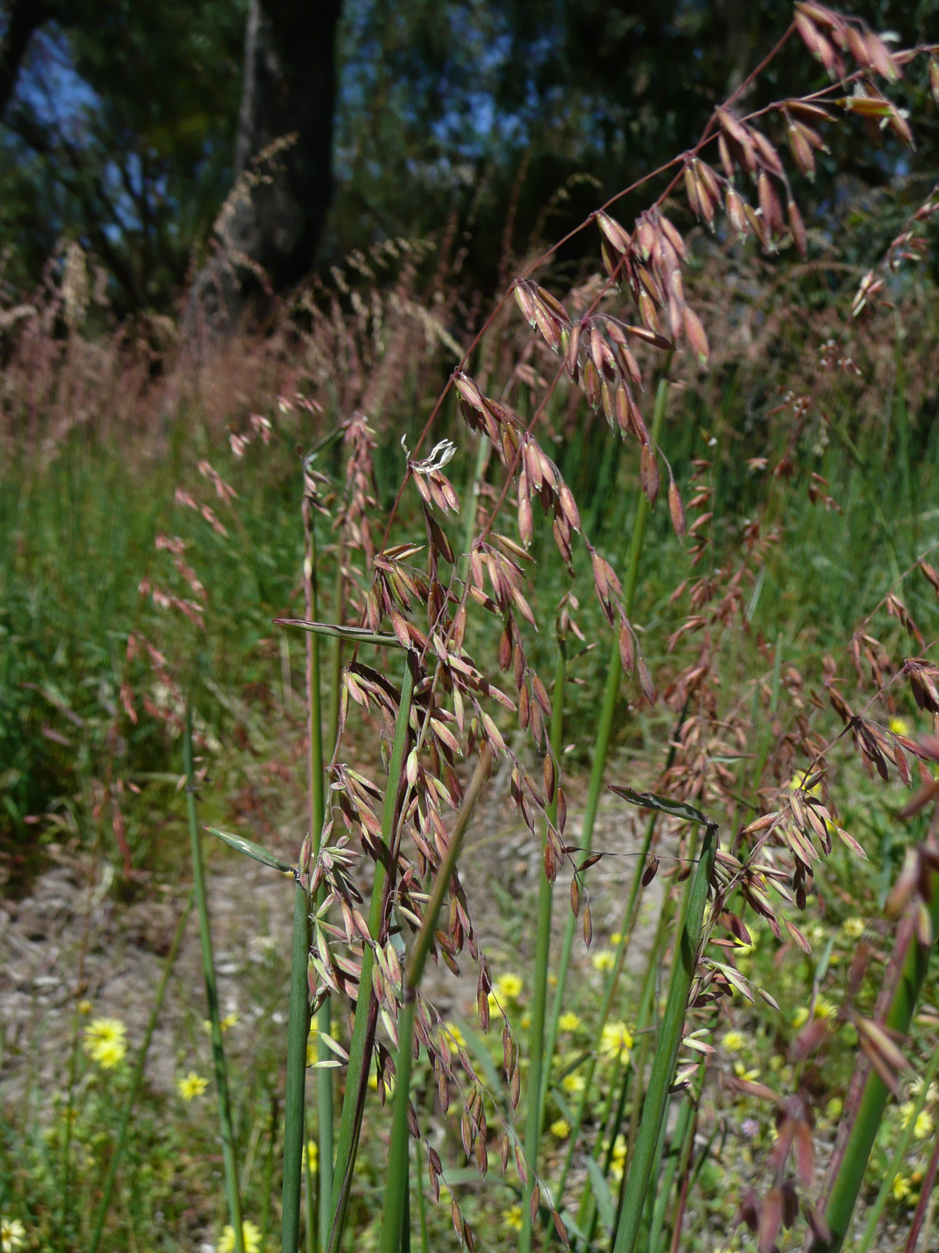
BE AWARE!
Ehrharta calycina
A threat to the EPPO region
How to recognize it? Can you help us?
A very variable species that has many described ecotypes or regional variants suggesting that it represents a species complex. It is a tussock grass, with culms generally varying in height from 300 to 70 cm high (but can reach up to 180 cm) and has creeping, branched rhizomes. Leaves are often red to purple tinged, up to 7 mm in width, flat or rolled, often wrinkled along the blade margin and filiform in shape. Inflorescences (panicles) are red in colour and may be produced at any time of the year, but usually in spring.
Because Ehrharta calycina has the potential to impact the habitats it invaded, including native plant species and important ecosystem services, it is important to report any sightings to plant protection authorities. Early detection will allow a rapid implementation of appropriate measures against Ehrharta calycina.
If you see Ehrharta calycina:
Check the identification of the species with other grass species.
Whenever possible, take a picture of the plant, record exact location, date and habitat where it was observed.
Contact us.
Image: Sian Mawson, Friends of Queens Park Bushland
Contact us
Your contact details
Your institution name
Logo
Image: Sian Mawson, Friends of Queens Park Bushland
This leaflet has been prepared within the LIFE funded project LIFE15 PRE FR 001 in collaboration with the NERC Centre for Ecology and Hydrology
Prepared in collaboration with EPPO – www.eppo.int

Slide 2
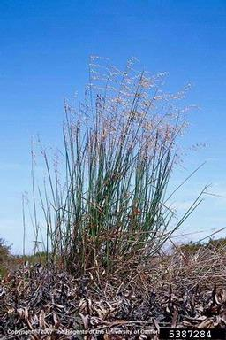
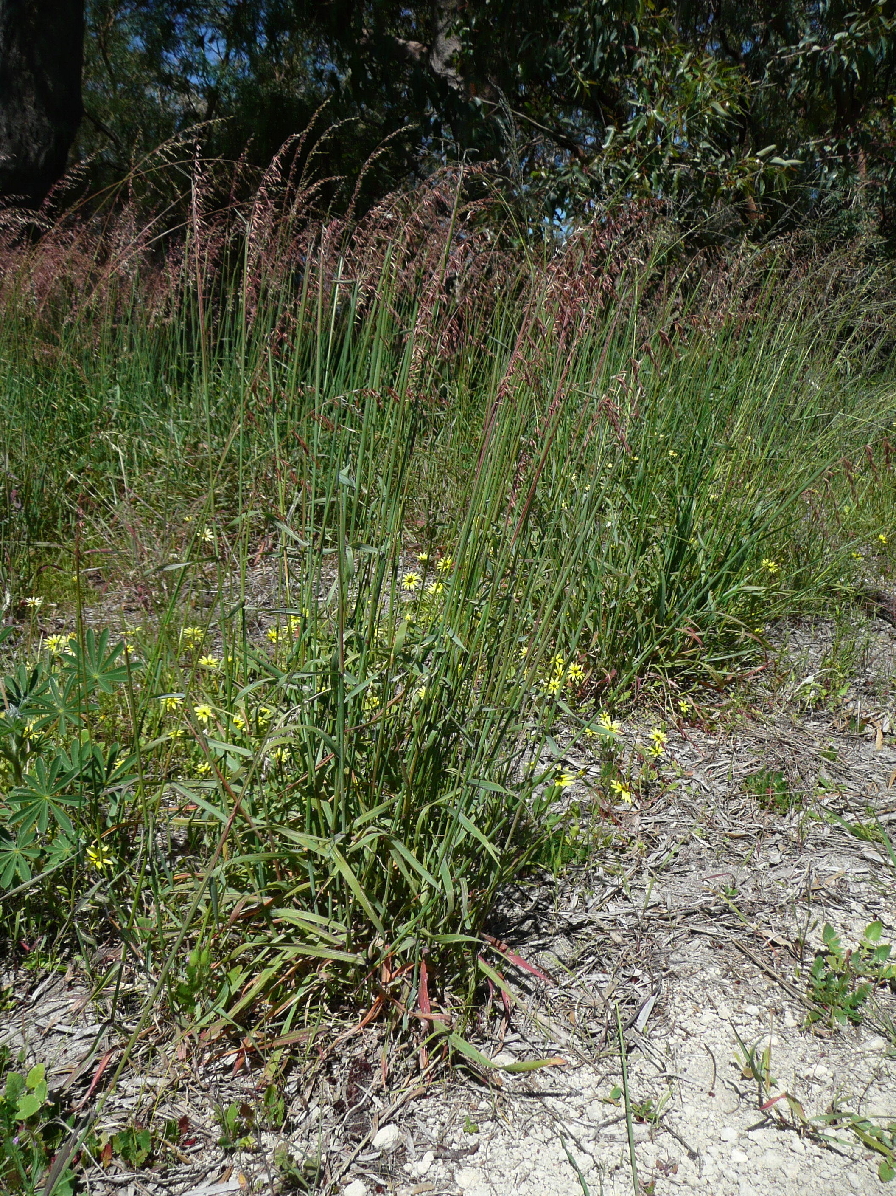
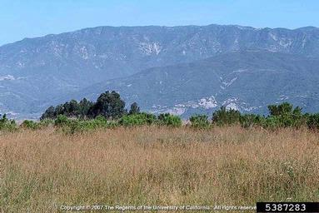
What is E. calycina? What is the problem? Where is it found?
Ehrharta calycina is a perennial grass species native to South Africa.
This species can form monospecific stands by suppressing the germination of native species through rapid growth and shading out of native plant seedlings. E. calycina can initiate an enhanced grass-fire cycle, promoting more frequent fires, which in turn favour this fire-adapted species at the expense of native plant species
As Ehrharta calycina is considered to be a threat to native biodiversity, its appearance in new areas should be reported immediately to us.
There is no evidence that the species is currently promoted as a forage grass within the EPPO region but this is how it entered Tunisia where it was introduced as a fodder and pasture grass, almost certainly as seed. In California and Australia, E. calycina can dominate plant communities, excluding native plant species and transforming shrubland into grasslands. E. calycina either prevents the germination of native plants or prevents their establishment and survival through promotion of more frequent fires.
In the EPPO region, the species is recorded from Portugal, Spain and Tunisia.
In Spain, it has been found in dunes and dry pastures, in Portugal along roadsides and open woodland, and in Tunisia in pastures.
Joseph M. DiTomaso, University of California - Davis, Bugwood.org
Image: Sian Mawson, Friends of Queens Park Bushland
Joseph M. DiTomaso, University of California - Davis, Bugwood.org

