Slide 1
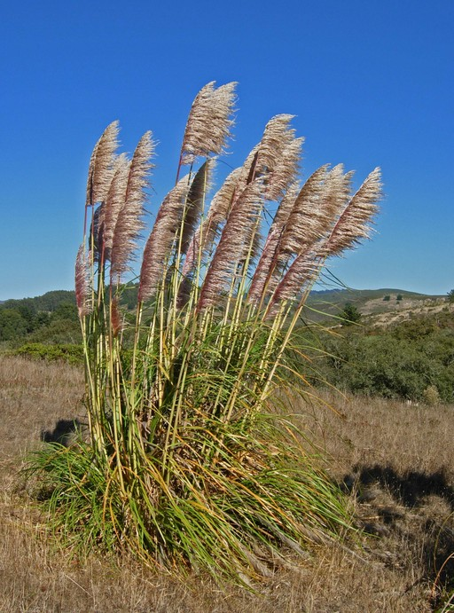
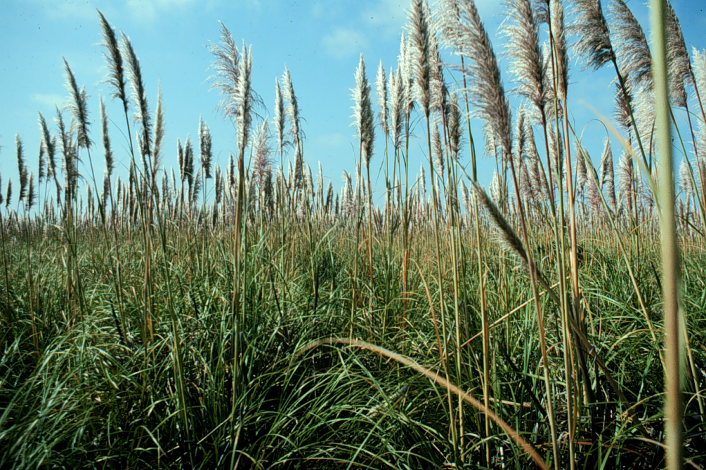
BE AWARE!
Cortaderia jubata
A threat to the EPPO region
How to recognize it? Can you help us?
When inflorescences are present, C. jubata can generally be distinguished from C. selloana by inflorescences that extend well above the foliage and young inflorescences that are violet hued rather than purely white or yellow as they are in C. selloana.
However, individuals of both taxa appear to express a high degree of phenotypic plasticity in these traits. Regional taxonomic treatments have identified a number of other potentially discriminating traits including: leaf blades in C. jubata that are dark green on both sides but blue green above and dark green below in C. selloana.
Because Cortaderia jubata has the potential to impact the habitats it invades, including native plant species and important ecosystem services, it is important to report any sightings to plant protection authorities. Early detection will allow a rapid implementation of appropriate measures against Cortaderia jubata.
If you see Cortaderia jubata:
Check the identification of the species with other grass-like species.
Whenever possible, take a picture of the plant, record exact location, date and habitat where it was observed.
Contact us.
Contact us
©2008 Neal Kramer
Your contact details
Your institution name
Logo
Image: John Lambrinos, EPPO Global Database
This leaflet has been prepared within the LIFE funded project LIFE15 PRE FR 001 in collaboration with the NERC Centre for Ecology and Hydrology
Prepared in collaboration with EPPO – www.eppo.int

Slide 2
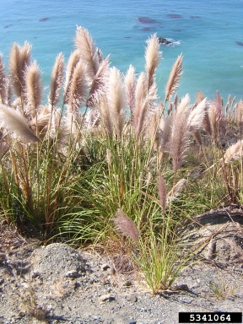
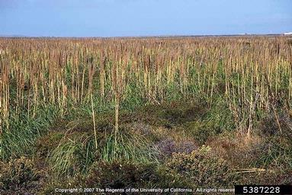
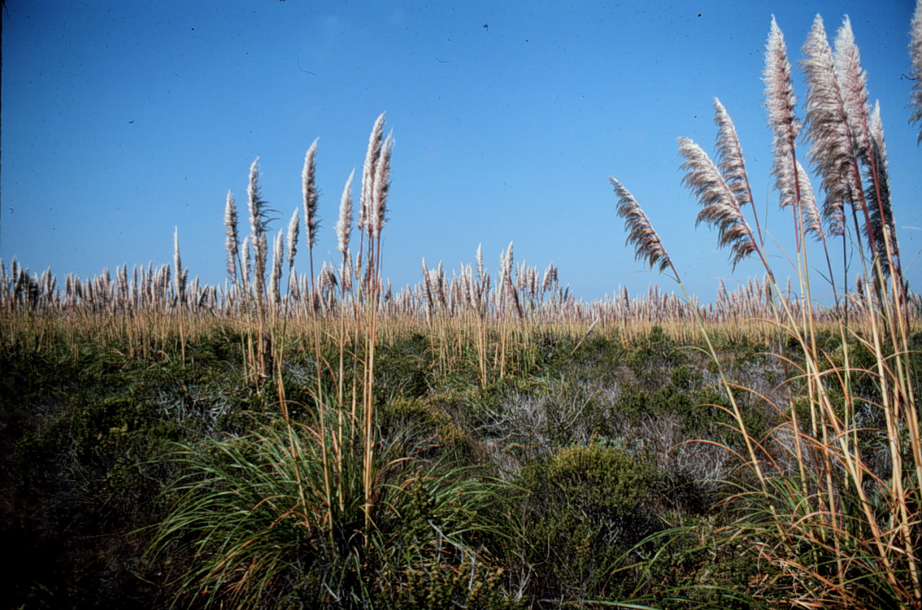
What is C. Jubata? What is the problem? Where is it found?
Cortaderia jubata is tall perennial grass tussock-forming grass species native to South America.
Only female plants of C. jubata are known to occur and this species reproduces from seeds produced from unfertilised female ovules.
C. jubata is extremely fecund, producing over 100 000 seeds from a single inflorescence in one season, with an adult plant having between five and 20 inflorescences
In California the species has been found to be able to outcompete native plants once it has established. This species produces a large amount of above- and belowground biomass that allow it to acquire light, moisture, and nutrients that would be used by other plants . Coastal sand dunes and inland sand hills are the most invaded habitats, and these harbour a number of rare and endangered plant species. Associated with vegetation change is a decrease in arthropod abundance and diversity. Rodents were less common in C. jubata-dominated grasslands, but rabbits more common. In Hawaiʽi, the species has been recorded as developing into dense monotypic stands in mesic to humid areas with the potential to replace or compete with native species.
It is invasive in North America, South Africa, Australia and new Zealand and is currently absent from the natural environment in the EPPO region.
In its current invasive range, it invades a wide range of habitats including disturbed/ruderal areas such as roadsides, logged forests/plantations and is capable of invading areas with intact vegetation. Plants for planting is one pathway for the movement of the species. Cortaderia jubata has been historically planted as an ornamental in France, Ireland and the UK.
C. jubata has a very broad environmental tolerance. However, it establishes best in wet, sandy soil without existing vegetation and has been shown to germinate best in high light, warm (~20º C) and moist conditions.
Image: Mandy Tu, The Nature Conservancy, Bugwood.org
Image: Joseph M. DiTomaso, University of California - Davis, Bugwood.org
Image: John Lambrinos, EPPO Global Database

