Slide 1
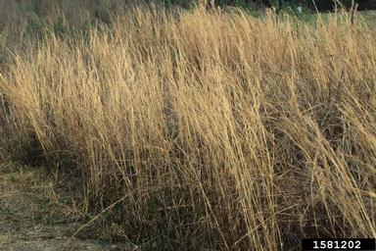
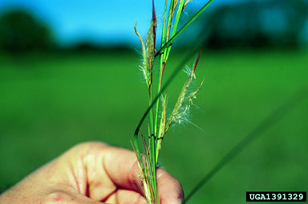
BE AWARE!
Andropogon virginicus
A threat to the EPPO region
How to recognize it? Can you help us?
Andropogon virginicus is an herbaceous, perennial, warm season (C₄) grass. It has a cespitose (i.e. densely tufted) growth form, and a height range of 40-210 cm. The culms are typically branched distally, with light-green to reddish brown colouration. The leaf-sheaths are long-ciliate, with a tuberculate (scabrous) surface. The ligules are yellow to brownish and membranous, 0.2-1 mm, with cilia 0.2-1.3 mm. Leaf blades reach up to 52 cm, and are 1.7-6.5 mm wide. These blades are variably hairy.
The species is very difficult to tell apart from close relatives.
Because Andropogon virginicus has the potential to impact the habitats it invades, including native plant species and important ecosystem services, it is important to report any sightings to plant protection authorities. Early detection will allow a rapid implementation of appropriate measures against Andropogon virginicus.
If you see Andropogon virginicus:
Check the identification of the species with other grass like species.
Whenever possible, take a picture of the plant, record exact location, date and habitat where it was observed.
Contact us.
Image: John D. Byrd, Mississippi State University, Bugwood.org
Contact us
Your contact details
Your institution name
Logo
Image: John D. Byrd, Mississippi State University, Bugwood.org
This leaflet has been prepared within the LIFE funded project LIFE15 PRE FR 001 in collaboration with the NERC Centre for Ecology and Hydrology
Prepared in collaboration with EPPO – www.eppo.int

Slide 2
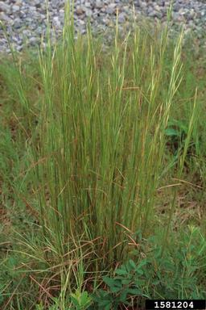
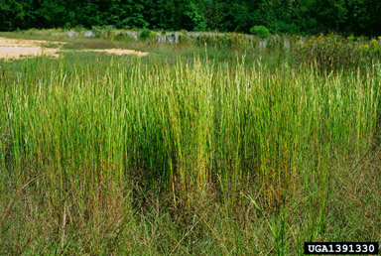
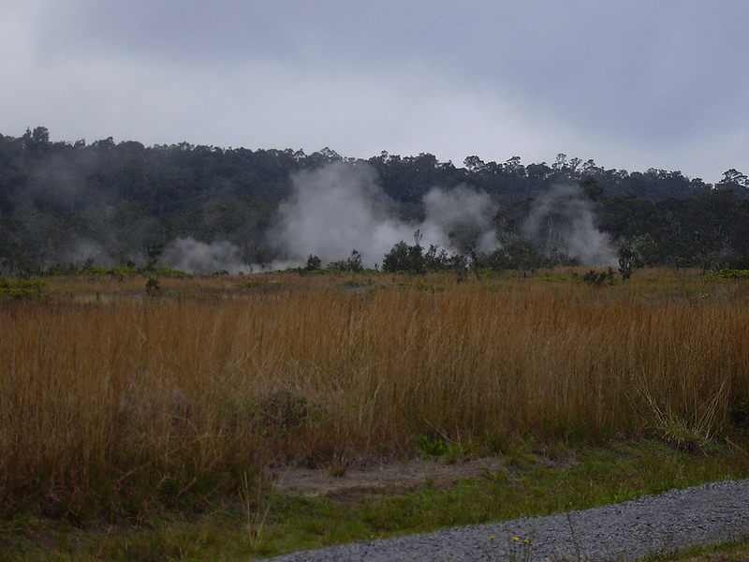
What is A. virginicus? What is the problem? Where is it found?
Andropogon virginicus (EPPO Observation List of invasive alien plants) is an erect perennial grass which is native to South and Central America.
As Andropogon virginicus is considered to be a threat to native biodiversity, its appearance in new areas should be reported immediately to us.
Andropogon virginicus stands can be dense, widespread, and highly competitive suggesting the species reduces biodiversity. The species is reported to be able to dominate within the grass layer. Although present in the EPPO region, there are no reported studies that have evaluated the ecological or economic impact of A. virginicus in the region. However, due to its aggressive spread in natural areas in Georgia, and around the Black Sea, and due to the rapid expanse of the plant in France, potential impacts are likely to be high.
There is evidence that A. virginicus has entered the EPPO region as a contaminant of machinery and equipment. In France, it is suspected that A. virginicus was introduced into the military camp with munitions in the years 1950-1967.
The species is present in the EPPO region, recorded from France, the Russian Federation and Georgia.
A. virginicus invades a wide variety of habitats from disturbed to relatively intact habitats including ruderal areas, wetlands, open pastures, grasslands, and open woodlands.
The species is invasive also in Asia, North America, Australia and new Zealand.
Image: John D. Byrd, Mississippi State University, Bugwood.org
Image: John Ruter, University of Georgia, Bugwood.org
Image: John D. Byrd, Mississippi State University, Bugwood.org

