Slide 1
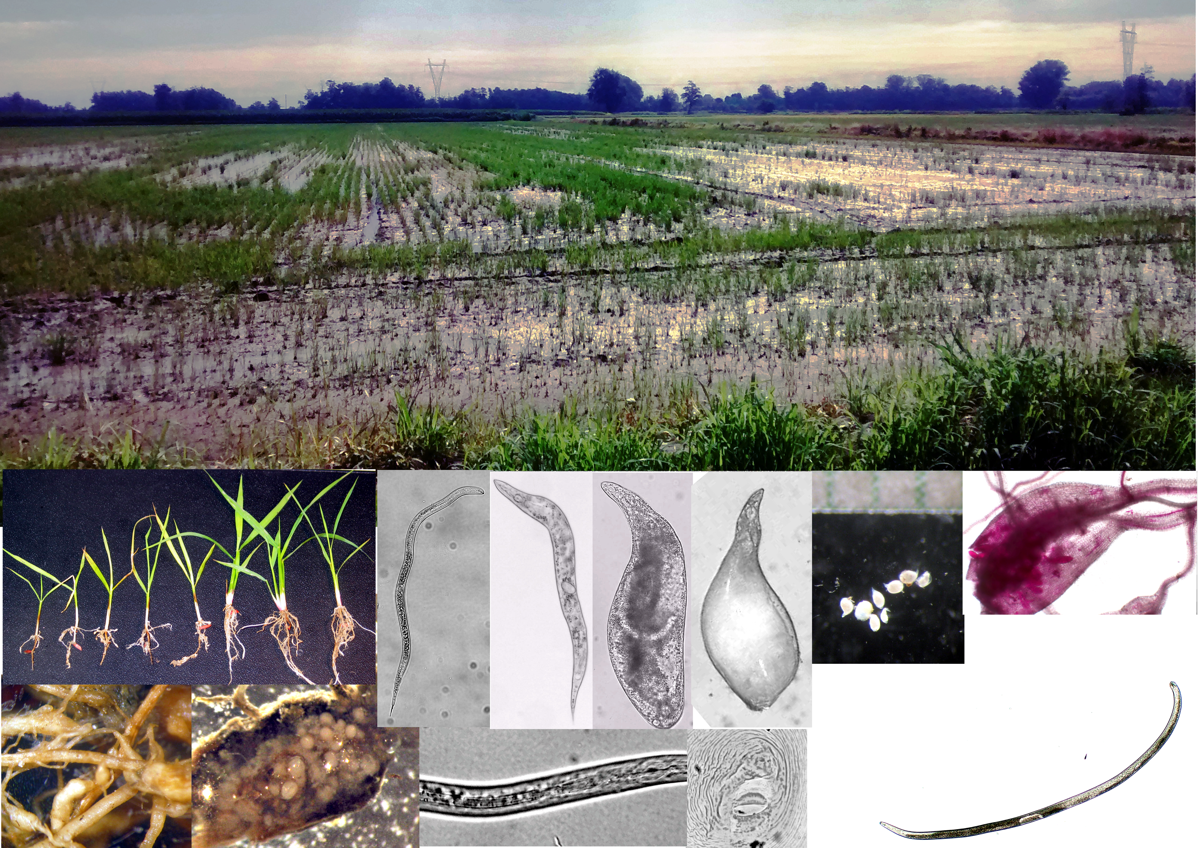
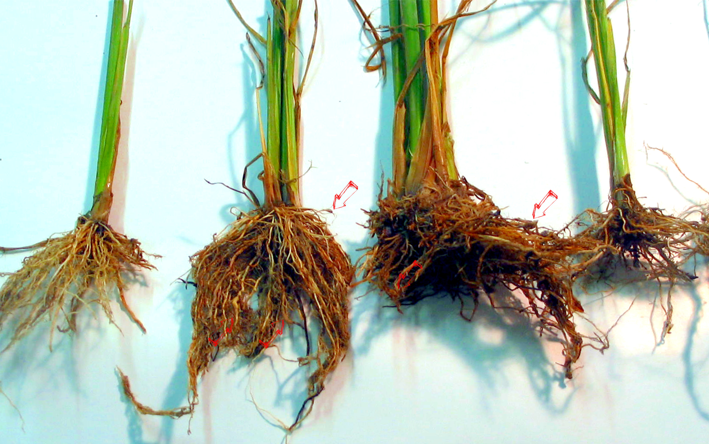
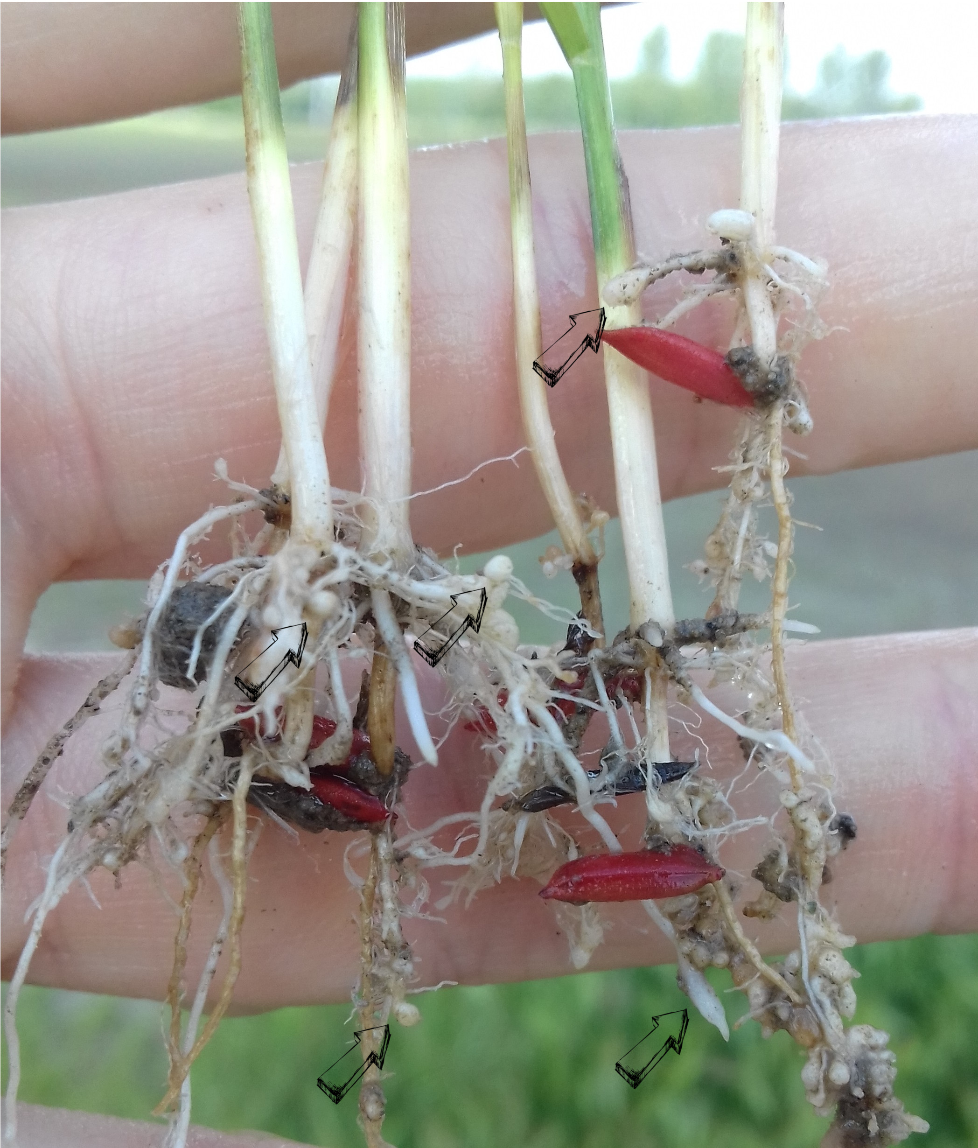


^{CAN YOU HELP US?}
^{Rice root-knot nematode}
^{Meloidogyne} graminicola Golden & Birchfield
Image: Stefano Sacchi, LOMBARDIA REGION (IT) – PLANT HEALTH LABORATORY
What is it?
The rice root-knot nematode, M. graminicola, is one of the most serious pests of rice (Oryza sativa L.). It has been found associated with many species from different families that include cereals and weeds. This nematode is present in Asia, part of the Americas, South Africa, and it has recently been found in Italy, Piemonte (2016) and Lombardia (2018) regions. The infestation of M. graminicola on rice can cause yield losses ranging from 20 to 80%.
How to recognize it?
Symptoms of M. graminicola on rice are characteristic hook-shaped galls on the roots. Affected plants show reduced vigour, stunting, chlorosis, poor caryopsis production and empty spikelets. The capacity for natural spread of
M. graminicola is very limited but it can be moved with soil and root material, as well as transported adhering to clothing, vehicles, agricultural machinery and animals.
Image: Stefano Sacchi, LOMBARDIA REGION (IT) – PLANT HEALTH LABORATORY
Contact us!
Learn more about Meloidogyne graminicola: https://gd.eppo.int
This poster has been prepared by the Plant Protection Service of Regione Lombardia (IT) in collaboration with EPPO (www.eppo.int)

