Slide 1

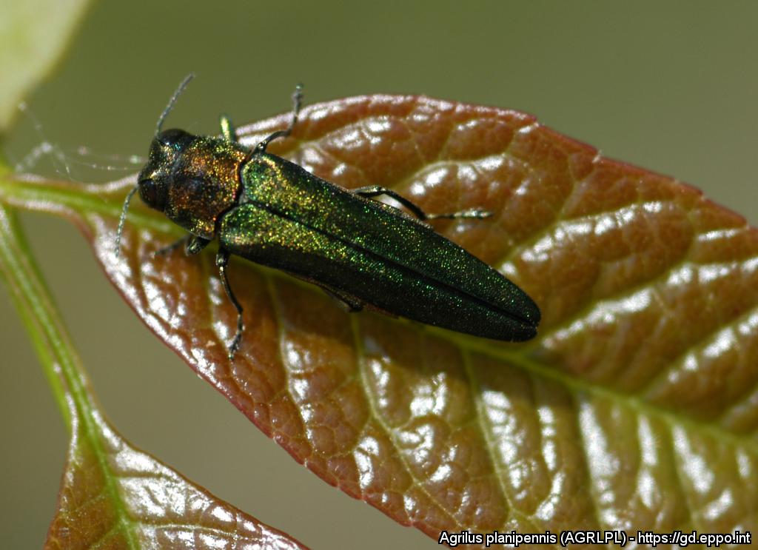
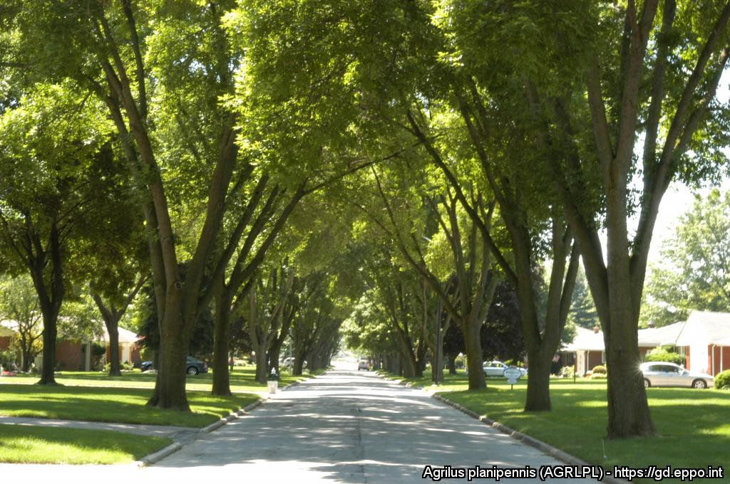
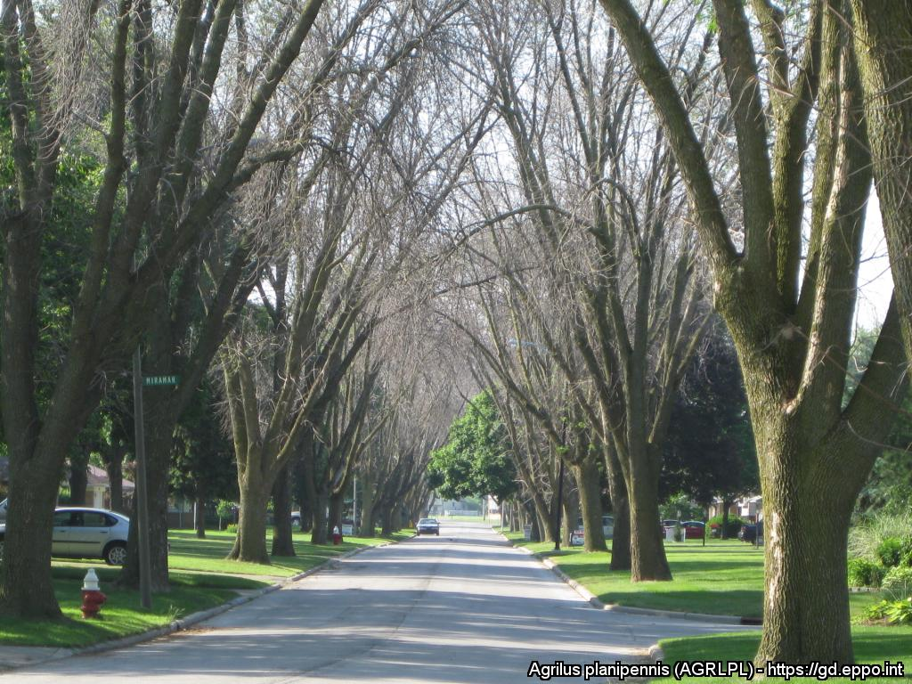
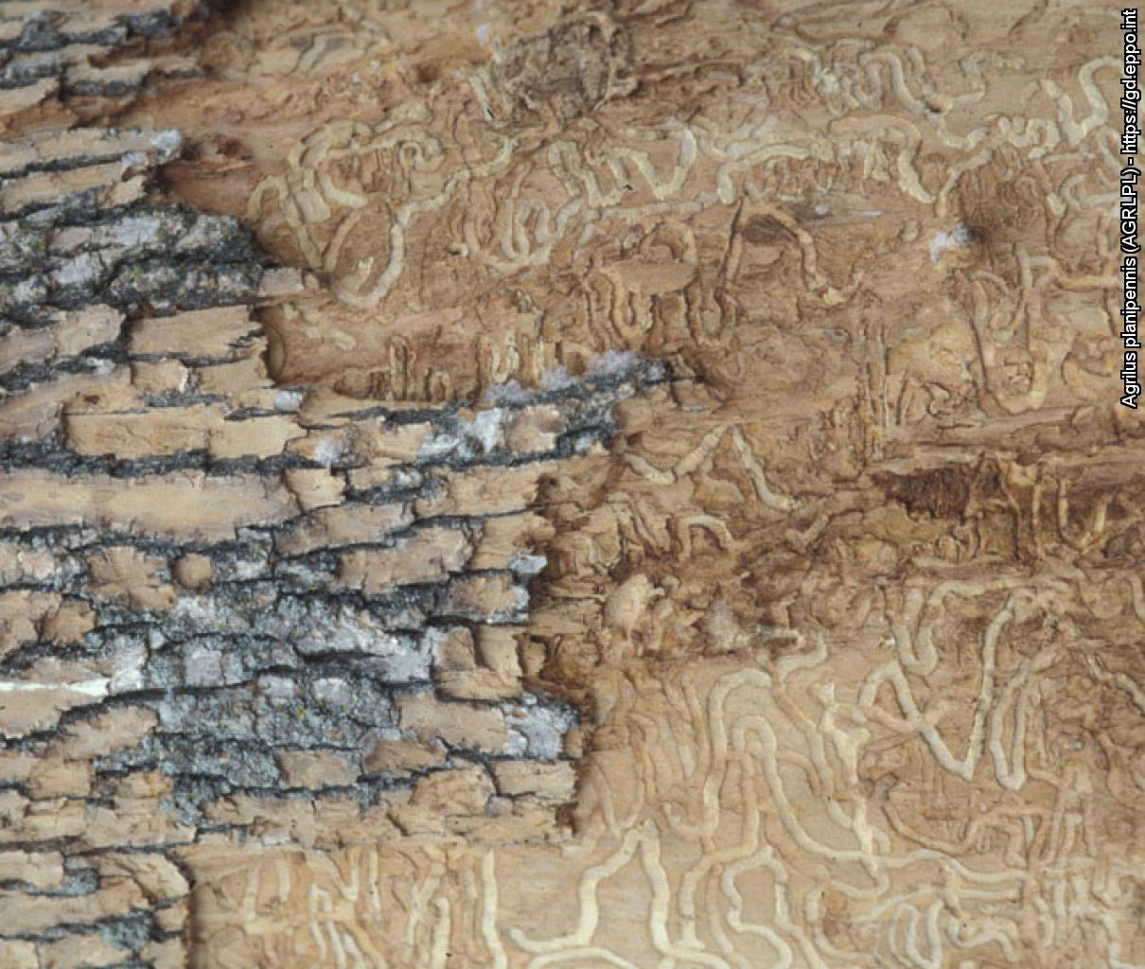


^{HELP US STOP THIS PEST!}
^{Emerald ash borer}
^{A threat to ash trees}
All Images: Daniel A. Herms, The Ohio State University (US). EPPO Global Database, https://gd.eppo.int
What is it?
The emerald ash borer (Agrilus planipennis - Coleoptera: Buprestidae) originates from Asia but has been inadvertently introduced into other parts of the world (e.g. Canada and USA) where it has killed millions of ash trees. In the mid-2000s, it was discovered in the European part of Russia, near Moscow. As its spread is threatening ash trees in our forests and urban environments, it is important to detect it as early as possible.
Damage
Before
After
Contact us !
Contact us!
Your contact details, logos, links, QR codes …
^{Learn more about} ^{the} ^{emerald} ^{ash} ^{borer: www.your.website}
This poster has been prepared in collaboration with EPPO (www.eppo.int)

Slide 2
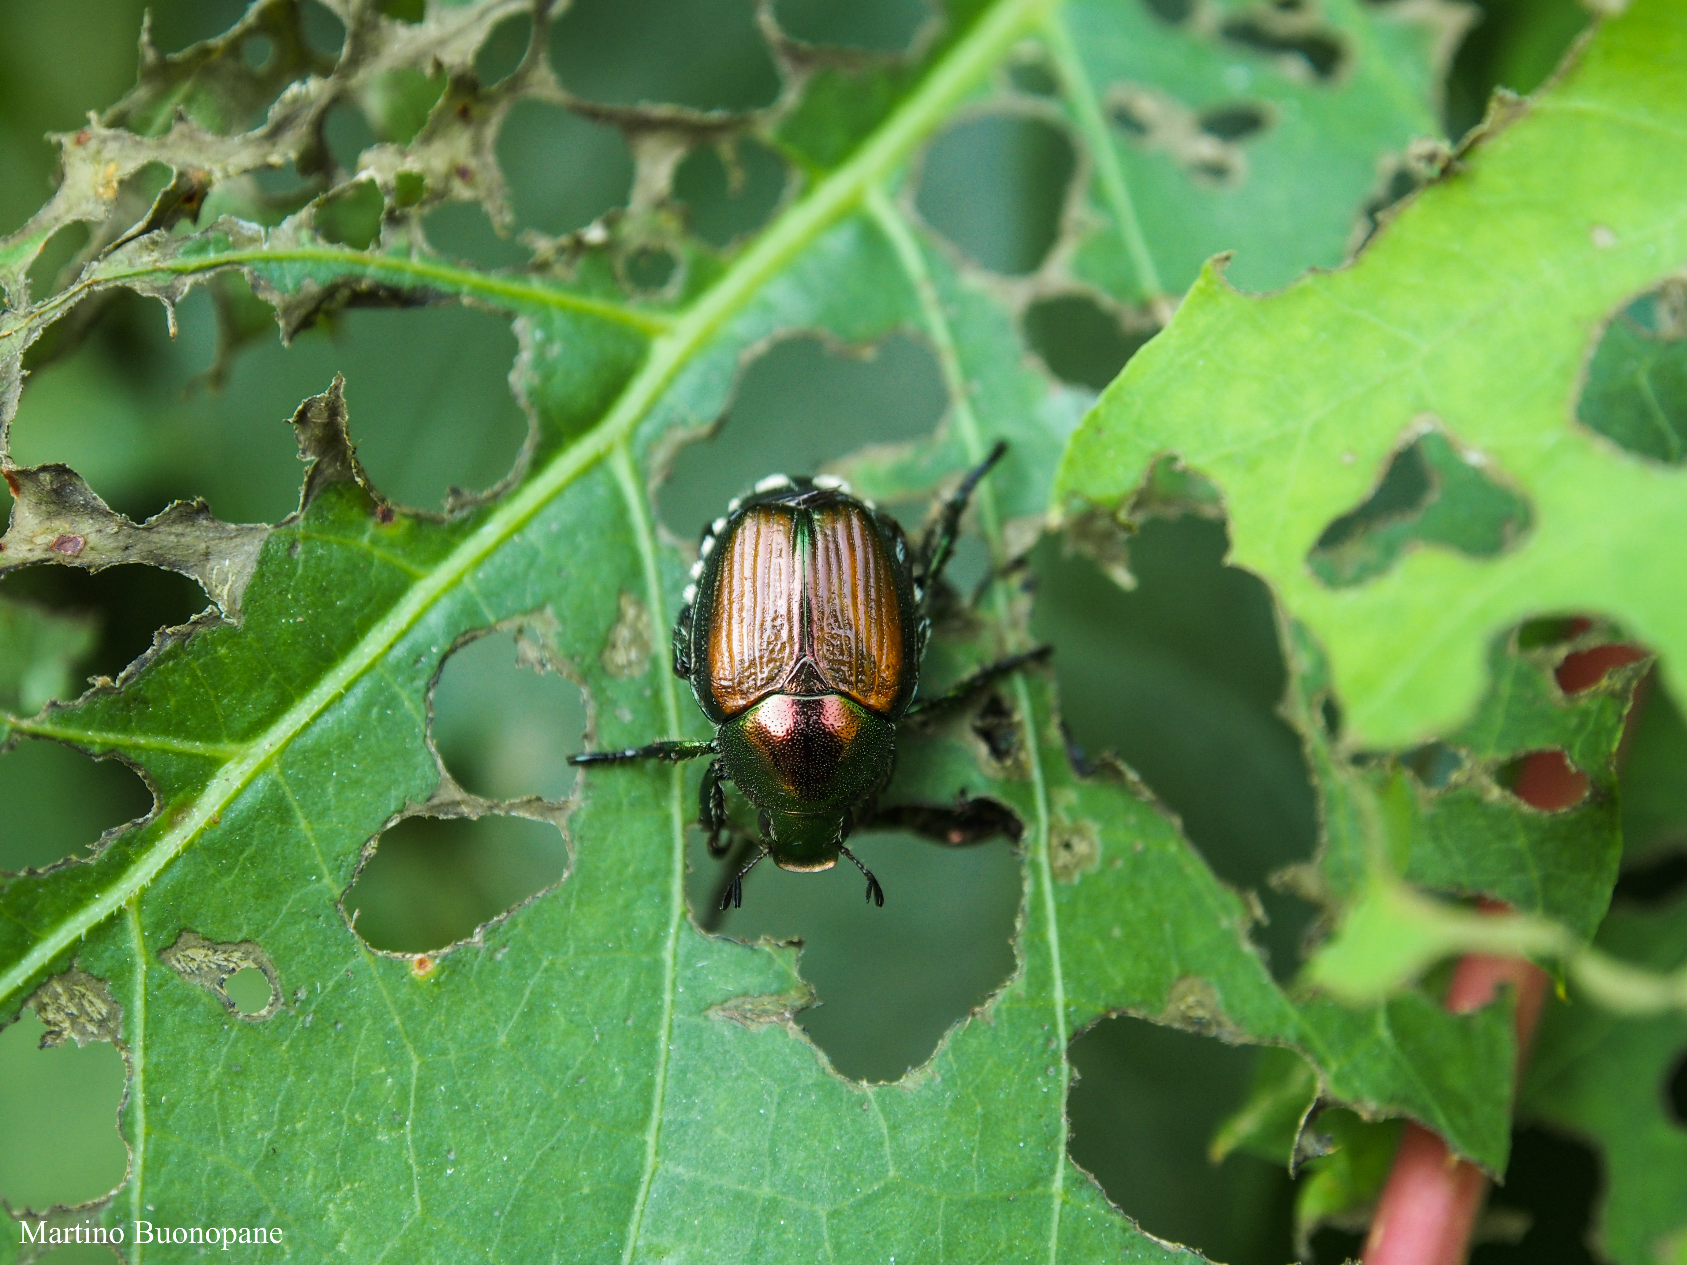
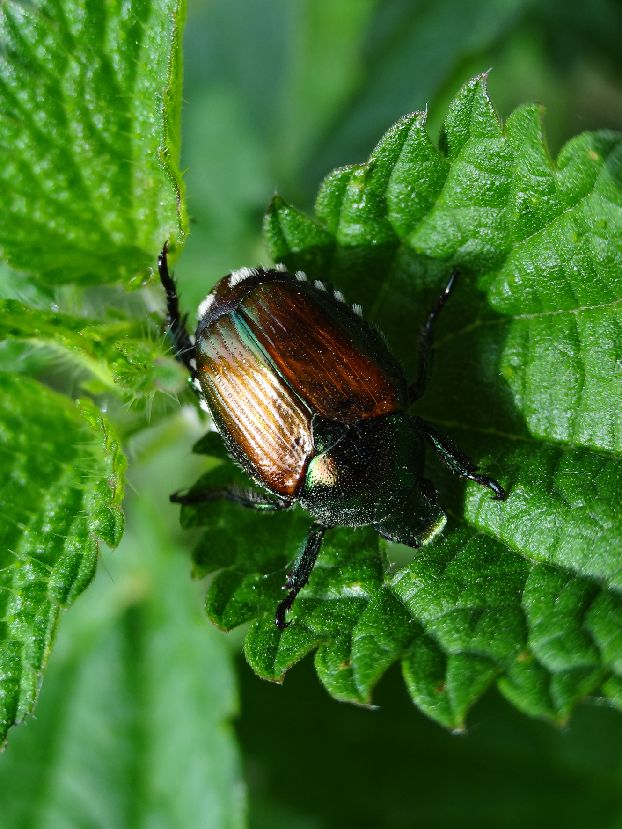
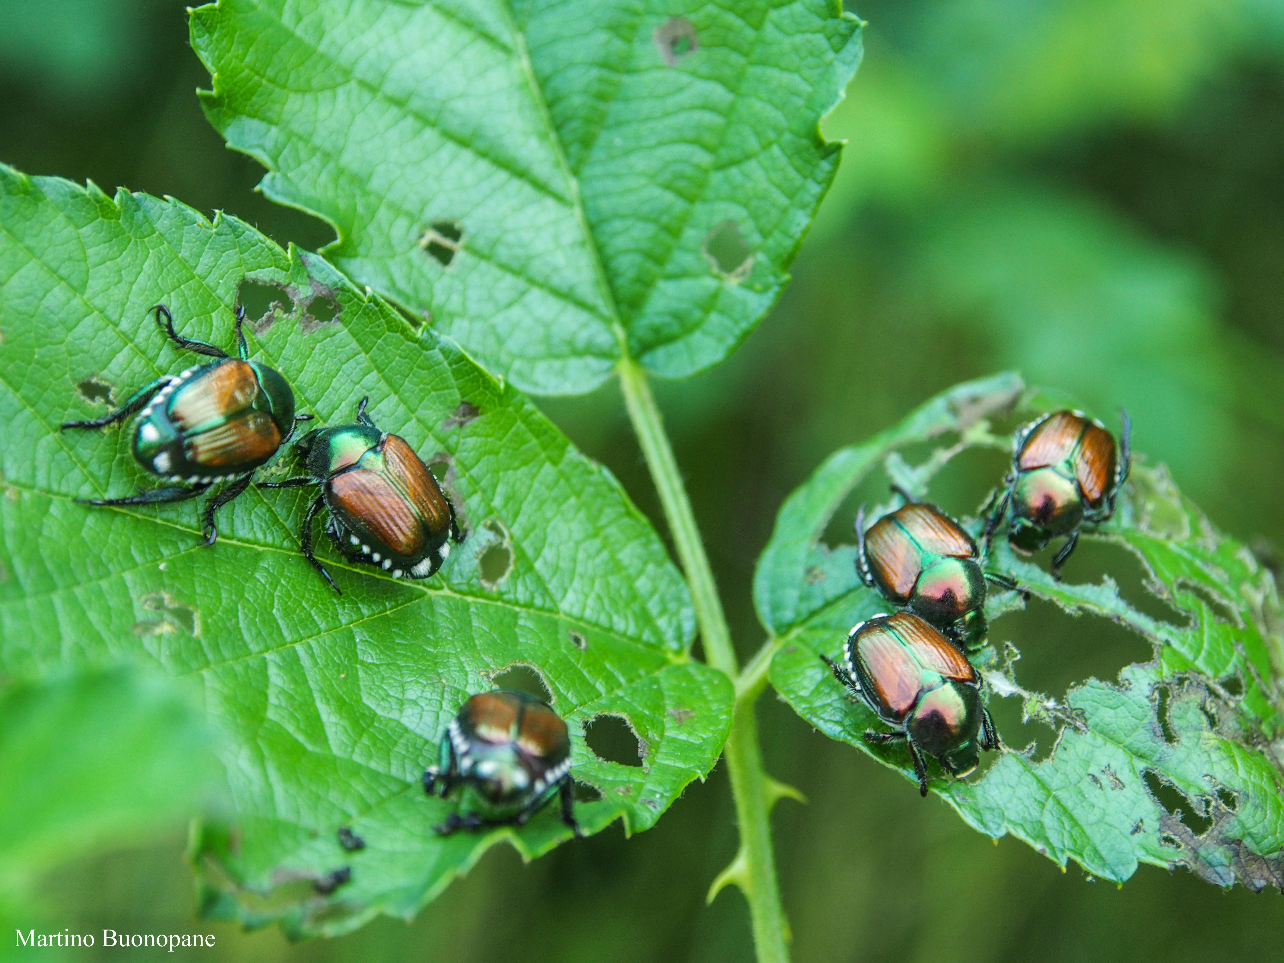
^{CAN YOU HELP US?}
^{Popillia japonica}
A threat to lawns, woods and crops
All Images: Martino Buonopane (IT)
What is it?
Popillia japonica is a beetle (Coleoptera: Rutelidae) originating from Japan which has been inadvertently introduced into other parts of the world (e.g. Azores islands and USA). In summer 2014, it was found for the first time in continental Europe, near Milano in Italy. Popillia japonica attacks many plants (almost 300 species). Its larvae feed on plant roots and are particularly damaging in lawns and meadows. Adult beetles are voracious leaf feeders.
How to recognize it?
Adult beetles are 10-12 mm long with iridescent copper-coloured elytra and metallic green thorax and head. They can be identified by the presence of 12 tufts of white hair on their body (5 along each side of the abdomen and 2 larger ones near the bottom end). Other life stages (eggs, larva, pupa) live in the soil and are difficult to see.
Contact us!
Your contact details, logos, links, QR codes …
^{Learn more about Popillia} ^{japonica: www.your.website}
This poster has been prepared in collaboration with EPPO (www.eppo.int)

Slide 3
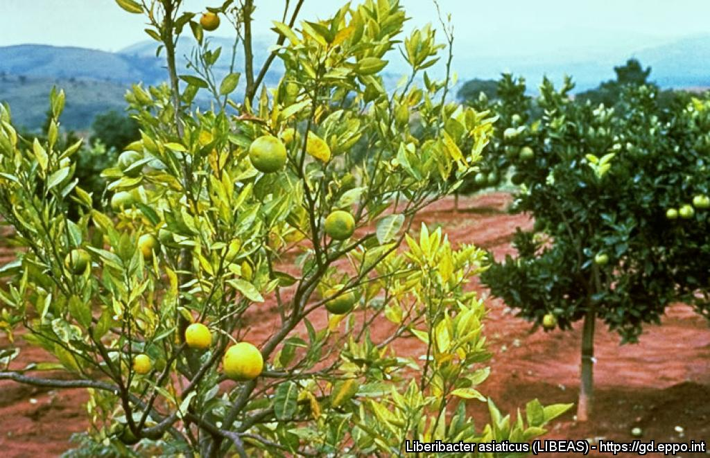
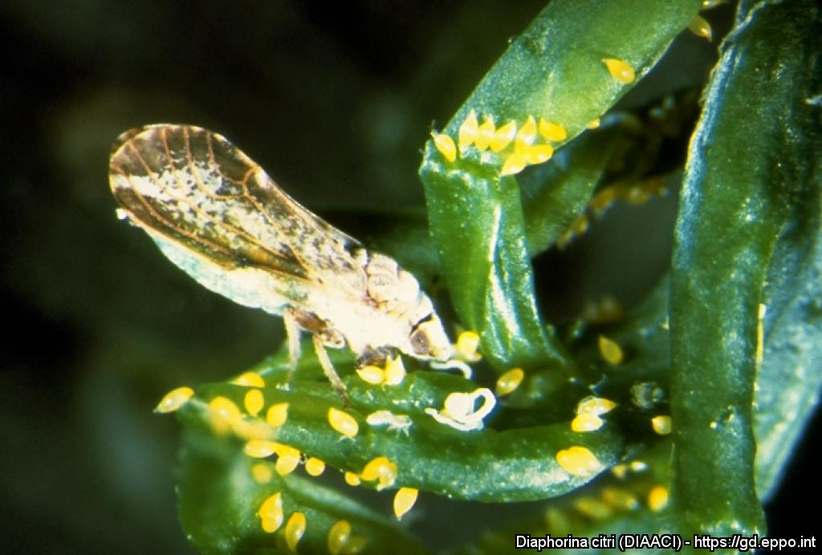
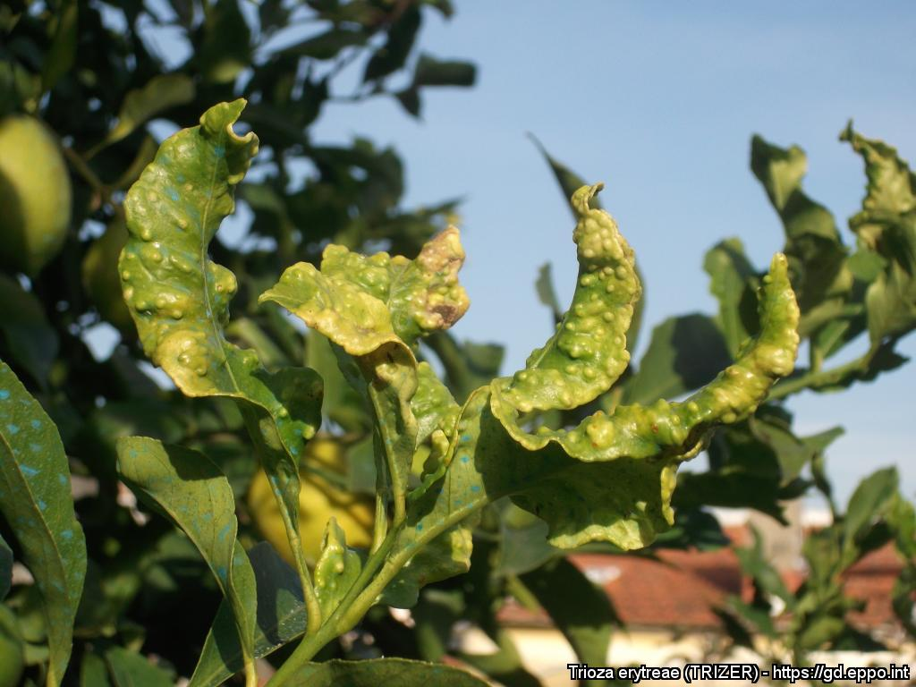

^{BE AWARE!}
^{Huanglongbing}
^{A threat to citrus}
Image: H.D. Catling (BD). EPPO Global Database, https://gd.eppo.int
What is it?
Huanglongbing (also called greening) is a severe bacterial disease of citrus (associated with ‘Candidatus Liberibacter spp.’). Affected trees are stunted, with sparse yellow foliage, and fruit fall prematurely. As these symptoms can be confused with other diseases or nutrition deficiencies, laboratory analysis might be required to confirm suspicions. Bacteria associated with huanglongbing do not affect humans but cause serious losses to citrus production. Two insect species are known to transmit huanglongbing to citrus plants: Diaphorina citri and Trioza erytreae.
Disease vectors
Adult and eggs of
Diaphorina citri.
Trioza erytreae transmits
the disease and also causes
leaf galls on the leaves
when feeding.
Image J.M. Bové, INRA Bordeaux (FR)
EPPO Global Database. https://gd.eppo.int
Image: C.A. Coutinho Conceição (PT)
EPPO Global Database. https://gd.eppo.int
Contact us!
Your contact details, logos, links, QR codes …
Learn more about huanglongbing: www.your.website
This poster has been prepared in collaboration with EPPO (www.eppo.int)

