Slide 1
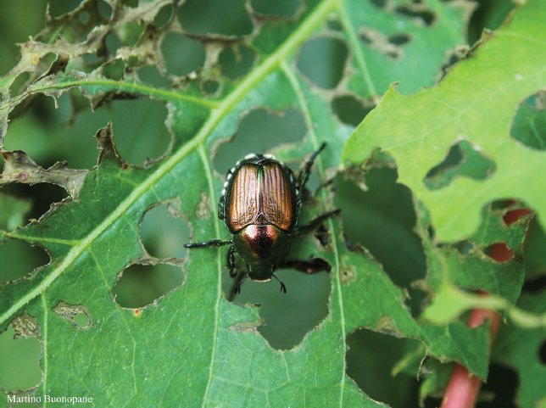
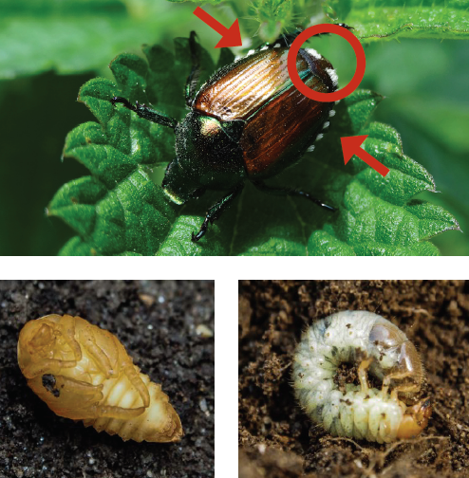


CAN YOU HELP US?
Popillia japonica
An insect pest threatening our lawns,
woods and crops
How to recognize it? Can you help us?
Adult beetles are 10-12 mm long with iridescent copper-coloured elytra and metallic green thorax and head. The presence of 12 tufts of white hair can be seen on their body (5 along each side of the abdomen and 2 larger ones near the bottom end). The presence of these white hair tufts is quite distinctive of Popillia japonica. Adults can be seen mainly during late spring and summer. Other stages of the insect (eggs, larvae and pupae) live in the soil and are therefore more difficult to see and to identify.
Because Popillia japonica can seriously damage many wild and cultivated plants, it is important to report any sightings to plant protection authorities. Early detection will allow a rapid implementation of appropriate measures against Popillia japonica.
If you see Popillia japonica:
Check the presence of tufts of white hairs on both sides of the abdomen.
Whenever possible, take a picture of the insect, record exact location and the name of the host plant on which it was observed.
Contact us.
Contact us
Your contact details
Your institution name
Logo
Your institution name, logo
Prepared in collaboration
with EPPO – www.eppo.int

Slide 2
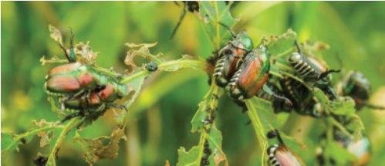
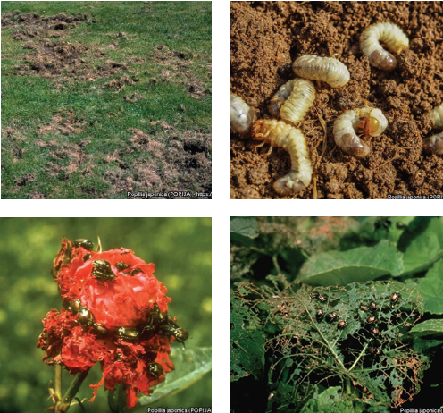
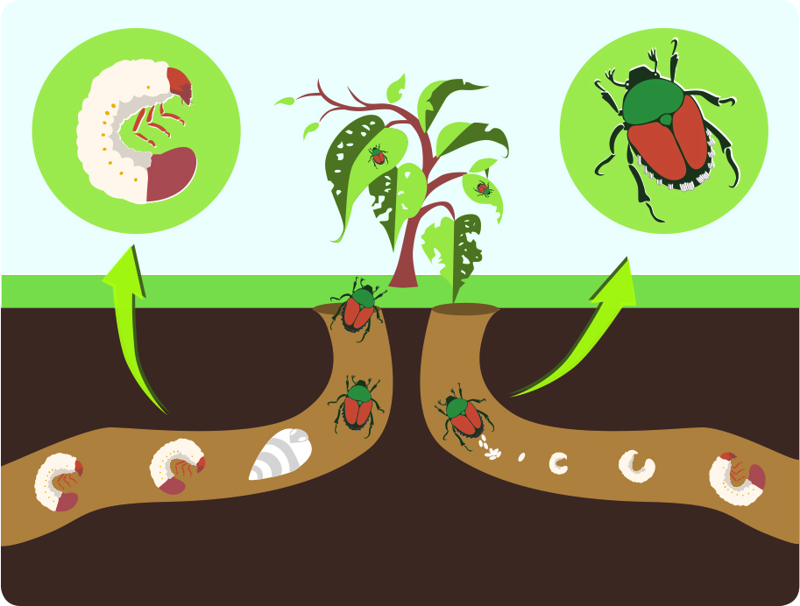
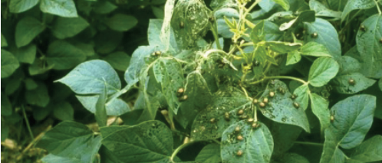
What is Popillia japonica? What is the problem? What is its life cycle?
Larvae are consuming plant roots and are particularly damaging in lawns and meadows. Adult beetles are voracious feeders and can attack many different plant species (approximately 300 wild and cultivated plant species). Among the most vulnerable plants the following can be mentioned: apple, bramble, elm, grapevine, grasses, linden, maize, maple, rose, peach, soybean.
The adults skeletonize leaves by chewing out the tissue between the veins, thus leaving a vein skeleton. They can also feed on flowers and fruit. The adults are gregarious and many beetles group together on a single plant, so individual plants or trees may be completely defoliated.
Popillia japonica usually produces one generation per year but under cold climates, its life cycle can be extended to two years. Adult beetles usually emerge from the soil in May or June and mate. Females lay eggs in the soil. After hatching, larvae (white grubs) develop in the soil where they feed on roots of grasses. The insect overwinters in a larval stage in the soil. In spring, larvae resume feeding and become pupae (metamorphosis). After emergence, adult beetles start feeding on the aerial parts of the plants and a new cycle begins again.
Popillia japonica is a beetle originating from Japan which has been inadvertently introduced into other parts of the world such as the Azores islands and the USA. These introductions most probably resulted from human-mediated activities (e.g. agricultural trade, transports). In summer 2014, Popillia japonica was found for the first time in continental Europe, near Milano in Italy.
As Popillia japonica is considered to be a serious threat to cultivated and wild plants, its appearance in new areas should be reported immediately to us.
Life cycle

