Slide 1

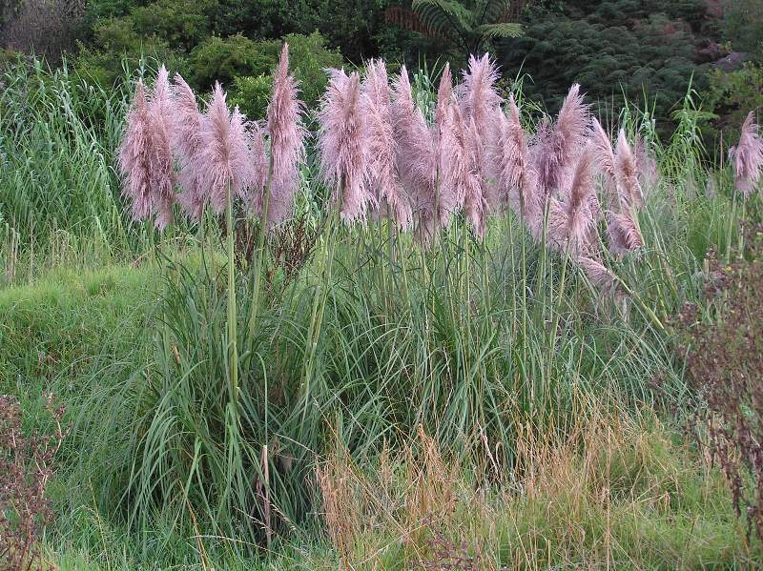
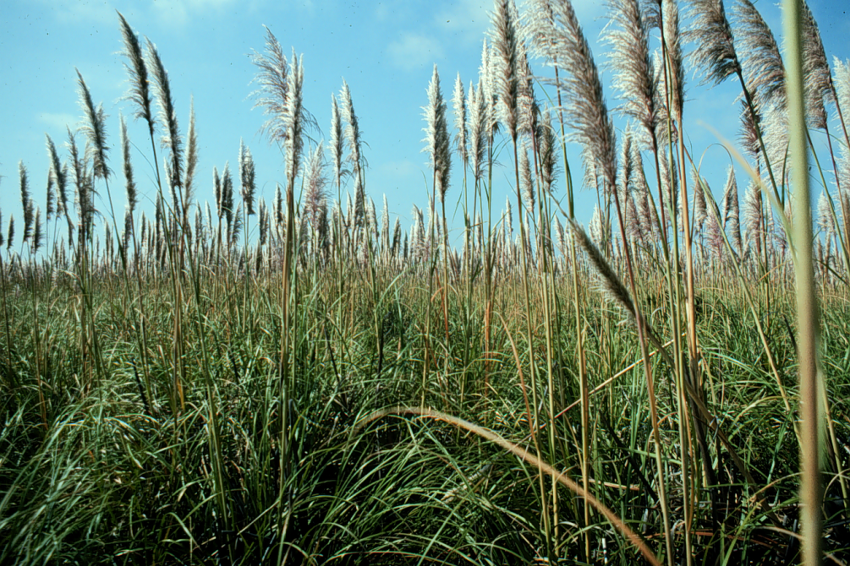
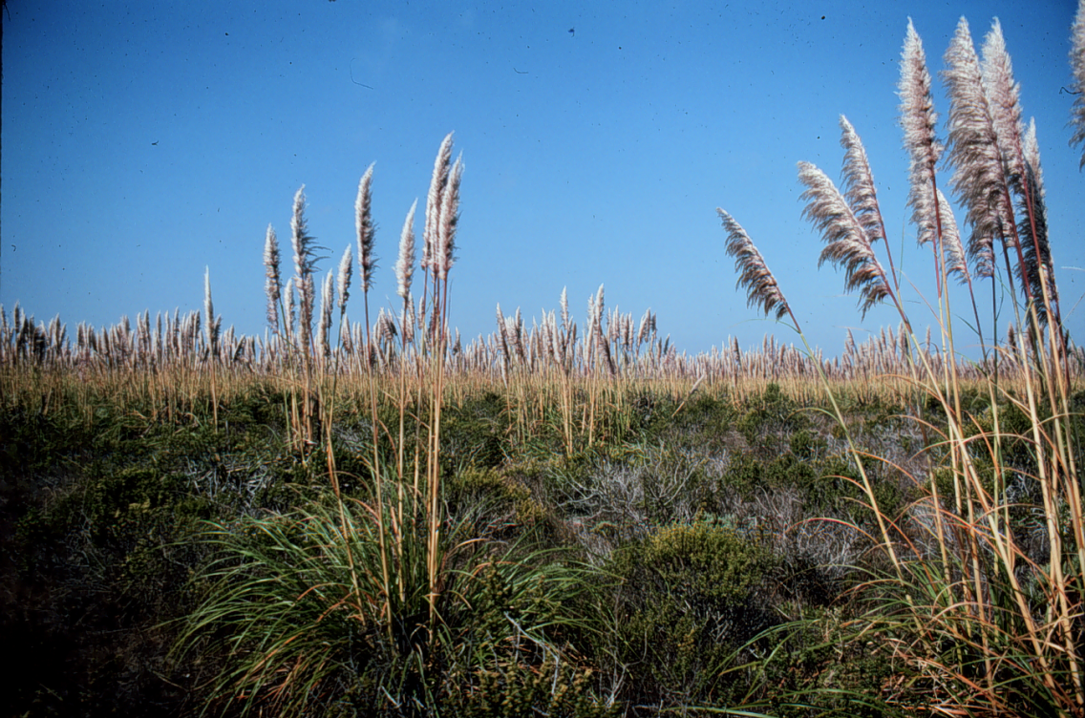


^{BE AWARE!}
^{Cortaderia jubata}
^{A threat to the EPPO region}
Image: John Lambrinos (Department of Horticulture, Oregon State University) EPPO Global database, https:\\gd.eppo.int
What is it?
Cortaderia jubata is a tall perennial grass species native to South America. It is invasive in North America, South Africa, Australia and new Zealand and is currently absent from the natural environment in the EPPO region. In its current invasive range, it invades a wide range of habitats including disturbed/ruderal areas such as roadsides, logged forests/plantations and is capable of invading areas with intact vegetation. Plants for planting is one pathway for the movement of the species. Cortaderia jubata has been historically planted as an ornamental in France, Ireland and the UK.
In California the species has been found to be able to outcompete native plants once it has established. This species produces a large amount of above- and belowground biomass that allow it to acquire light, moisture, and nutrients that would be used by other plants . Coastal sand dunes and inland sand hills are the most invaded habitats, and these harbour a number of rare and endangered plant species. Associated with vegetation change is a decrease in arthropod abundance and diversity. Rodents were less common in C. jubata-dominated grasslands, but rabbits more common. In Hawaii, the species has been recorded as developing into dense monotypic stands in mesic to humid areas with the potential to replace or compete with native species.
What's the problem?
Stands of invasive
C. jubata in N. America
Images: John Lambrinos (Department of Horticulture, Oregon State University) EPPO Global database, https:\\gd.eppo.int
Contact us!
Your contact details, logos, links, QR codes …
Learn more about Cortaderia jubata: https://gd.eppo.int
This poster has been prepared within the LIFE funded project LIFE15 PRE FR 001

