Slide 1
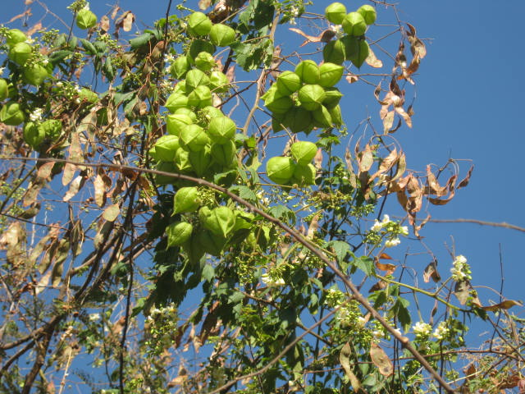
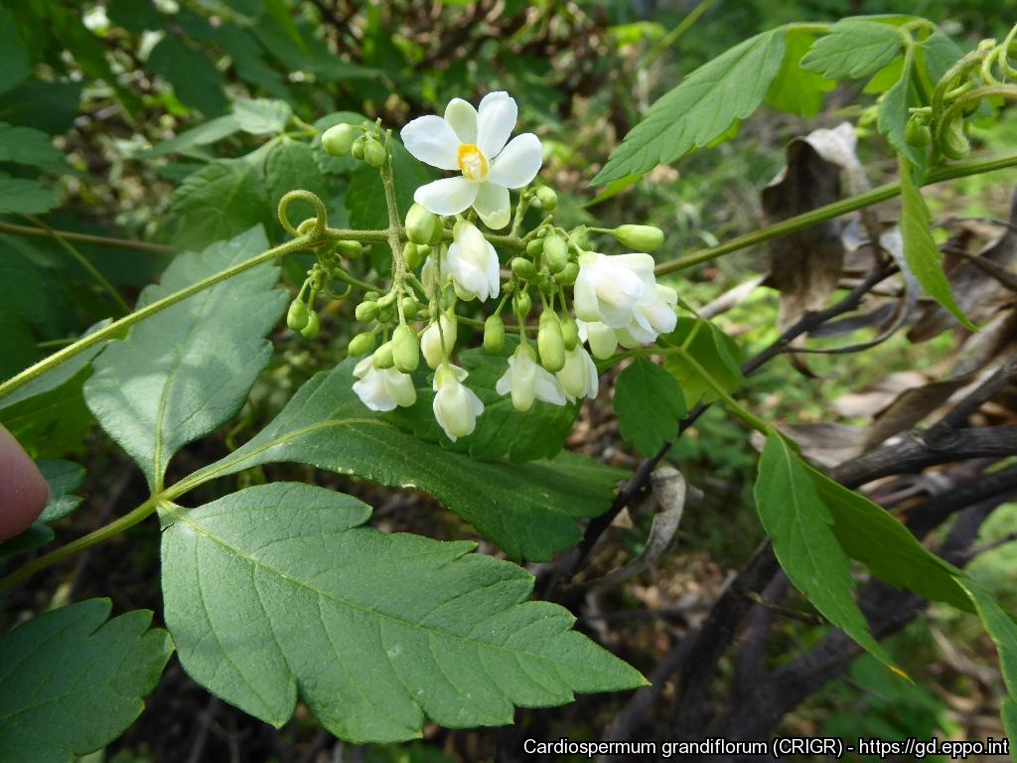
BE AWARE!
Cardiospermum grandiflorum
A threat to the EPPO region
How to recognize it? Can you help us?
Cardiospermum grandiflorum is a large, semi-woody annual or perennial often draping over other vegetation. While the fruit of C. grandiflorum can be variable (size and shape), their distinct shape and coverage by hairs make the species easily recognizable and distinguishable from closely related taxa such as C. halicacabum and C. corindum. Cardiospermum grandiflorum has hairy ribbed stems that are reddish-green in colour covered in bristly hairs. Leaves are compound and up to 16 cm long and are dark green and heavily serrated. The species' flowers have four petals that are white with a yellow lip.
Because Cardiospermum grandiflorum has the potential to impact the habitats it invades, including native plant species and important ecosystem services, it is important to report any sightings to plant protection authorities. Early detection will allow a rapid implementation of appropriate measures against Cardiospermum grandiflorum.
If you see Cardiospermum grandiflorum:
Check the identification of the species with other vine like species.
Whenever possible, take a picture of the plant, record exact location, date and habitat where it was observed.
Contact us.
Contact us
Image: Johannes Le Roux, EPPO Global Database
Your contact details
Your institution name
Logo
Image: Iñigo Sánchez, EPPO Global Database
This leaflet has been prepared within the LIFE funded project LIFE15 PRE FR 001 in collaboration with the NERC Centre for Ecology and Hydrology
Prepared in collaboration with EPPO – www.eppo.int

Slide 2
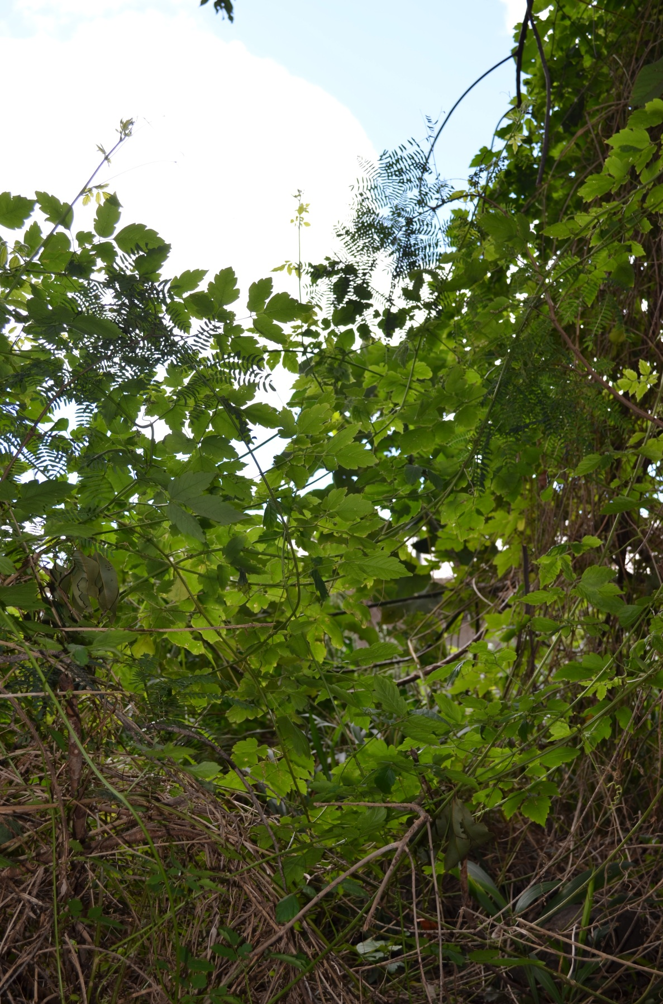
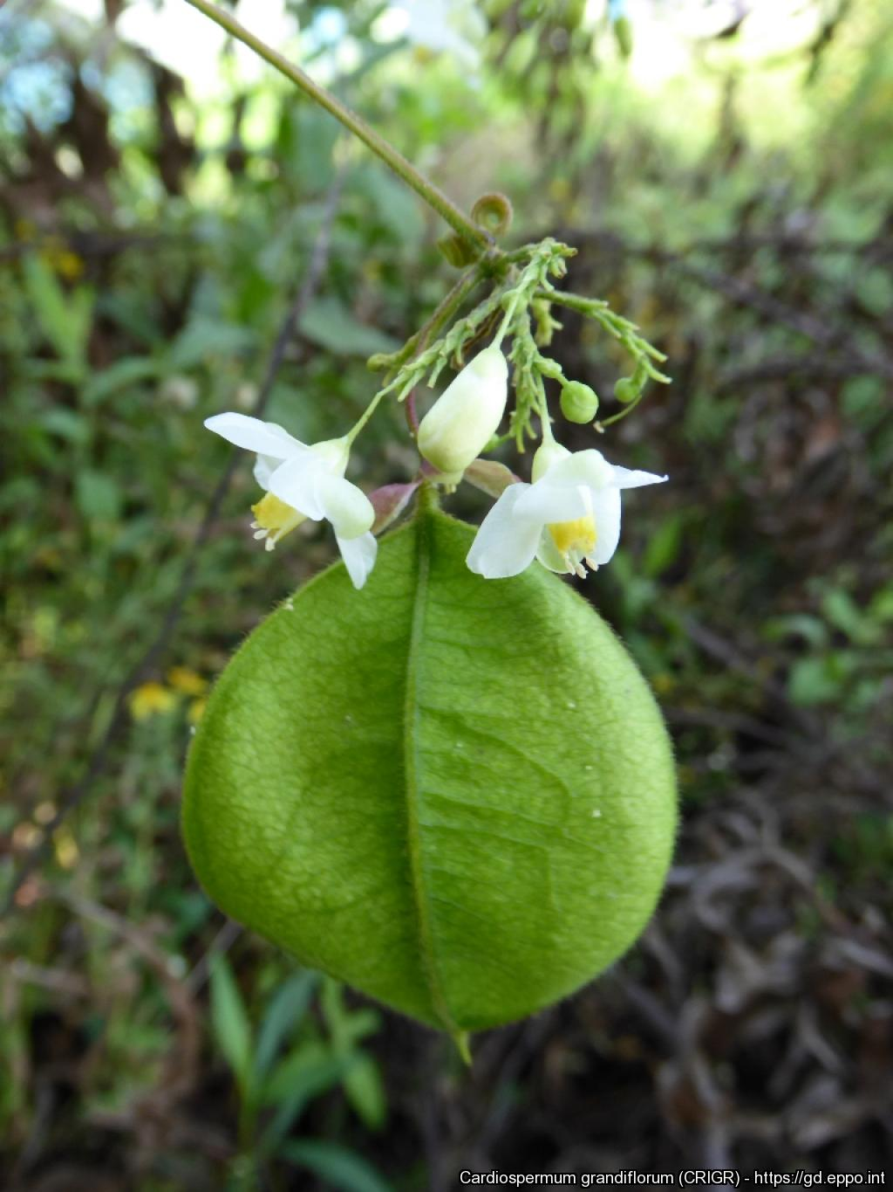
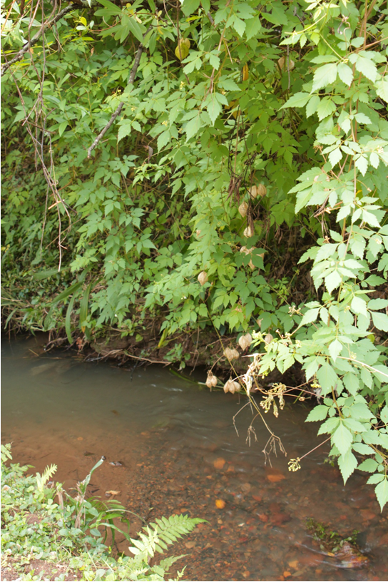
What is C. grandiflorum? What is the problem? Where is it found?
Cardiospermum grandiflorum is a annual or perennial vine-like climber native to the Americas and is an EPPO A2 pest, recommended for regulation as a quarantine pest.
As Cardiospermum grandiflorum is considered to be a threat to native biodiversity, its appearance in new areas should be reported immediately to us.
Plants for planting is considered the main pathway for entry into the EPPO region. In its invasive range C. grandiflorum typically forms dense draping carpets/mats, smothering large areas of underlying vegetation. In Malta, there is evidence of impacts on biodiversity as the species has formed extensive invasive populations. The invaded area in Malta may present unique micro-climatic conditions for the species due to it being a steep-sided dry valley.
In the EPPO region, C. grandiflorum is recorded from France (only in Landes and Alpes-Maritimes departments), Italy (mainland and the Island of Sicily), Malta, Portugal (only in Madeira Island), Spain (only in Canary Islands: Gran Canaria, Tenerife, La Gomera, La Palma).
C. grandiflorum prefers open habitats though it may grow well in forest edges and thrives in well-drained soil types
Image: Iñigo Sánchez, EPPO Global Database
Image: Johannes Le Roux, EPPO Global Database
Image: Johannes Le Roux, EPPO Global Database

